Slide 1
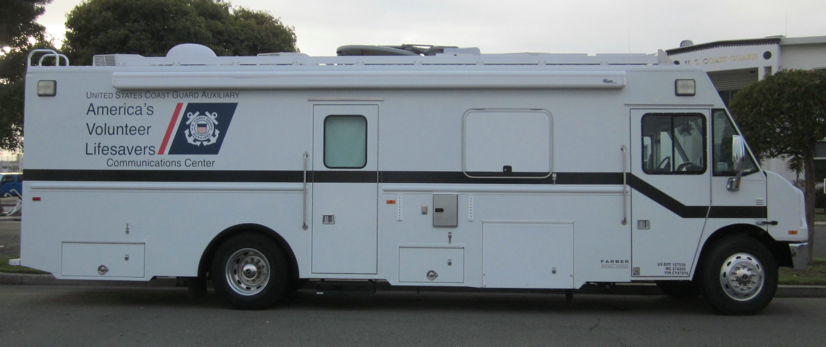
AUXILIARY COMMUNICATIONS VEHICLE
FEATURES & CONTROLS

Slide 2
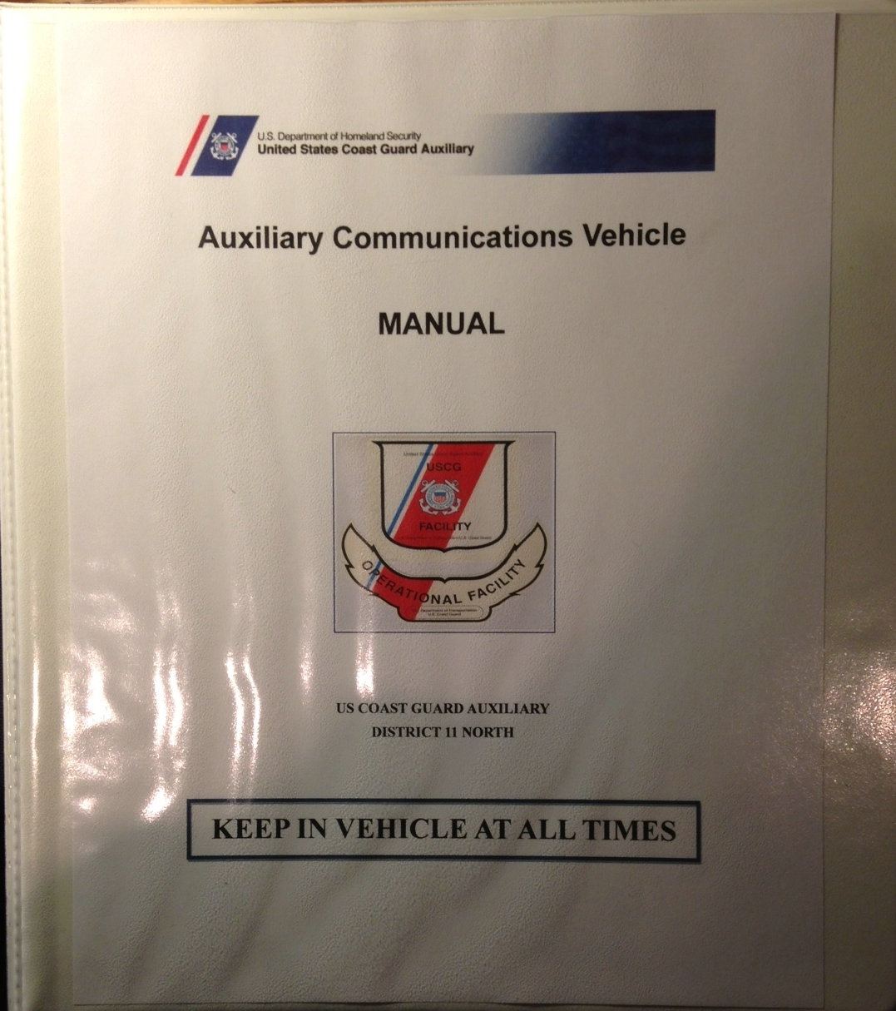
MANUALS to remain in vehicle at all times

Slide 3
CONTENTS: Operator’s Manual Specifications Basic information start-up procedure leveling system hot water genset (Generator)
MANUAL to remain in vehicle at all times

Slide 4
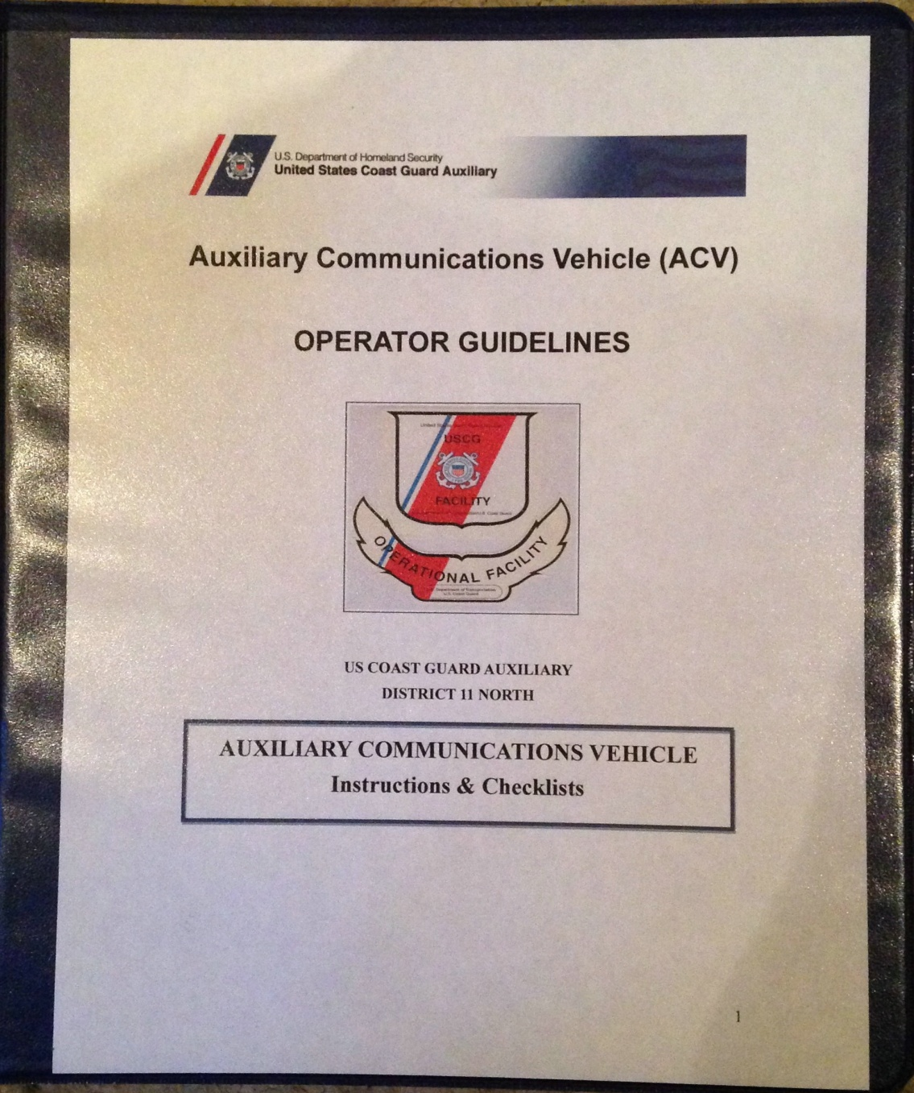
CONTENTS: PRE-UNDERWAY CHECKLIST START UP PROCEDURE GUIDE FOR USAGE QUALIFICATTION GUIDE OPERATOR REFERENCES WAIVER FORMS INTRODUCTORY POWERPOINT
MANUAL to remain in vehicle at all times

Slide 6
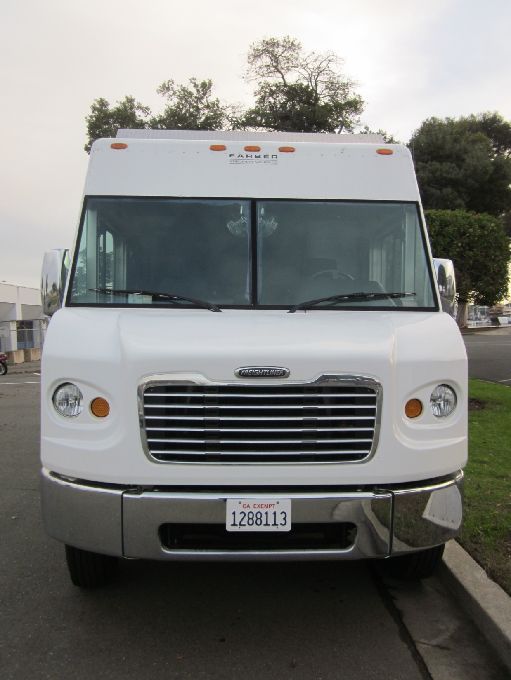
AUXILIARY COMMUNICATIONS VEHICLE Front View

Slide 7
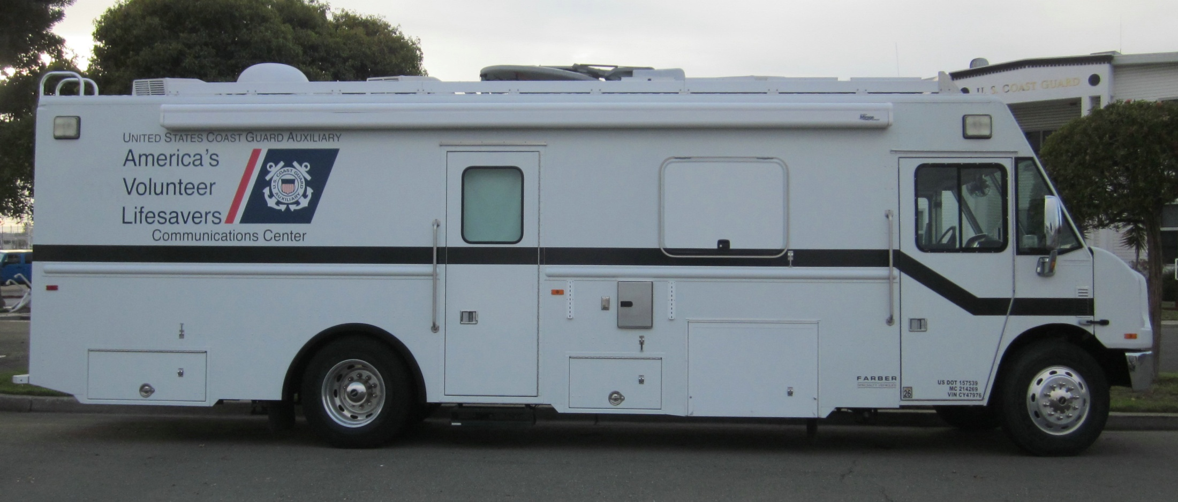
AUXILIARY COMMUNICATIONS VEHICLE
STARBOARD SIDE VIEW

Slide 8
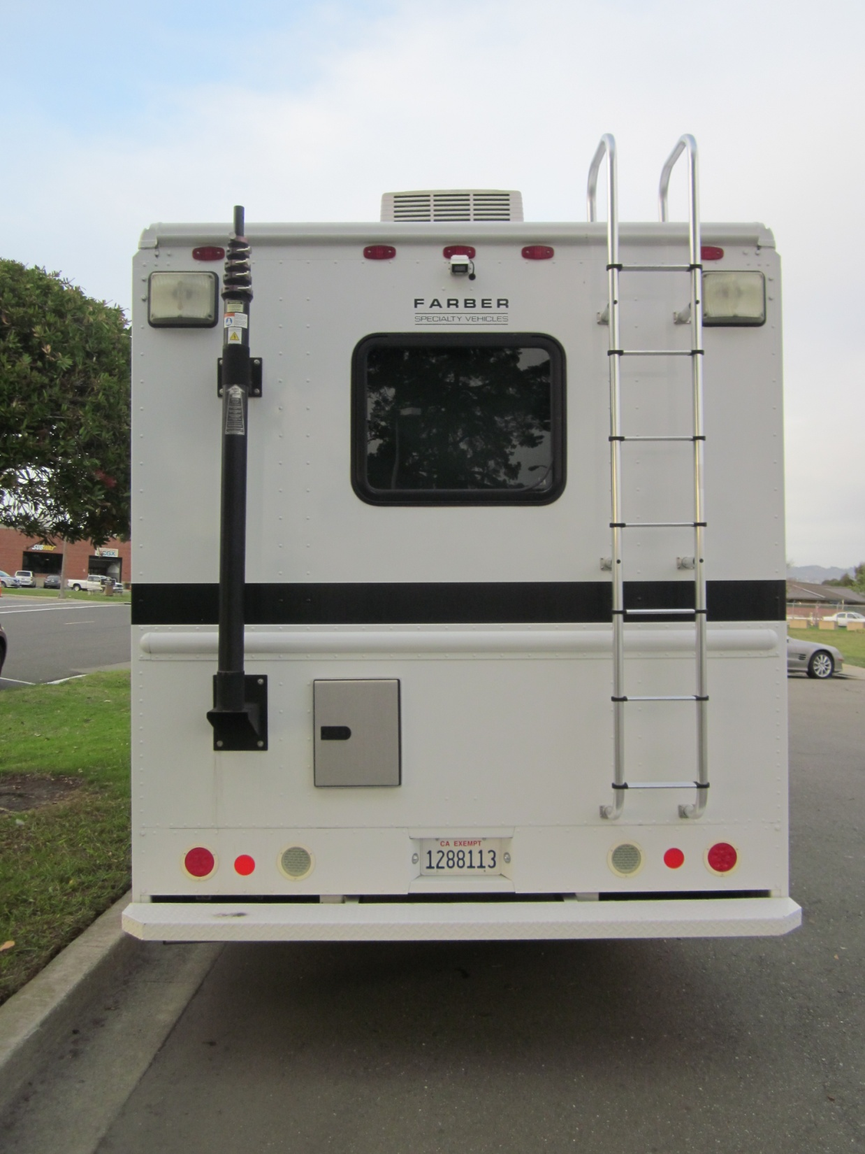
AUXILIARY COMMUNICATIONS VEHICLE AFT View
ROOF ACCESS LADDER

Slide 9
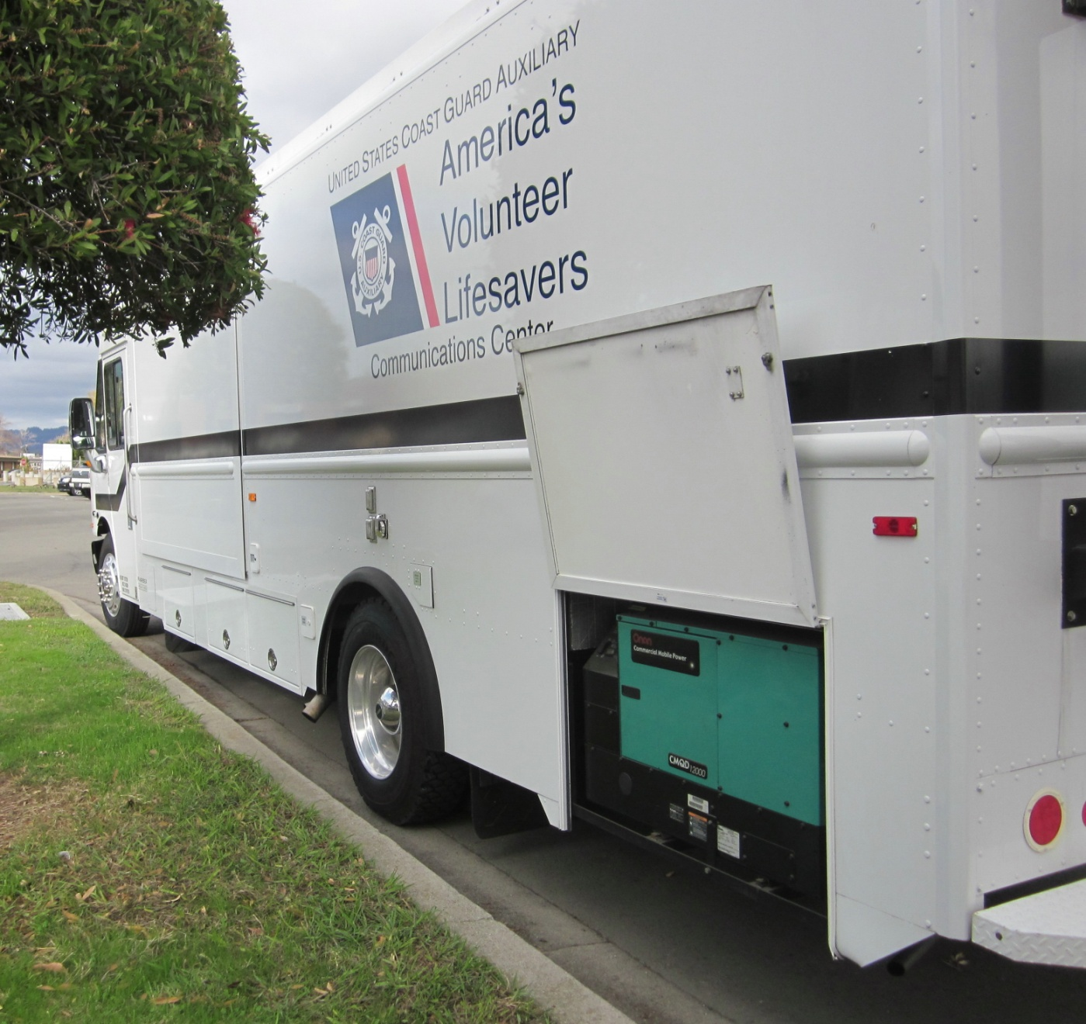
AUXILIARY COMMUNICATIONS VEHICLE PORT SIDE View
ONE OF TWO GENERATORS

Slide 10
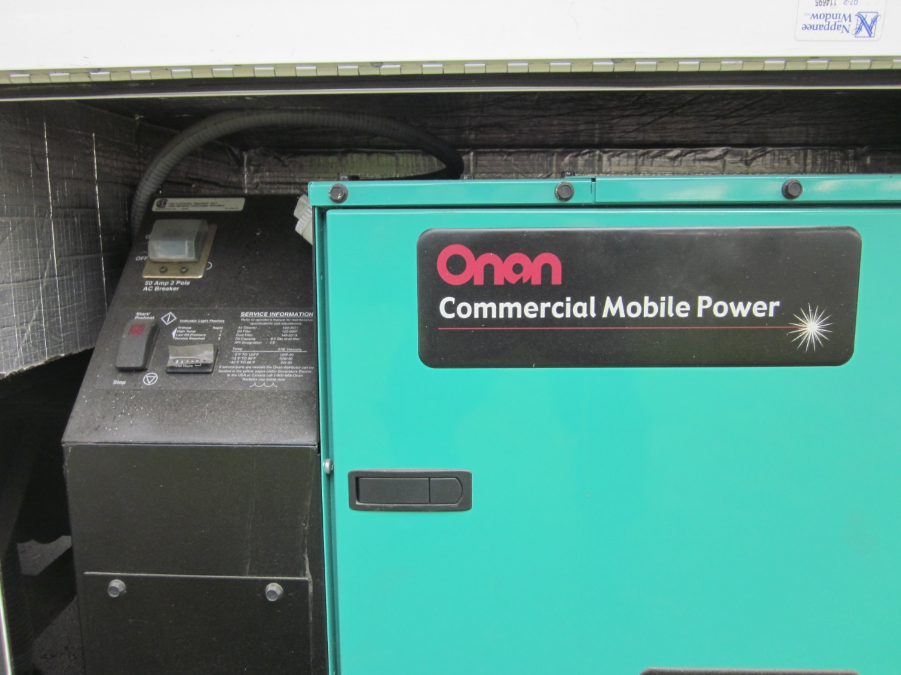
AUXILIARY COMMUNICATIONS VEHICLE GENERATOR 12 kw

Slide 11
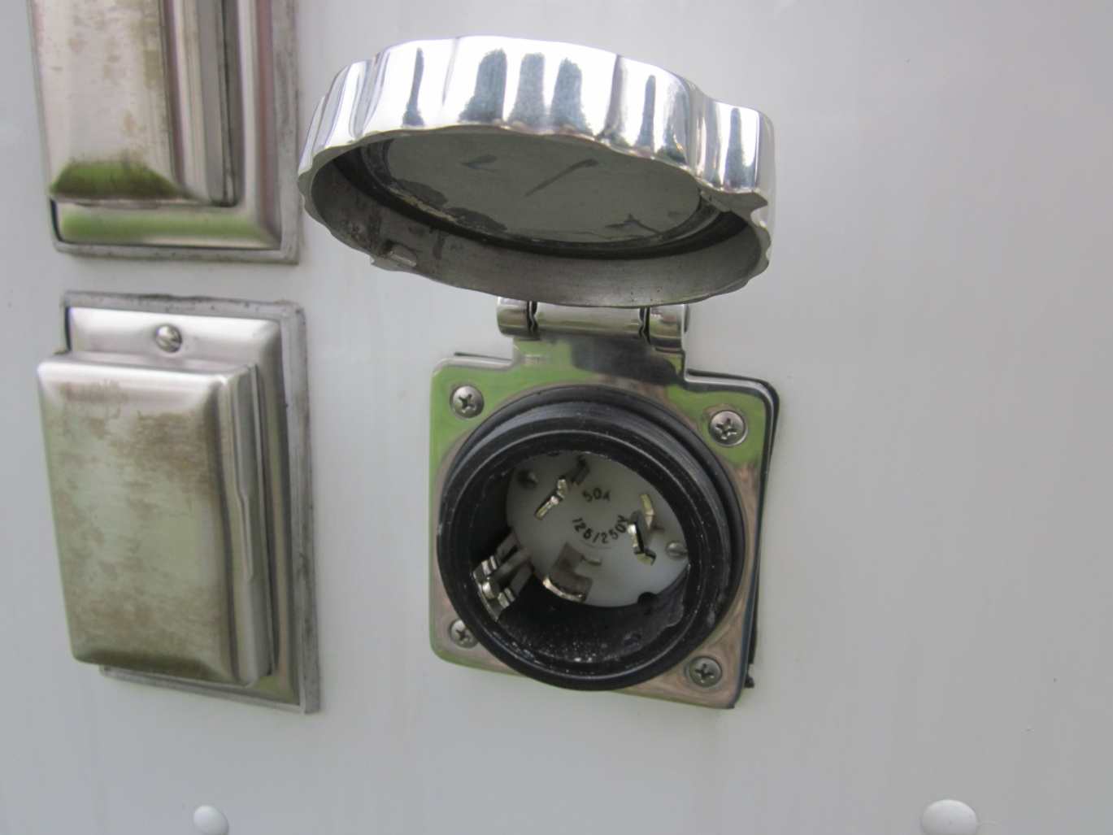
AUXILIARY COMMUNICATIONS VEHICLE PORT SIDE View
SHORE POWER CONNECTION

Slide 12
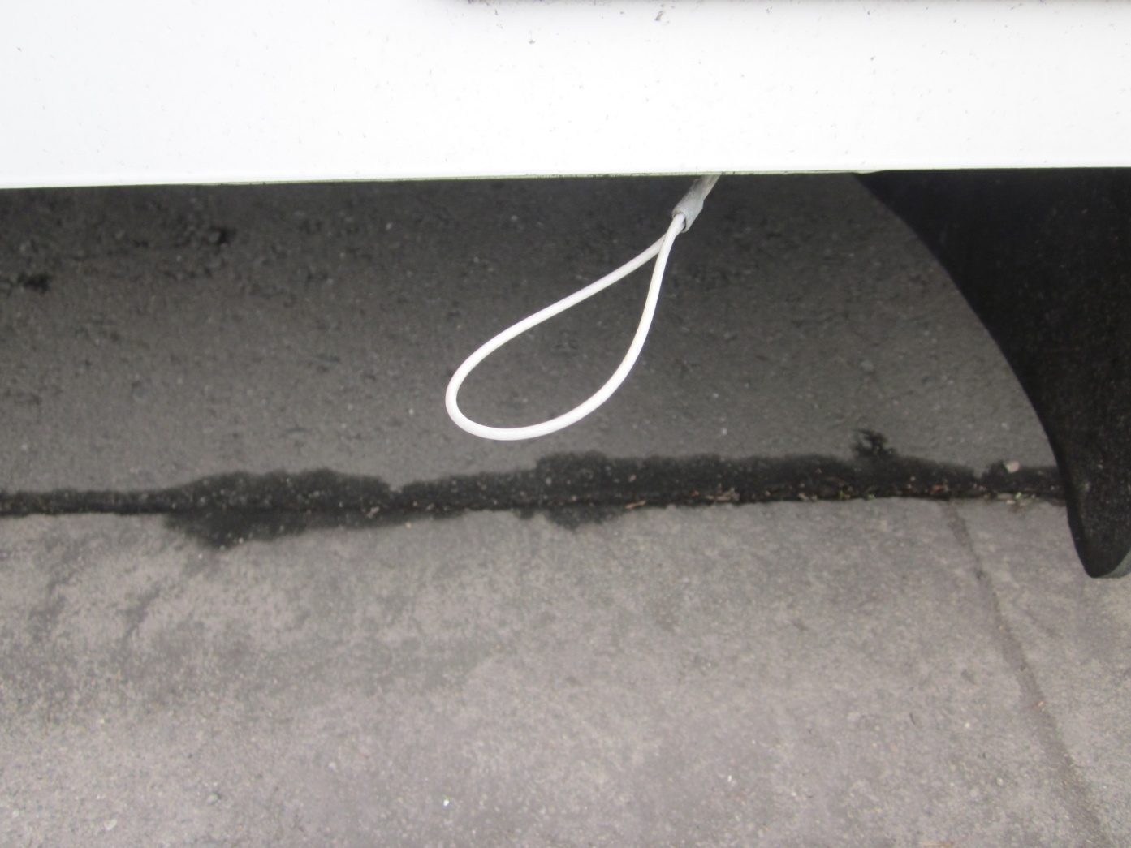
AUXILIARY COMMUNICATIONS VEHICLE PORT SIDE View
AIR BRAKE CONDENSED
WATER RELEASE

Slide 13
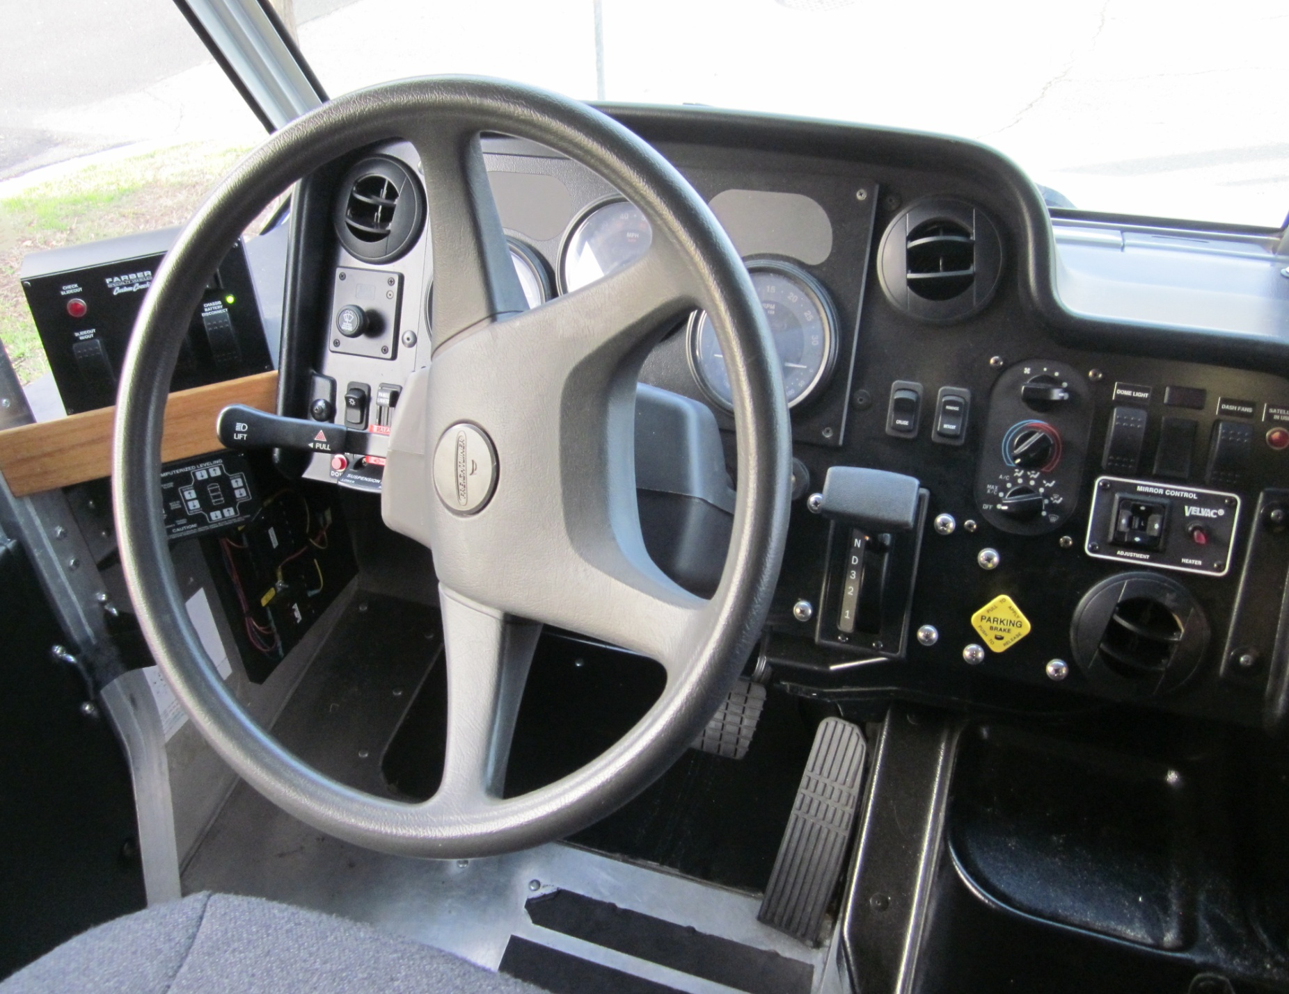
AUXILIARY COMMUNICATIONS VEHICLE
PILOT
SEAT
CONTROLS

Slide 14
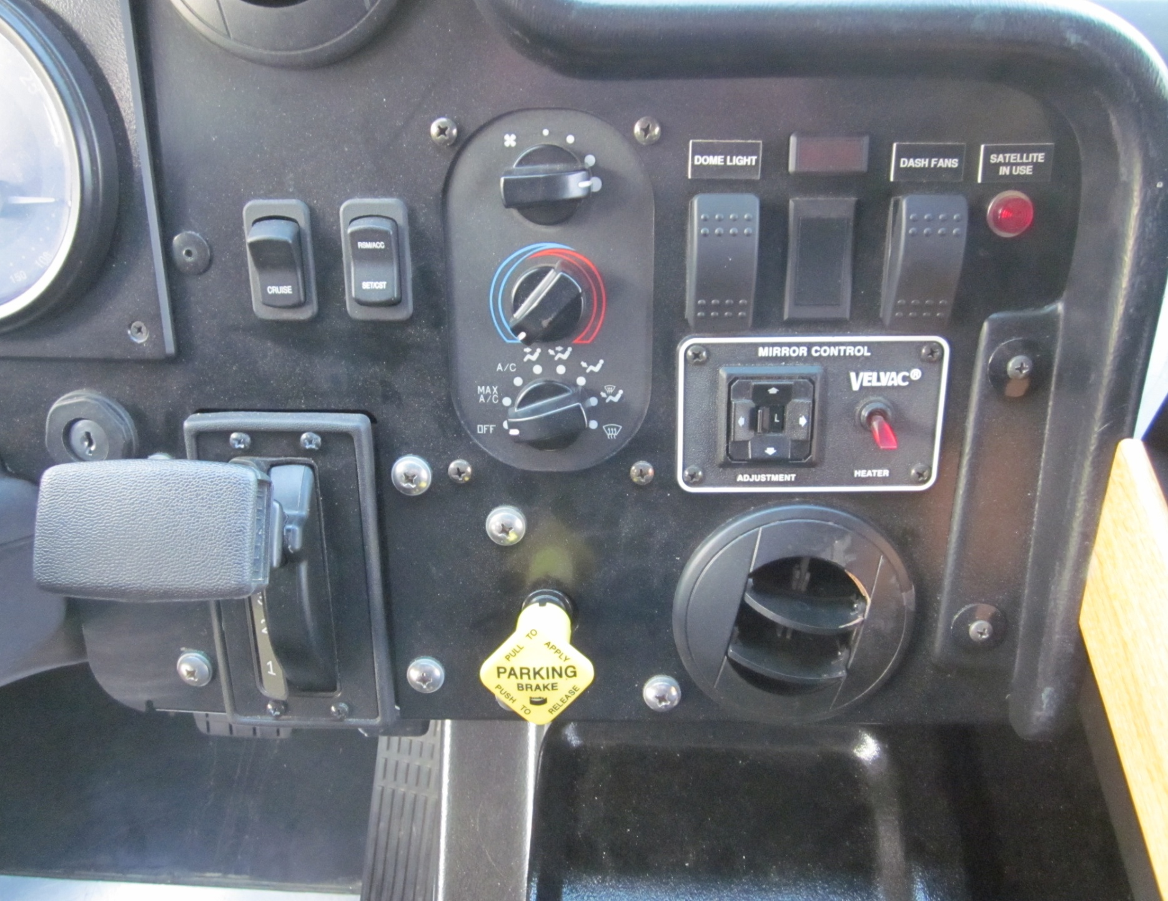
AUXILIARY COMMUNICATIONS VEHICLE
PILOT
SEAT
CONTROLS
RIGHT
SIDE

Slide 15
AUXILIARY COMMUNICATIONS VEHICLE
PILOT
SEAT
CONTROLS
RIGHT
SIDE
IGNITION

Slide 16
AUXILIARY COMMUNICATIONS VEHICLE
CRUISE CONTROL – ON / OFF
PILOT
SEAT
CONTROLS
RIGHT
SIDE

Slide 17
AUXILIARY COMMUNICATIONS VEHICLE
CRUISE CONTROL
Resume / Accelerate
Set / Coast
PILOT
SEAT
CONTROLS
RIGHT
SIDE

Slide 18
AUXILIARY COMMUNICATIONS VEHICLE
PILOT
SEAT
CONTROLS
RIGHT
SIDE
GEAR SHIFT
Must be in Neutral to start

Slide 19
AUXILIARY COMMUNICATIONS VEHICLE
PILOT
SEAT
CONTROLS
RIGHT
SIDE
HVAC

Slide 20
AUXILIARY COMMUNICATIONS VEHICLE
PILOT
SEAT
CONTROLS
RIGHT
SIDE
AIR BRAKE - PARKING

Slide 21
AUXILIARY COMMUNICATIONS VEHICLE
PILOT
SEAT
CONTROLS
RIGHT
SIDE
DOME LIGHT

Slide 22
AUXILIARY COMMUNICATIONS VEHICLE
PILOT
SEAT
CONTROLS
RIGHT
SIDE
DASH FANS

Slide 23
AUXILIARY COMMUNICATIONS VEHICLE
PILOT
SEAT
CONTROLS
RIGHT
SIDE
MIRROR HEATER
MIRROR CONTROL

Slide 24
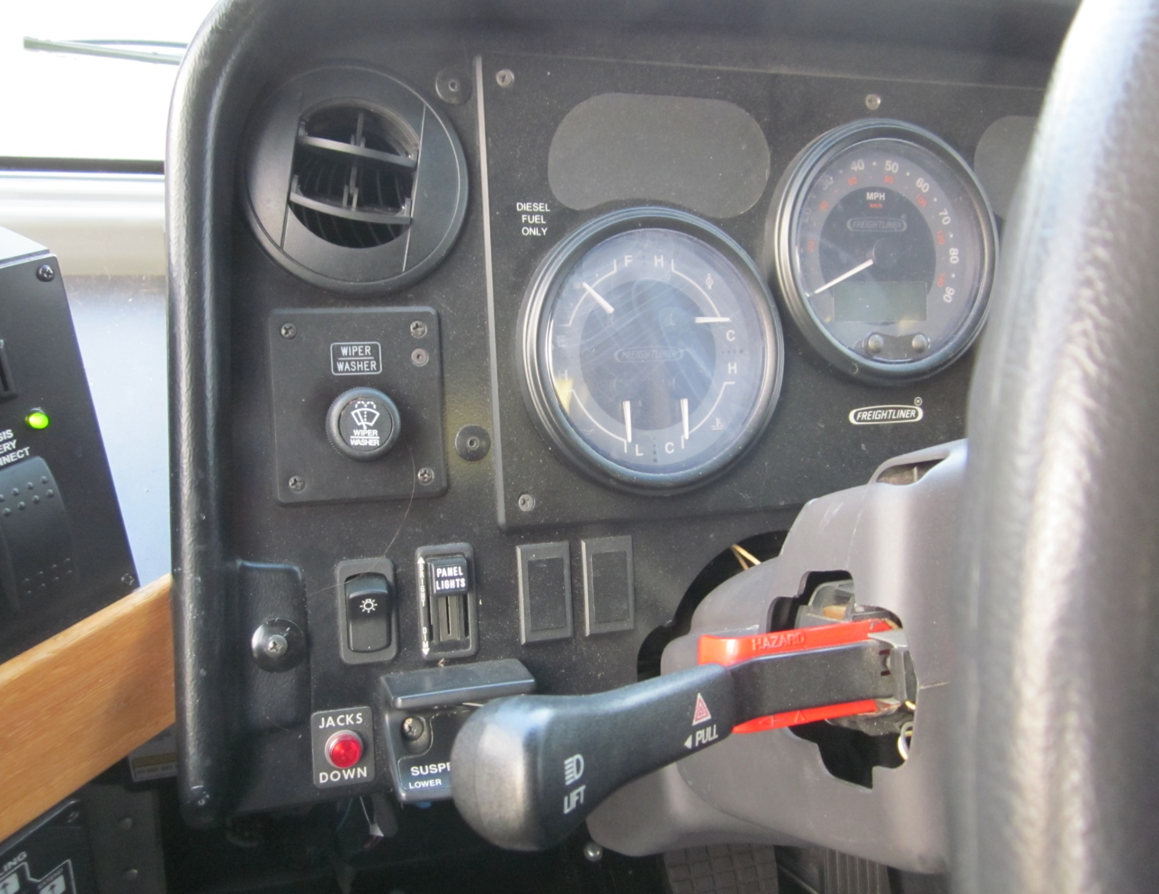
AUXILIARY COMMUNICATIONS VEHICLE
PILOT
SEAT
CONTROLS
LEFT
SIDE
WINDSHIELD WIPER / WASHER

Slide 25
AUXILIARY COMMUNICATIONS VEHICLE
PILOT
SEAT
CONTROLS
LEFT
SIDE
HEADLIGHT SWITCH

Slide 26
AUXILIARY COMMUNICATIONS VEHICLE
PILOT
SEAT
CONTROLS
LEFT
SIDE
INSTRUMENT PANEL LIGHTS

Slide 27
AUXILIARY COMMUNICATIONS VEHICLE
PILOT
SEAT
CONTROLS
LEFT
SIDE
DIRECTIONAL SIGNALS &
HIGH BEAM CONTROL

Slide 28
AUXILIARY COMMUNICATIONS VEHICLE
PILOT
SEAT
CONTROLS
LEFT
SIDE
HAZARD FLASHERS (PULL)

Slide 29
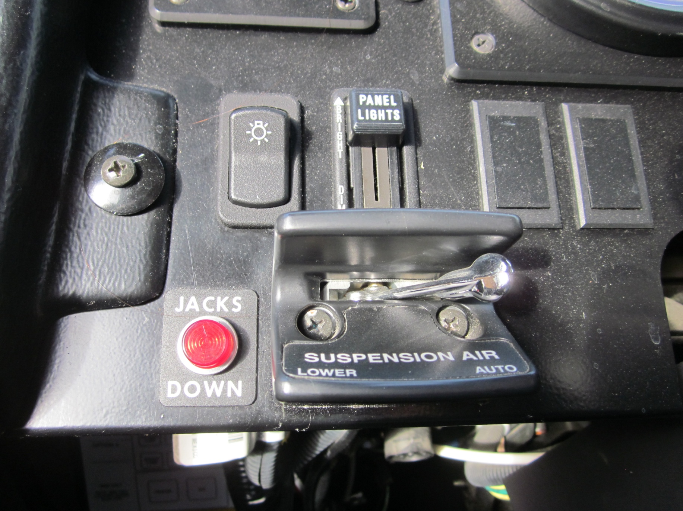
AUXILIARY COMMUNICATIONS VEHICLE
PILOT
SEAT
CONTROLS
LEFT
SIDE
SUSPENSION CONTROL

Slide 30
AUXILIARY COMMUNICATIONS VEHICLE
Start Up Procedures
1. Do a walk-around the ACV. Check:
Tires
Clearance overhead & sides
Raise hood and check fluid levels
Leave hood up to check transmission oil after running engine for 10 minutes
Check underneath for evidence of any leaks on ground
2. Turn on DC power (starboard side aft)
3. Set “Battery Disconnect” to “ON”
4. Turn on DC lighting & miscellaneous switches (inside electrical control cabinet)

Slide 31
AUXILIARY COMMUNICATIONS VEHICLE
Start Up Procedures
5. Turn on battery chassis switch (left side of driver seat)
6. To start engine
a. Turn ignition switch to “ON” position
b. Wait for gauges to “cycle”
c. Turn key to START / release key once started
d. Note: Parking brake must be on before starting

Slide 32
AUXILIARY COMMUNICATIONS VEHICLE
Start Up Procedures
7. Check gauges
8. After starting, check air pressure (must be at least 95 psi before moving vehicle)

Slide 33
AUXILIARY COMMUNICATIONS VEHICLE
Start Up Procedures
9. Before moving vehicle:
a. Check Leveler is in the “up” position
b. Check Slide-out is in the locked position
c. Air suspension must be in the “AUTO” position
10. Check transmission oil level
a. Read manual before checking
b. Do not over fill.

Slide 34
AUXILIARY COMMUNICATIONS VEHICLE
PILOT
SEAT
CONTROLS
LEFT
SIDE
SLIDE OUT CONTROL

Slide 35
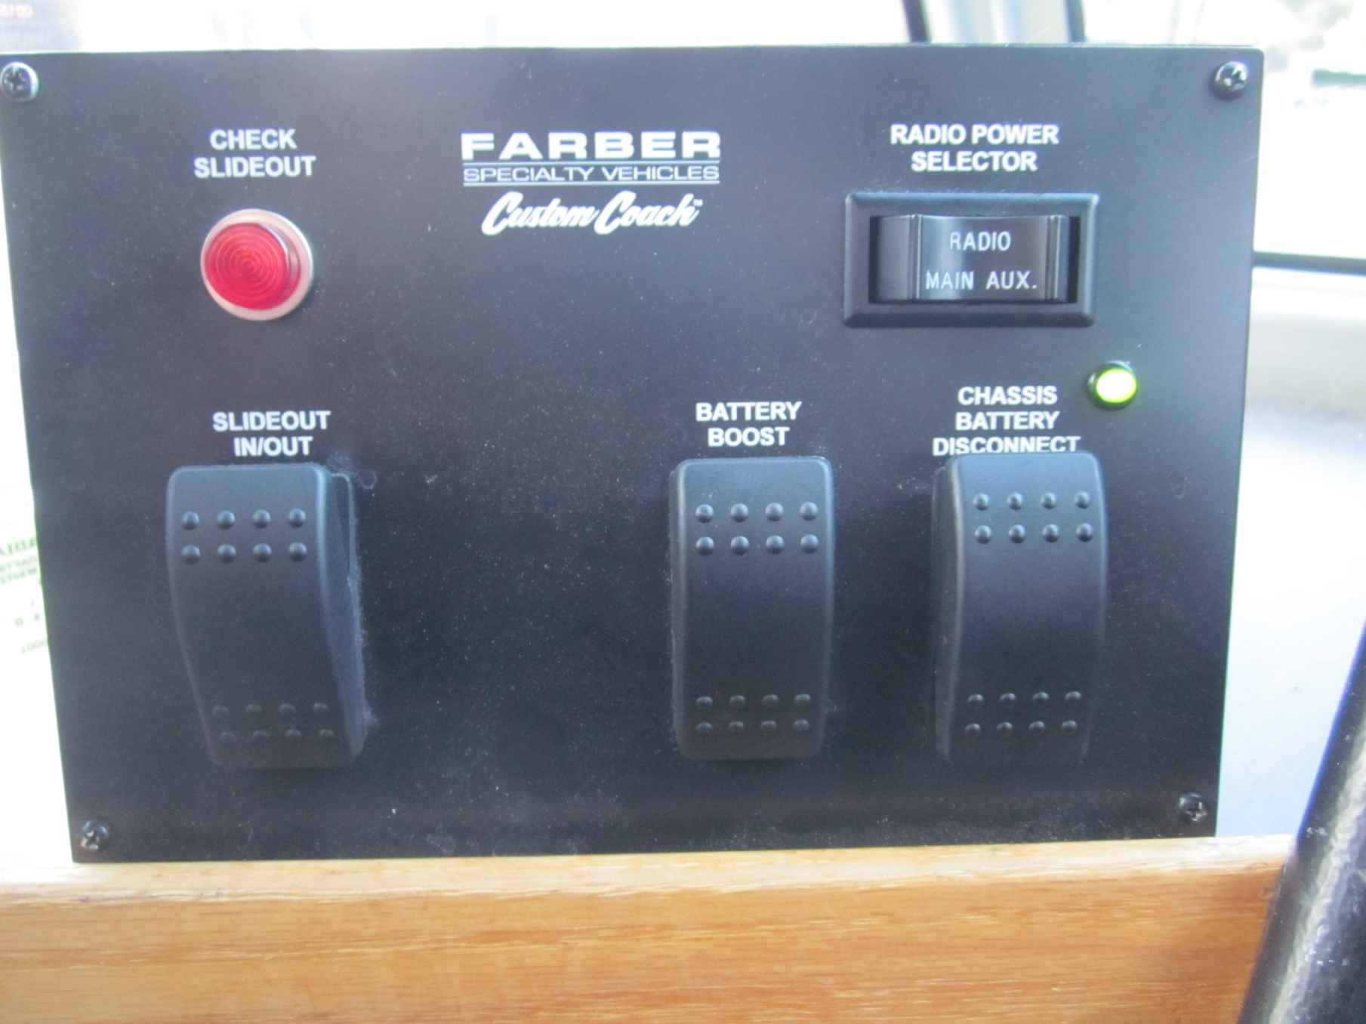
AUXILIARY COMMUNICATIONS VEHICLE
PILOT
SEAT
CONTROLS
LEFT
SIDE
SLIDE OUT CONTROL
Vehicle Must Be Level

Slide 36
AUXILIARY COMMUNICATIONS VEHICLE
PILOT
SEAT
CONTROLS
LEFT
SIDE
CHASSIS BATTERY DISCONNECT
Must be “ON” before starting engine or slide out

Slide 37
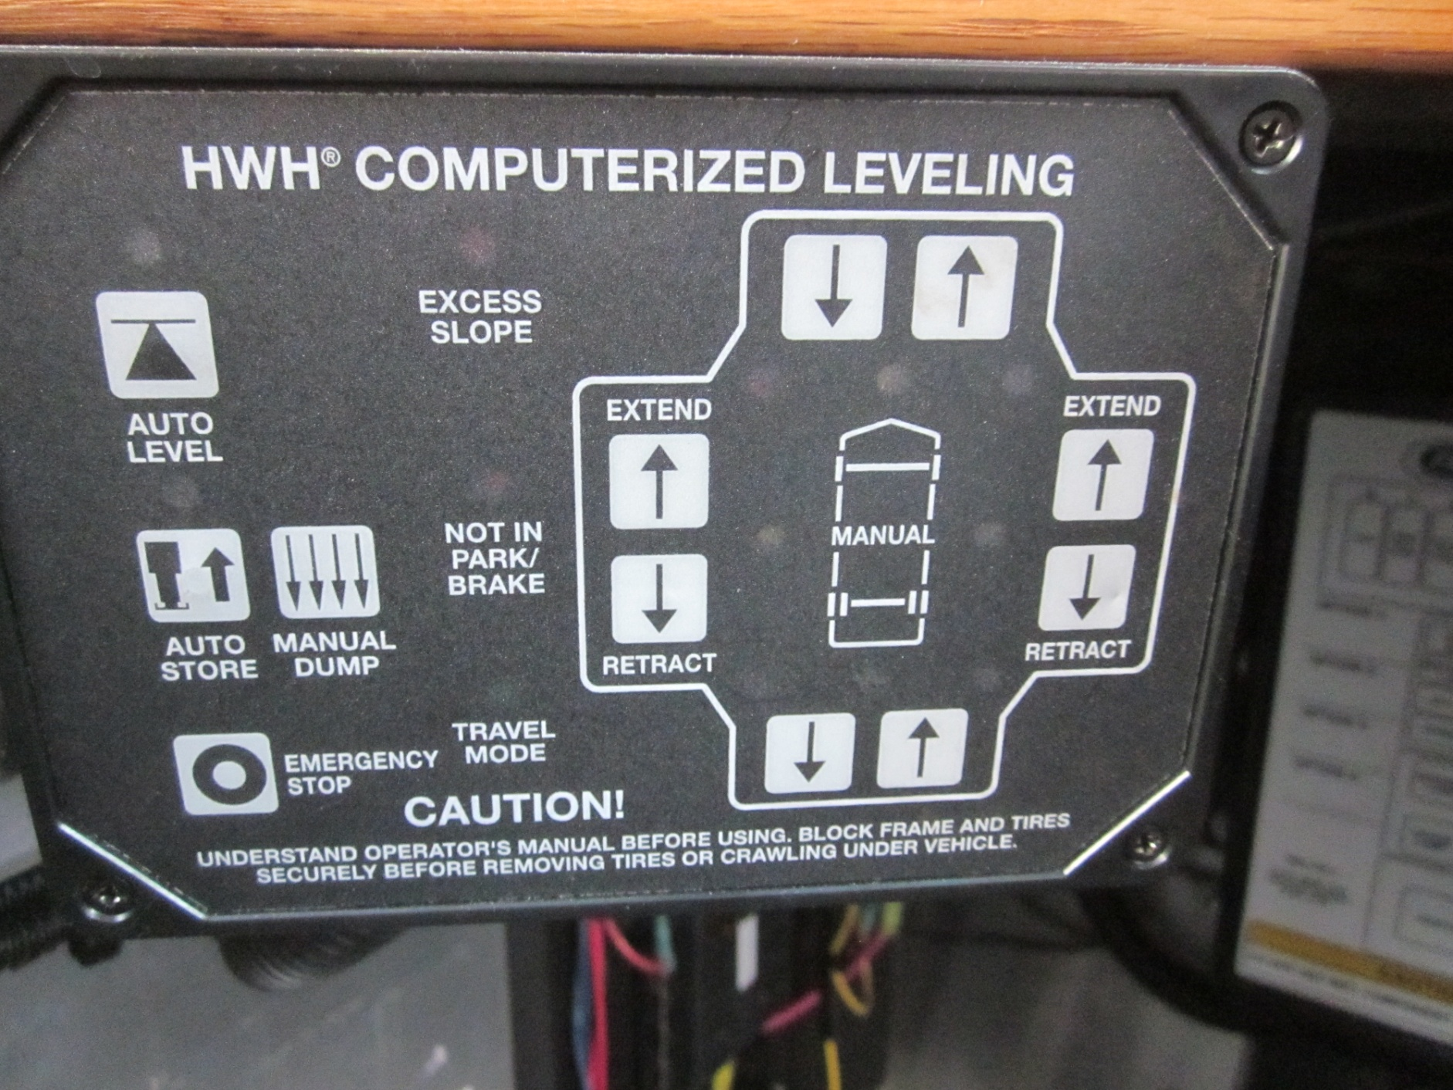
AUXILIARY COMMUNICATIONS VEHICLE
4 red lights will light up once level
Start engine before using system
PILOT
SEAT
CONTROLS
LEFT
SIDE
AUTO LEVEL
LEVELING CONTROLS
Park on level surface if possible
Suspension Air must be “LOWER” BEFORE leveling

Slide 38
AUXILIARY COMMUNICATIONS VEHICLE
Interior Features

Slide 39
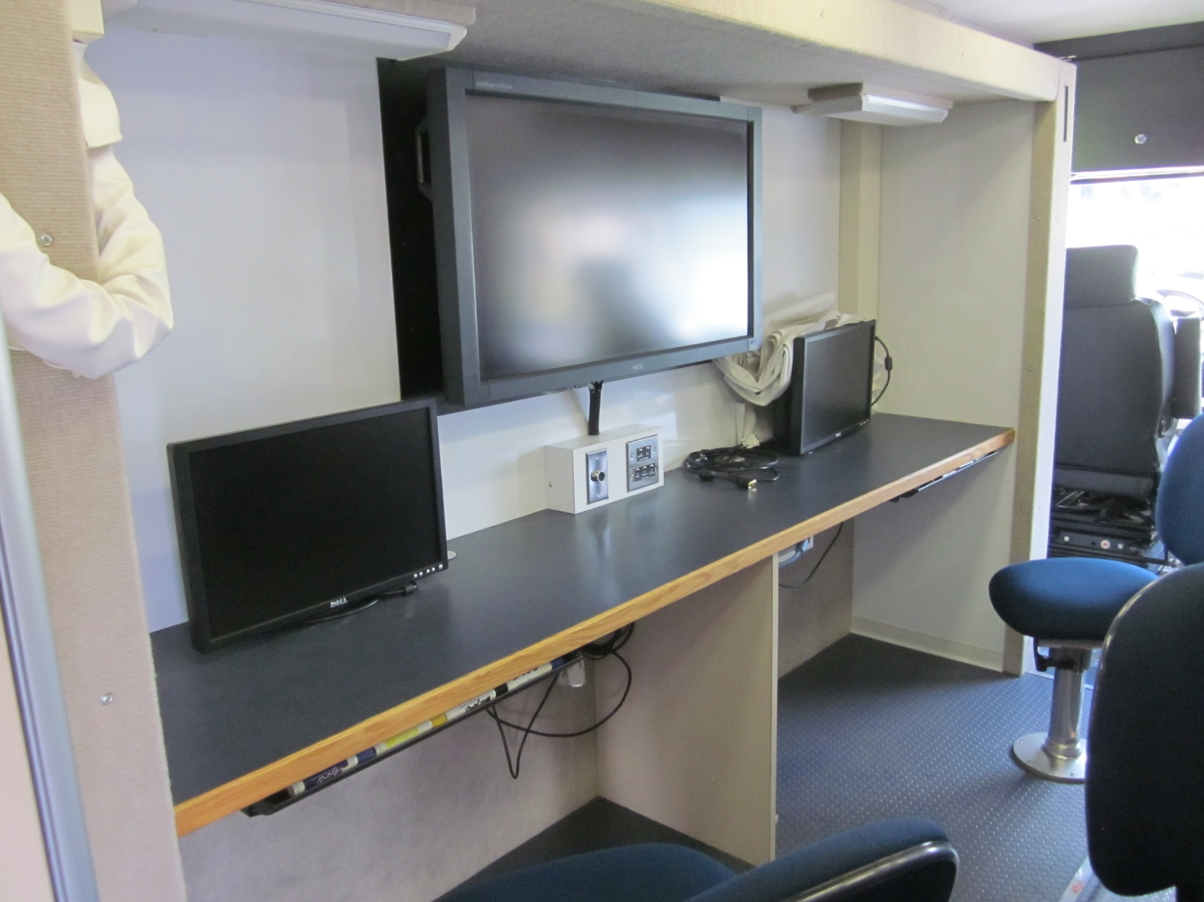
AUXILIARY COMMUNICATIONS VEHICLE
WORK AREA
PORT
SIDE
FORWARD
DRY ERASE BOARD WRITING SURFACES
(THROUGH OUT)
SLIDE OUT (ENTIRE SECTION)

Slide 40
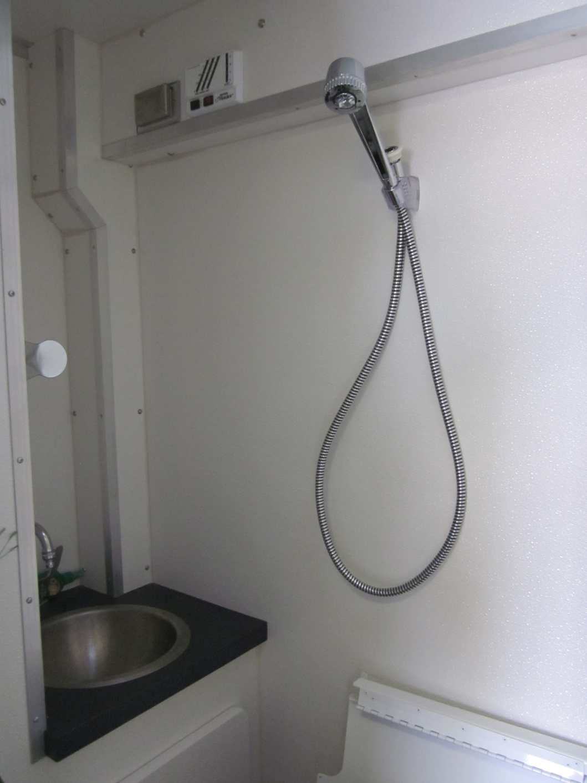
AUXILIARY COMMUNICATIONS VEHICLE
HEAD
PORT
SIDE
MIDSHIP
HEAD WITH SINK & SHOWER

Slide 41
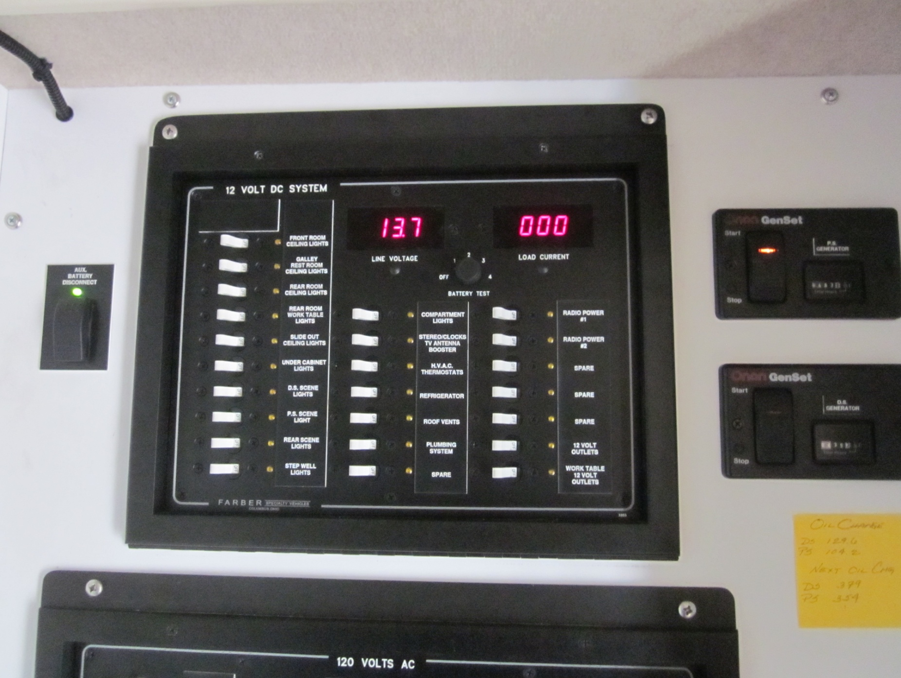
AUXILIARY COMMUNICATIONS VEHICLE
12 VOLT DC CONTROL PANEL
INTERIOR
CONTROLS
PORT
SIDE
GENERATOR START / STOP
AUX. BATTERY DISCONNECT
(TURN ON FOR DC LIGHTING & MISC 12 VOLTS –
TURN OFF WHEN FINISHED)
GENERATOR START / STOP
IF USING ONLY ONE GENERATOR, USE UNIT WITH LOWEST HOURS

Slide 42
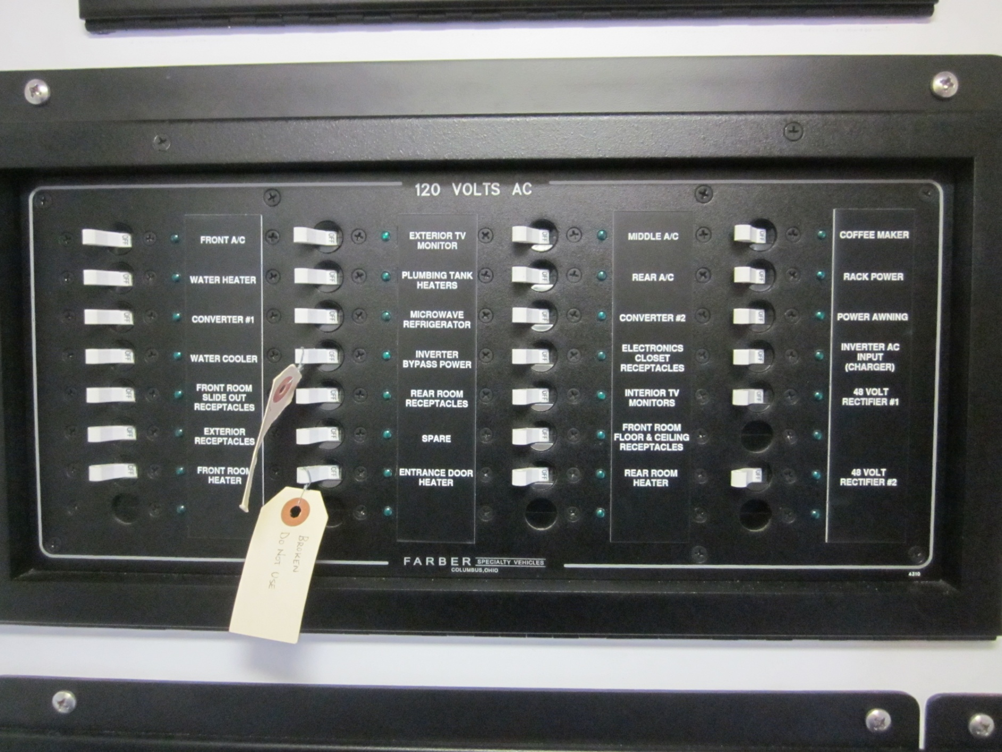
AUXILIARY COMMUNICATIONS VEHICLE
INTERIOR
CONTROLS
PORT
SIDE
120 VOLT CONTROL PANEL

Slide 43
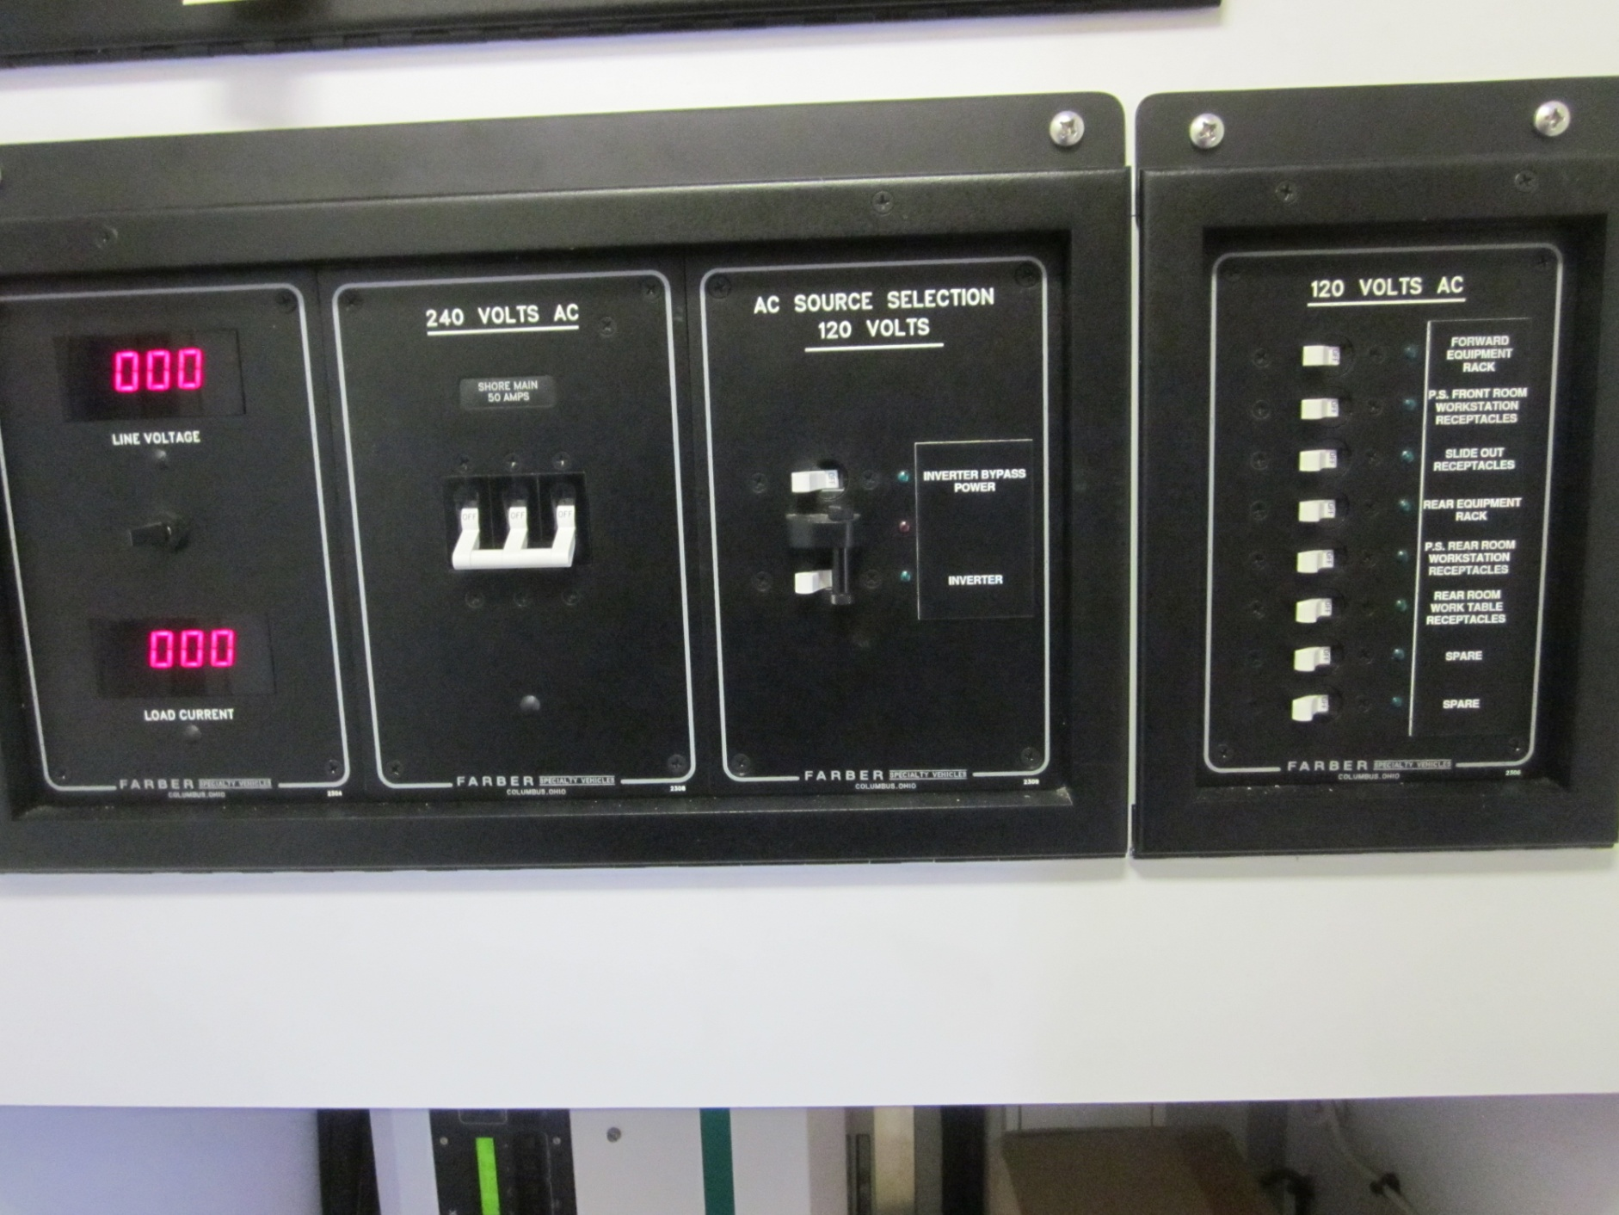
AUXILIARY COMMUNICATIONS VEHICLE
INTERIOR
CONTROLS
PORT
SIDE
POWER SOURCE SELECTION PANEL

Slide 44
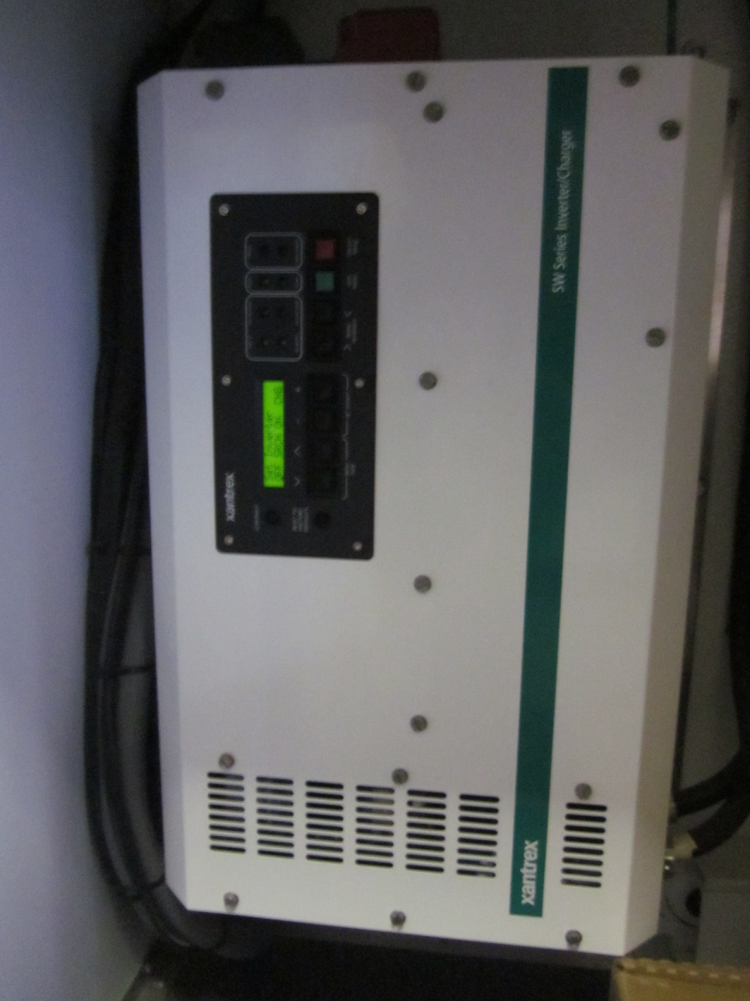
AUXILIARY COMMUNICATIONS VEHICLE
INTERIOR
CONTROLS
PORT
SIDE
ON / OFF SWITCH
INVERTER / CHARGER

Slide 45
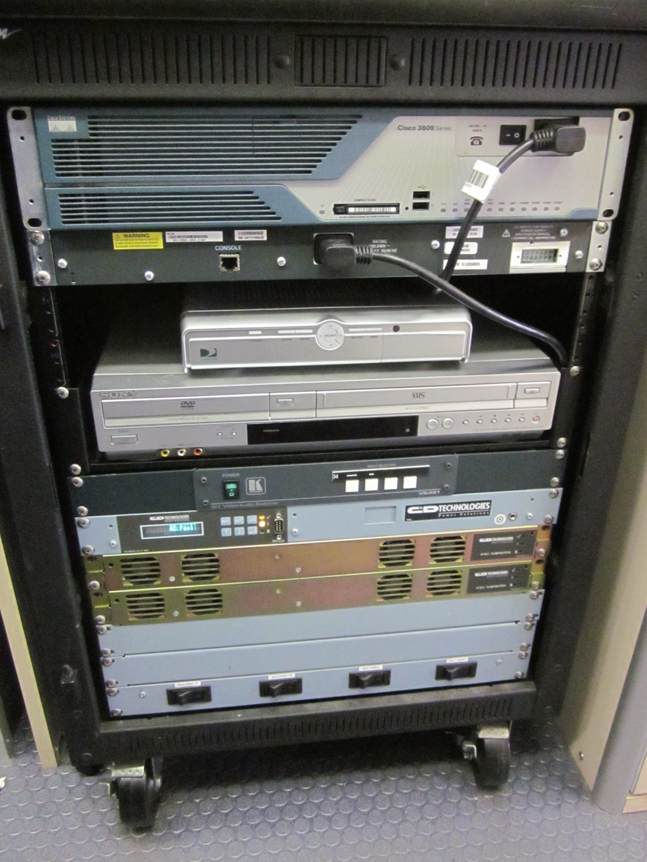
AUXILIARY COMMUNICATIONS VEHICLE
I.T. RACK
DIRECT TV
PORT
SIDE
AFT

Slide 46
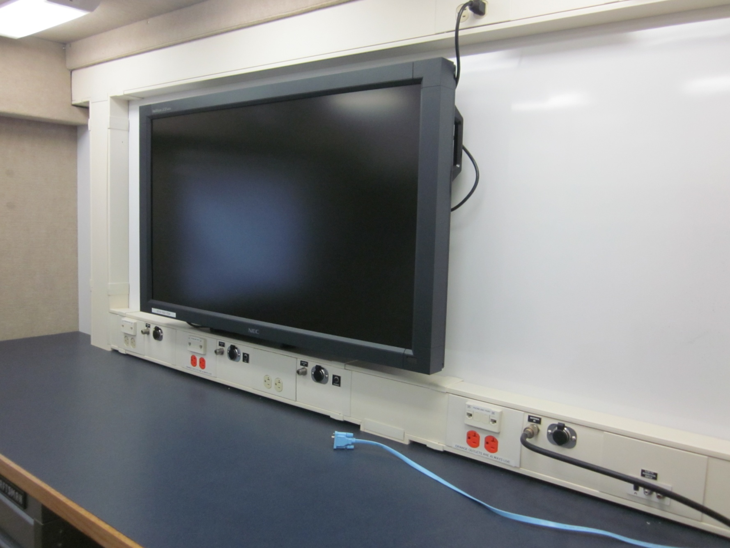
AUXILIARY COMMUNICATIONS VEHICLE
WORK AREA
PORT
SIDE
AFT

Slide 47
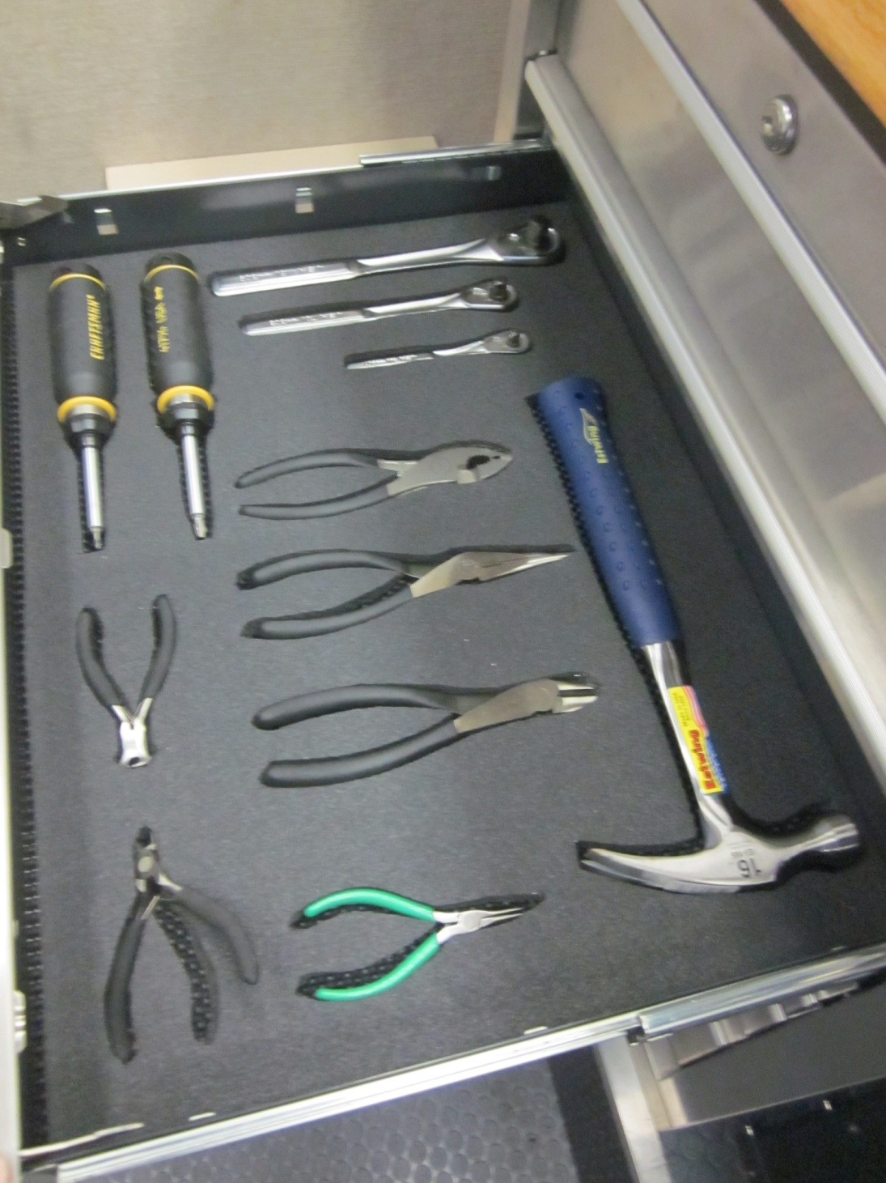
AUXILIARY COMMUNICATIONS VEHICLE
TOOL
BOX
PORT
SIDE
AFT

Slide 48
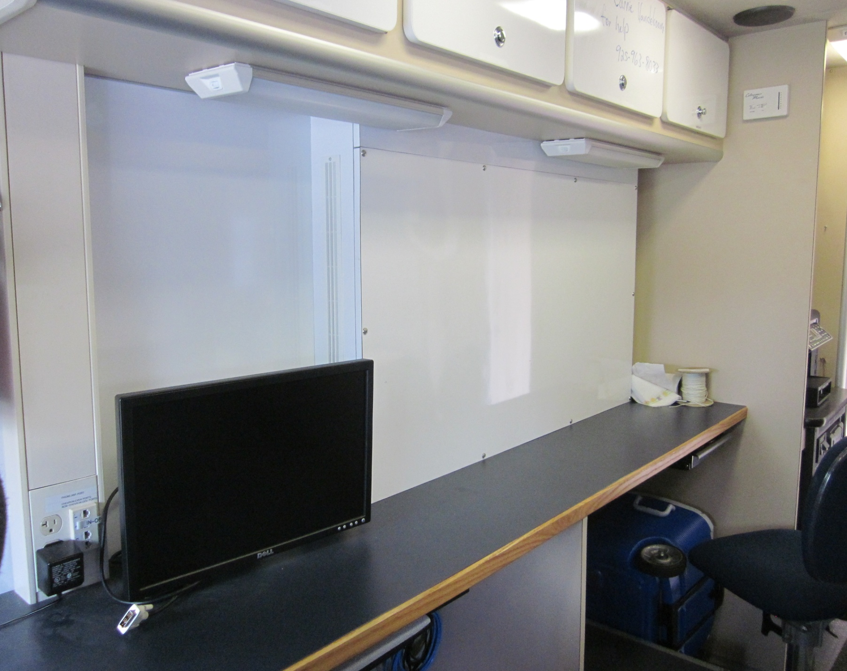
AUXILIARY COMMUNICATIONS VEHICLE
WORK AREA
STARBOARD
SIDE
FORWARD

Slide 49
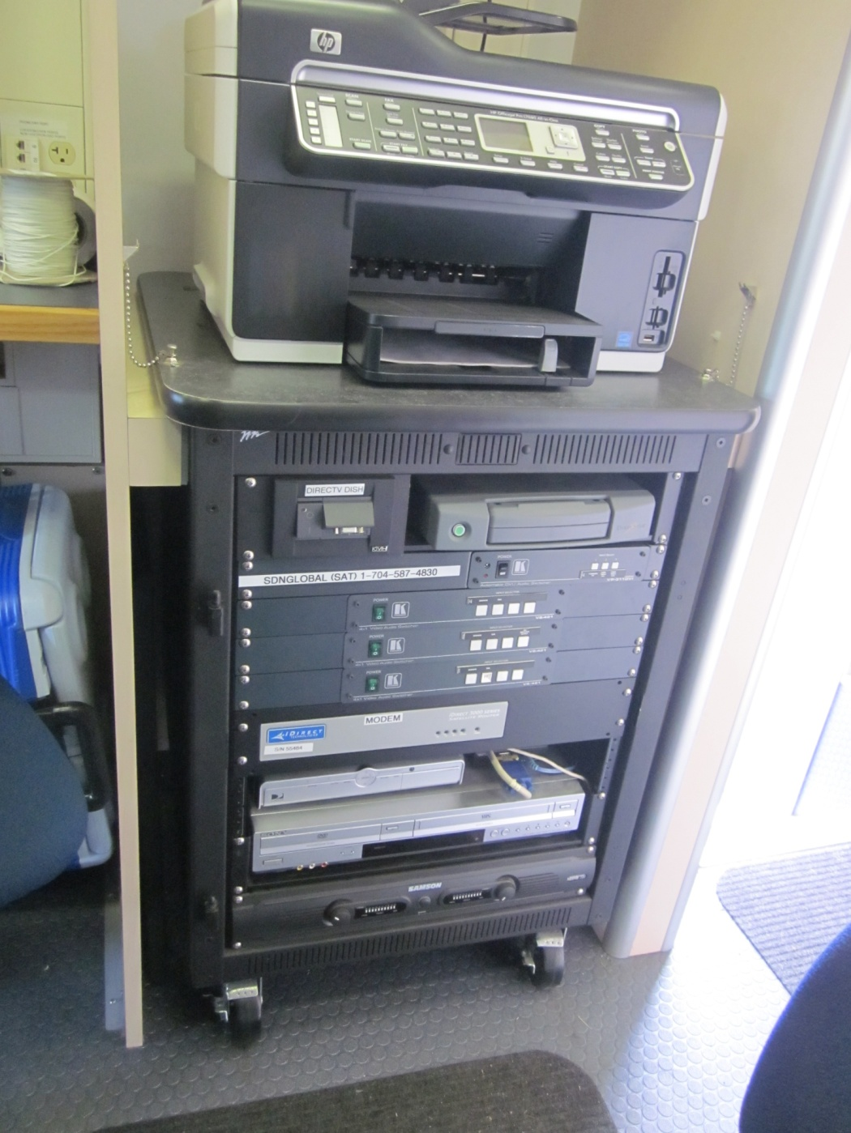
AUXILIARY COMMUNICATIONS VEHICLE
PRINTER / FAX
VSAT
DISH
STARBOARD
SIDE
MIDSHIP

Slide 50
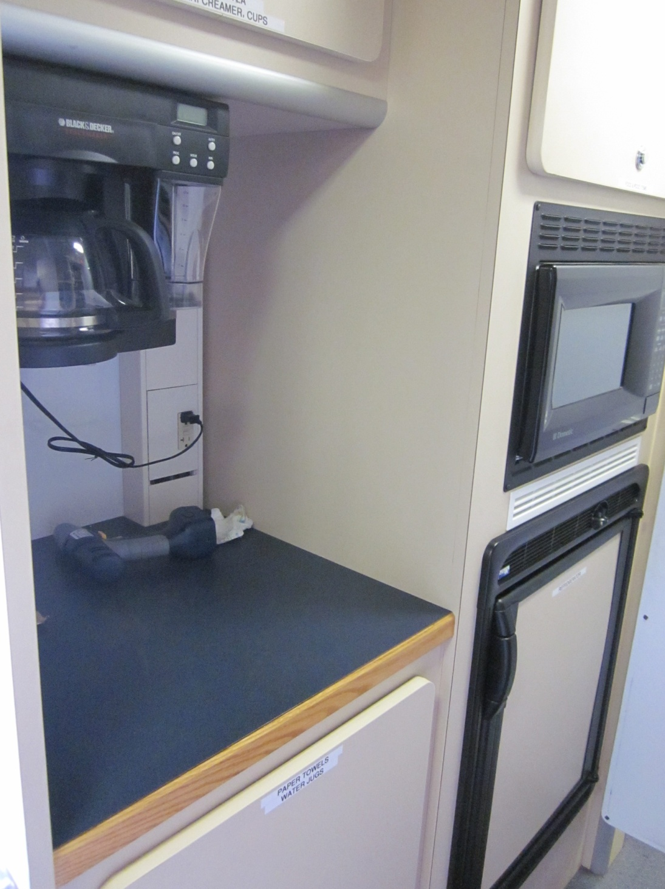
AUXILIARY COMMUNICATIONS VEHICLE
GALLEY
STARBOARD
SIDE
MIDSHIP
COFFEE MAKER
MICROWAVE
REFRIGERATOR

Slide 51
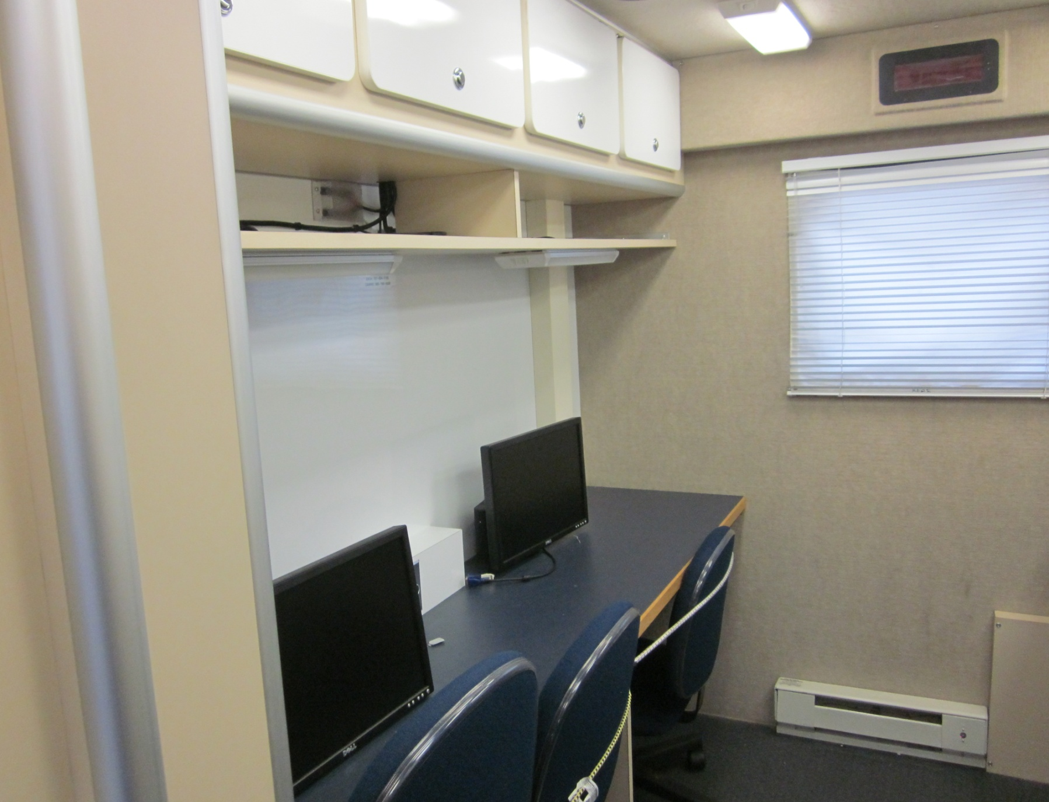
AUXILIARY COMMUNICATIONS VEHICLE
WORK AREA
STARBOARD
SIDE
AFT

Slide 52
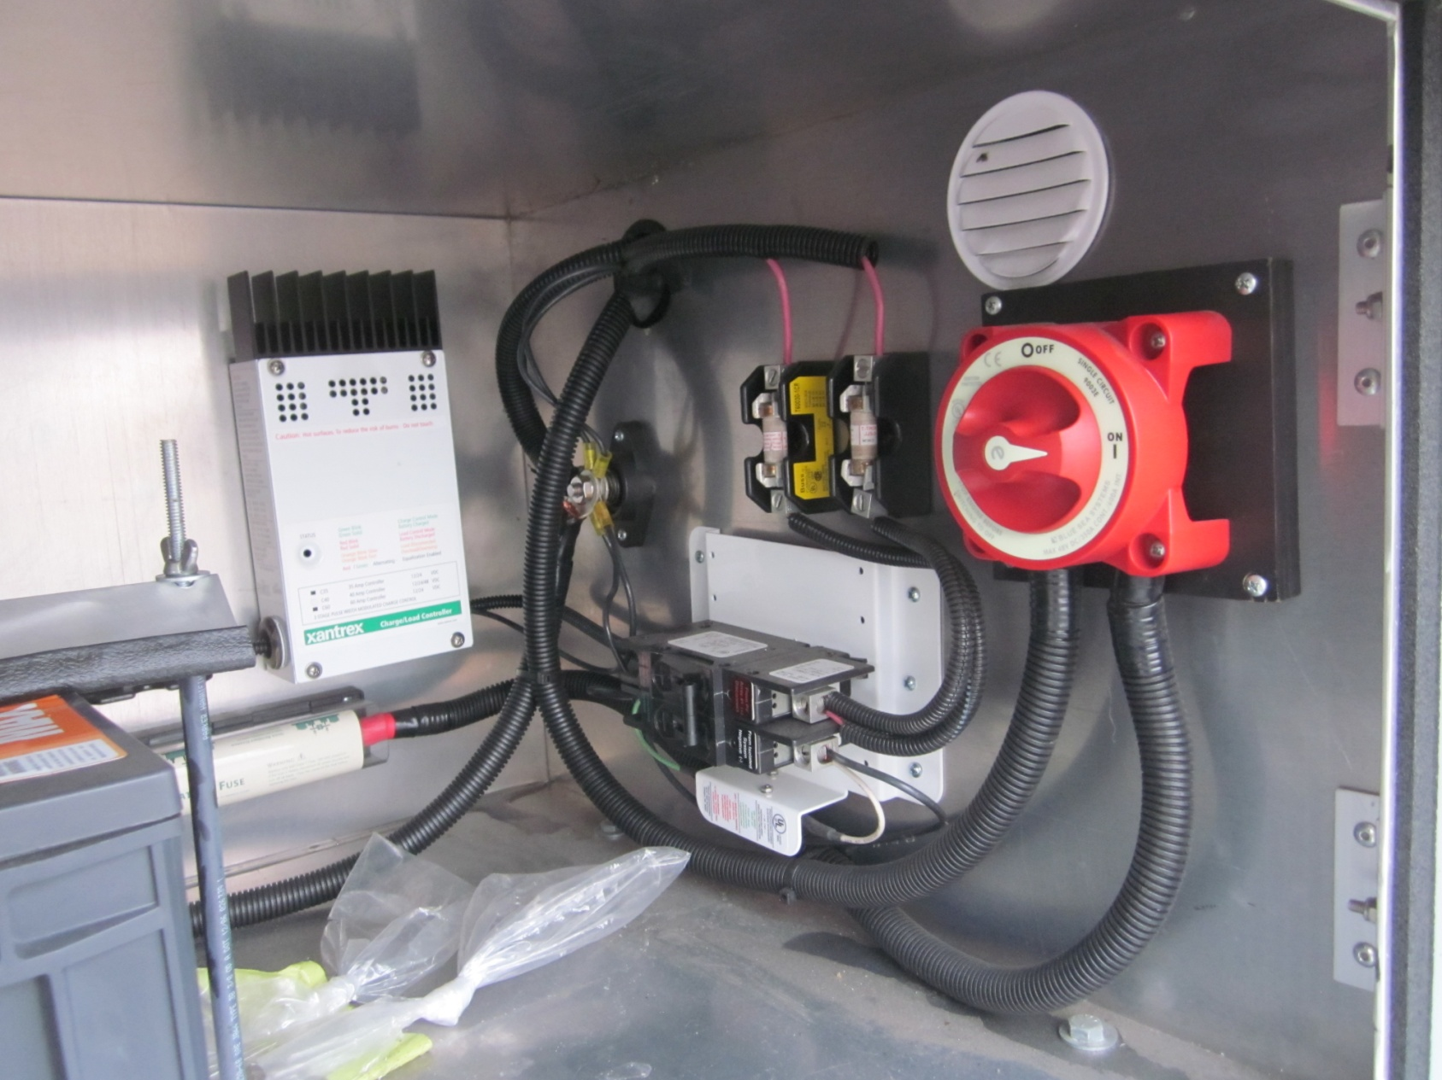
AUXILIARY COMMUNICATIONS VEHICLE
BATTERY COMPARTMENT
MAIN BATTERY SWITCH

Slide 53
AUXILIARY COMMUNICATIONS VEHICLE
EXTERNAL VIDEO SCREEN

Slide 54
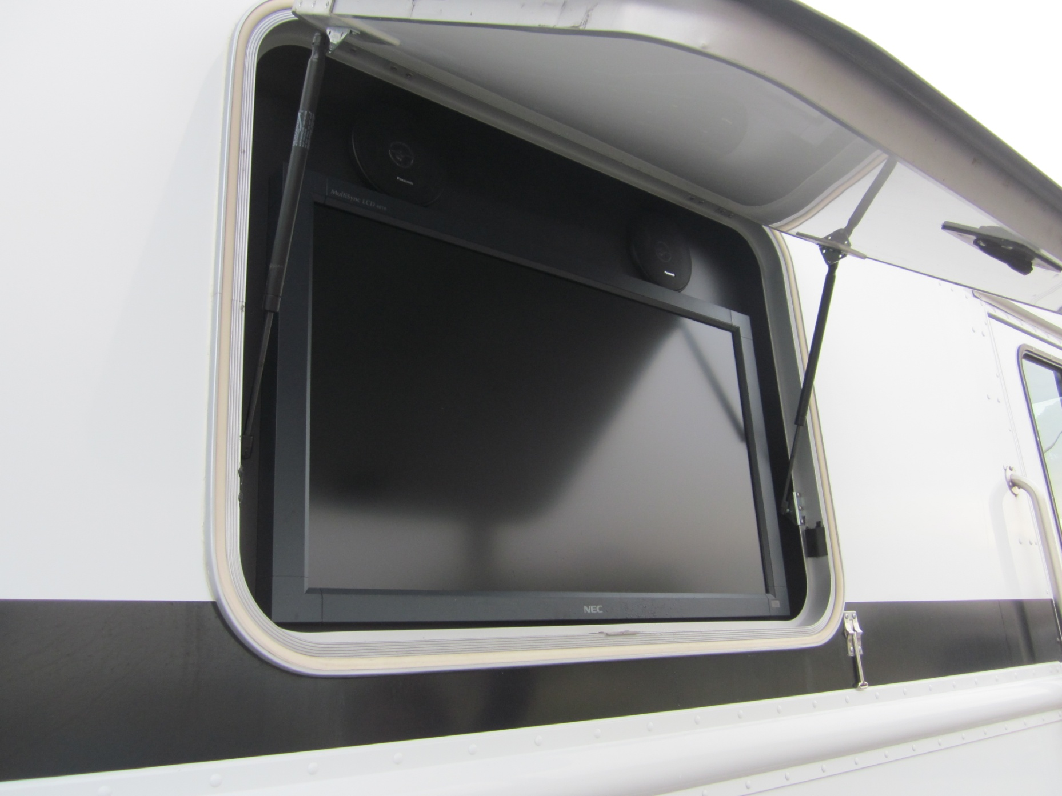
AUXILIARY COMMUNICATIONS VEHICLE
SPEAKERS
SPEAKERS
EXTERNAL VIDEO SCREEN
HATCH PULL-DOWN
POLE MOUNTED IN DOOR FRAME

Slide 55
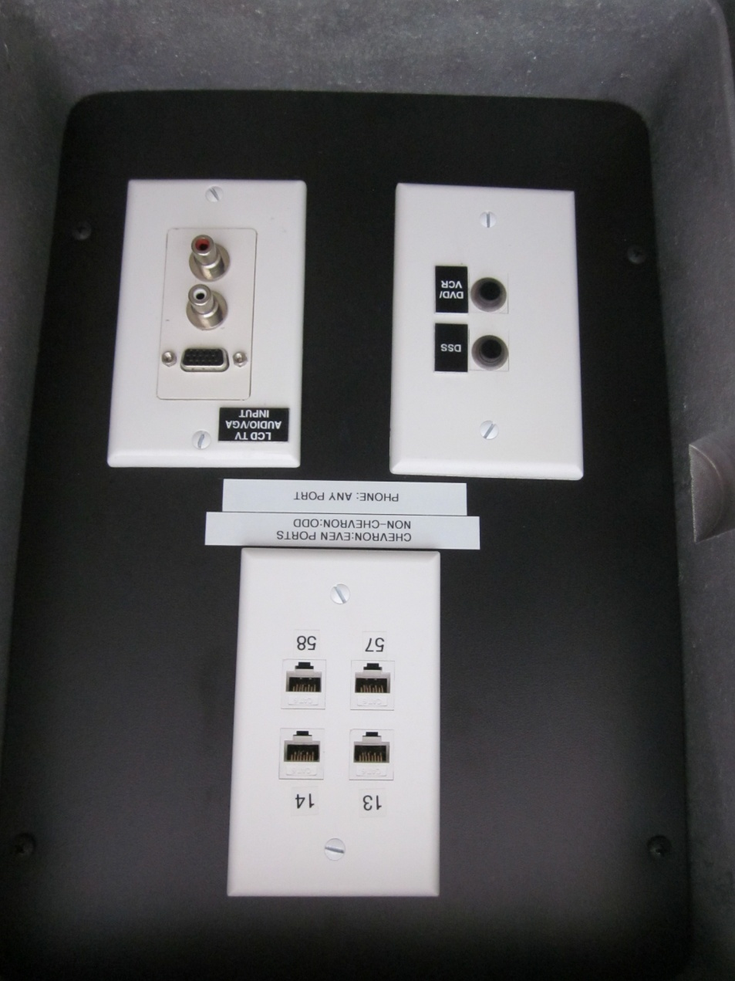
AUXILIARY COMMUNICATIONS VEHICLE
VIDEO INPUT
EXTERNAL VIDEO SCREEN
CONNECTION BOX
AUDIO INPUTS

Slide 56
AUXILIARY COMMUNICATIONS VEHICLE
End of Review

