Slide 1
California Supplement
For use with About Boating Safely and Boating Skills & Seamanship

Slide 2
Boater Card
Beginning January 1, 2018, certain boaters will need a boater education card to legally operate a power boat in California
On January 1, 2018, the requirement will apply to persons under 21 only
By January 1, 2025, it will apply to all power boat operators
For phase-in schedule, go to www.CaliforniaBoaterCard.com

Slide 3
Vessel Registration
California requires vessels to be registered with the DMV, except:
Boats propelled only manually*
Boats eight feet or less in length that are propelled only by sail
Vessels documented by the Coast Guard
Foreign vessels
Sailboards
*NOTE: Attaching any motor to a vessel such as a kayak, canoe, or angler float tube means that the vessel is no longer propelled only manually and must therefore be registered.

Slide 4
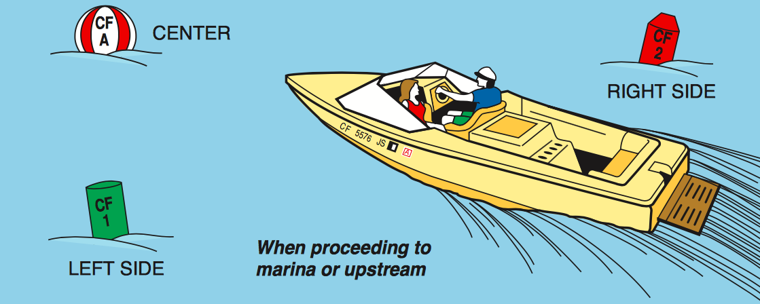
California ATONs
For waters entirely within the state, the state uses the California Uniform State Waterway Marking System

Slide 5
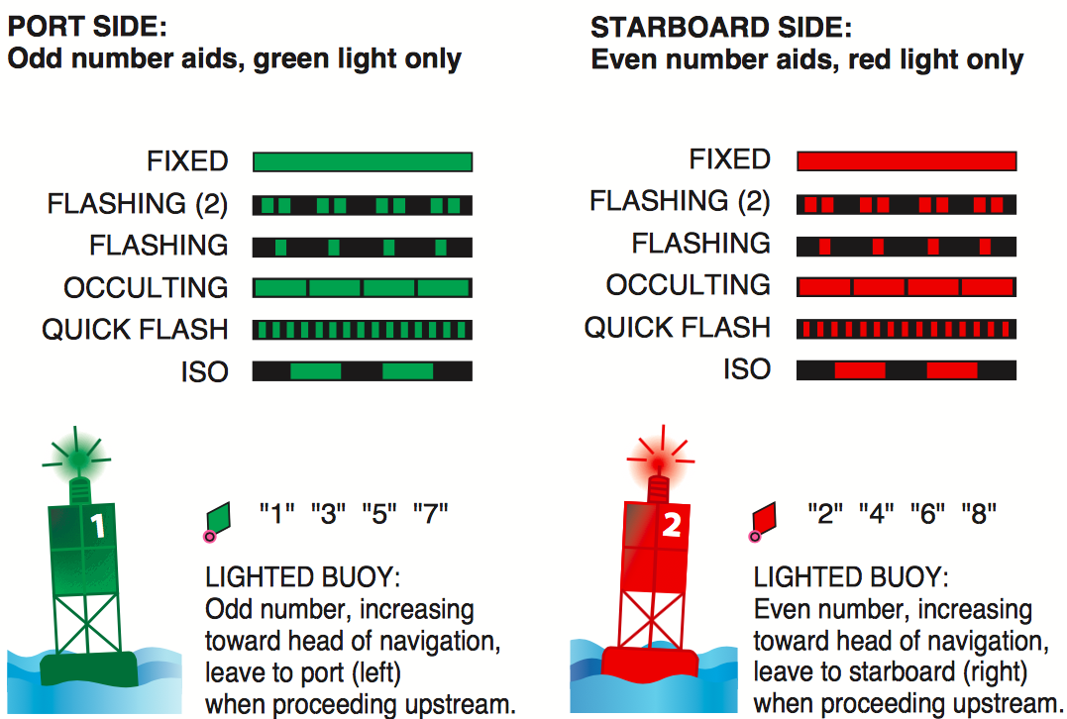
California ATONs
Lateral Markers – Primary Channel

Slide 6
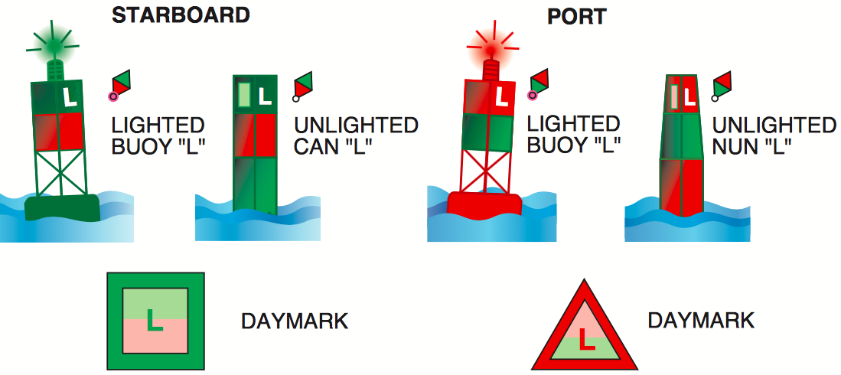
California ATONs
Lateral Markers – Preferred Channel
Notes:
Note that there are no numbers, only letters.

Slide 7
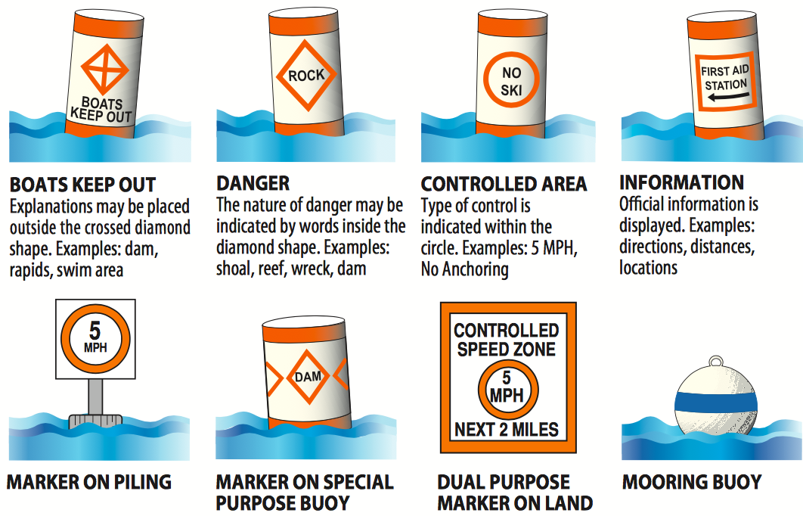
California ATONs
Information and Regulatory Marks

Slide 8
Law Enforcement
Every peace officer of the state, city, county, harbor district or other political subdivision of the state is empowered to enforce California boating law.
These officers have the authority to stop and board any vessel where they have probable cause to believe that a violation of law exists.

Slide 9
Law Enforcement
If you approach or are approached by a law enforcement vessel using its siren or blue light:
Immediately slow to a speed sufficient only to maintain steerage
Alter your course to avoid interfering with the law enforcement vessel
Unless otherwise directed, proceed at the reduced speed until beyond the law enforcement vessel’s area of operation
Notes:
The proper maneuver for a sailing vessel is to “heave to”. This should be practiced before needing to use it to comply with law enforcement.

Slide 10
Trailering
It is unlawful to tow a trailered vessel containing a passenger except when launching or retrieving the vessel

Slide 11
Age Restrictions
No person under 16 years of age may operate a boat with a motor of more than 15 horsepower, except for:
a sailboat that does not exceed 30 feet in length
a dinghy used directly between a moored boat and the shore (or between two moored boats).
Children 12–15 years of age may operate boats with a motor of more than 15 horsepower or sailboats over 30 feet if supervised on board by an adult at least 18 years of age.

Slide 12
Speed
The maximum speed for motorboats within 100 feet of a swimmer (but not a water skier) and within 200 feet of a bathing beach, swimming float, diving platform or lifeline, passenger landing being used, or landing where boats are tied up is 5 mph.

Slide 13
Teak Surfing
Teak surfing or platform dragging means holding onto the swim platform, swim deck, swim step, swim ladder, or any portion of the transom exterior of a motorized vessel for any amount of time while the vessel is underway at any speed.
This exposes the teak surfer to lethal amounts carbon monoxide fumes from the engine.
Vessel operators will be cited for observed teak surfing.
Notes:
The primary danger with teak suffering is that it exposes the teak surfer to carbon monoxide fumes from the engine. Carbon monoxide is colorless, odorless, and highly poisonous. It works by binding to the hemoglobin on red blood cells more effectively than does oxygen. It bonds permanently. This means that it robs the blood of the ability to transport oxygen to the brain and other parts of the body.

Slide 14
Carbon Monoxide Poisoning
Some signs of carbon monoxide poisoning are a dull headache, weakness, dizziness, nausea or vomiting, shortness of breath, confusion, blurred vision, and loss of consciousness.
A set of carbon monoxide warning stickers are required to be placed on the transom and helm of all new and used motorized boats sold in California.

Slide 15
Teak Surfing
It is illegal to operate a vessel’s motor or generator while someone is:
teak surfing, platform dragging, or bodysurfing behind the vessel
while someone is occupying or holding onto a swim platform, swim deck, swim step, or swim ladder, except for a very brief period of time for launching or docking, entering or exiting the vessel, or complying with law enforcement
Notes:
The next slide contains the definition of teak surfing.

Slide 16
Reckless or Negligent Operation
It is illegal to operate any vessel or manipulate any water skis, aquaplane or similar device in a reckless or negligent manner so as to endanger the life, limb or property of any person.
Among other things, this prohibits:
Riding on the bow, gunwale, or transom of a vessel under way unless protected by railings
Moving between a vessel and a towed skier
Operating under the influence of intoxicants or narcotics
“Buzzing” or “wetting down” others
Speeding
Operating at prohibited times or in prohibted areas

Slide 17
Hit-and-Run Accidents
If you are involved in a boating accident that results in injury, death, or disappearance, you are required to stay at the scene and:
Furnish appropriate information to others involved or to a peace officer at the scene, and
Render reasonable assistance to each injured person

Slide 18
Intoxication
Alcohol is a factor in about half of all fatal motorboat accidents in California
It is illegal to operate a vessel, water skis, or a similar device:
While under the influence of alcohol or drugs, or
If addicted to any drug

Slide 19
Intoxication
If 21 years of age or older, it is illegal to operate a vessel, water skis, or similar device with a blood alcohol content, by weight, of 0.08 or greater.
BACs of 0.05 to 0.08 may be used as evidence in determining if a boater was operating under the influence of alcohol

Slide 20
Intoxication
If under 21 years of age, it is illegal to operate a vessel, water skis, or a similar device with a blood alcohol content of 0.01 or greater
For all boaters, designating a sober skipper is not enough. Unlike in a car, intoxicated passengers can fall overboard, swim near the propeller, and cause vessels to become unbalanced.

Slide 21
Personal Watercraft
PWCs are subject to the same laws as powerboats of the same size.
In addition:
Operators are required to be connected by a lanyard to a cut-off switch.
PWCs with self-circling devices may not be operated if the device has been altered.
No operation between sunset and sunrise.
No wake jumping within 100 feet of the vessel that created the wake
Notes:
Remind students that PWCs refer to what they probably think of as JetSkis. JetSki is a trademark of Kawasaki.

Slide 22
Water Skiing & Towing
When towing a skier, knee boarder, tuber, etc., there must be an observer on board who can watch the person being towed. The observer must be at least 12 years of age.
The person being towed must wear a life jacket approved by the Coast Guard specifically for tow sports.
No towing a person between sunset and sunrise.

Slide 23
Ski / Towing Flag
You are required to display a red or orange flag to indicate a skier in the water, or a ski, a line, or similar equipment in the immediate area.
The display of the ski flag does not in itself restrict the use of the water, but warns boaters operating in the area to exercise caution.
Boaters who see a red or orange flag being displayed should be on the lookout for a skier or equipment in the water.

Slide 24
Towing Tips - Start
Don’t accelerate until the skier grasps the towline handle, with the ski or board in proper position, and signals readiness to be towed.
Ease the throttle at first, slightly increasing your speed to provide smooth acceleration until the skier is up on plane.

Slide 25
Towing Tips - Pickup
When a skier falls, the operator should return without delay. Other boaters may not easily see the skier in the water, and the presence of your boat may keep other boats away from the vicinity of your skier.
NEVER back the boat up to a person in the water.

Slide 26
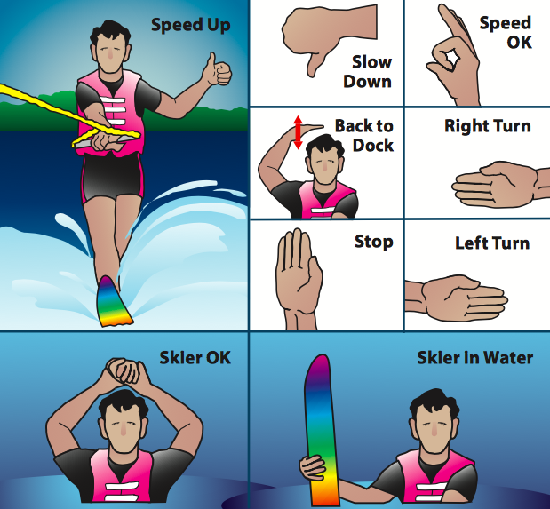
Towing Signals

Slide 27
Accident Reporting
Operators must make a written report with the California State Parks Division of Boating and Waterways:
within 48 hours of an accident if a person dies within 24 hours of the accident, disappears, or requires medical treatment beyond first aid
within 10 days of an accident if a person dies more than 24 hours of the accident or total damage to all vessels and property exceeds $500 or there is a complete loss of a vessel.

Slide 28
False Search and Rescue Calls
It is a misdemeanor to knowingly make a false report to a state or local agency that an emergency situation exists.
It is a felony to make such a report if you know (or should know) that the response is likely to cause death or great bodily injury to a responder, and such a death or injury occurs.

Slide 29
Green Boating
Visit www.BoatingCleanAndGreen.com
All oil and chemical spills must be reported to the National Response Center at 800-424-8802 and to the state at 800-OILS911 (800-645-7911).
Visit www.earth911.org or call 800-CLEANUP (800-253-2687) for your nearest oil, recycling and hazardous waste disposal center.

Slide 30
Invasive Species
To prevent the spread of invasive plants, fish, and other animals from one body of water to another, clean, drain, and dry your boat between visits to different bodies of water.
There are specific drying times for each boat. Use www.100thmeridian.org/Emersion.asp to calculate.

Slide 31
Invasive Species
Quagga and zebra mussel inspections are determined by county or local municipalities. Boaters should check ahead to see whether boat inspections will be required.
CA-registered vessels are required to pay a Mussel Prevention Fee and display a Mussel Prevention Fee sticker, unless operated exclusively in “marine” (salt) waters.
In the Bay Area and the Delta, “marine” waters are those west of Chipps Island.

Slide 32
Sewage
Discharging raw sewage into any of California’s lakes, rivers, reservoirs or coastal waters within three miles of shore is prohibited within U.S. navigable waters.
State law prohibits dumping any human waste (treated or untreated) in a marina, yacht harbor, fresh water lake, or fresh water impoundment, No Discharge Zones, and into rivers that do not support interstate traffic.

Slide 33
Sewage
California’s No Discharge Zones are:
Lake Tahoe
Avalon Bay Harbor (Catalina Island)
Richardson Bay
Dana Point Harbor, Huntington Harbor, Newport Bay (Upper and Lower), Sunset Bay
Mission Bay (San Diego), Oceanside Harbor, San Diego Harbor
Channel Islands Harbor

Slide 34
Vessel Disposal
Never abandon or sink your vessel to dispose of it. It poses an environmental and navigational hazard on our state’s waterways and is illegal.
There are several options for proper vessel disposal: donation, recycling, dismantling, and DBW’s Vessel Turn-In Program. Visit:
www.BoatingCleanAndGreen.com

Slide 35
Thank you!
Any questions?
Find other Auxiliary boating courses at www.cgaux.org/boatinged
Request a vessel safety check at www.safetyseal.net
Learn more about joining the Auxiliary at: join.cgaux.org
Learn more about mandatory boater education at www.CaliforniaBoaterCard.com

