Slide 1
OPERATIONS – CERTIFICATIONS & REYR
2020 – In Our Wake!
PCA FAIR
16 January 2021

Slide 2
Introduction
All face-to-face activities including patrols have been severely impacted!
Surface operations have been significantly altered since the onset of the pandemic in March 2020.

Slide 3
Introduction
“Required Yearly Not Met”
First …
What is “REYR”

Slide 4
Current State of Affairs
In the ALAUX 032-20 dated 29 October 2020, the following was included regarding currency maintenance:
All annual currency maintenance requirements for CY 2020 (e.g., the two marine dealer visits required to maintain currency as a program visitor) and other-than-annual requirements that were due in CY 2020 (e.g., the 3-year check ride required to maintain currency as a coxswain if due in 2020) are waived except tests and workshops that can be completed online through the Auxiliary Learning Management System (AUXLMS) or Auxiliary National Classroom.
See Next Slide

Slide 5
Current State of Affairs
What does this mean for us? If a coxswain or crew member was due for a checkride in 2020, they remain “current” through 2021
Except that the “1-Hr. Ops Workshop” and “TCT Refresher” must have been completed.
Going forward, twelve hours underway will be required to maintain currency.

Slide 6
Current State of Affairs
Based on AUXDATA II reports, in our District there are 160 members that were or are due for requalification in 2020 / 2021.
Not including new candidates for initial qualification … we believe that will be very limited.

Slide 7
Current State of Affairs
Bottom line: In order to provide requalification opportunities for everyone needing a checkride, coordination amongst all Divisions will be necessary.
PLEASE schedule your 2021 OPTREX as soon as possible.
Be aware that the “Bubble” requirement for operational facilities may extend for several months so schedule accordingly. Additional guidance for requesting a checkride will be included in an upcoming DSO-OP report.

Slide 8
Scheduled OPTREXs - 2021
Divisions 1 & 12 | Division 7 | Division 6 | Flotilla 55 | Division 10
Victory OPTREX - Marina Bay, Richmond | Jordanelle Resevoir | Santa Cruz | Bodega Bay | Millerton Lake
June 25 - 26 | August 6 - 7 | Sept. 11 - 12 | Sept. 24 - 26 | Sept. 24 - 26
Not posted on District Calendar

Slide 9
Current State of Affairs
Requests for orders in AUXDATA II must be submitted at least 7 days prior to the patrol date.
Prior to submitting a request for orders, you must submit the following two forms to D11NORTHERN@uscg.mil

Slide 10
Bubble Request Form
1. Bubble Request Form Coxswains submit this form and it is valid until the Bubble is changed.
https://www.emailmeform.com/builder/form/dbbV1669i5TYw4

Slide 11
Bubble Request Form

Slide 12
High Risk Assessment Form
2. High Risk Assessment Form Each Bubble member submits this form and it is valid until the entries change.
http://d113-cloud.d11nr.info/D11N-documentation/pdfs/AUX_COVID19_High-Risk_Certification.pdf

Slide 13
High Risk Assessment Form
Form has two classifications:
“… are at increased risk”
“might be at
increased risk”

Slide 14
High Risk Assessment Form

Slide 15
Assignment To Duty Request Form
Prior to submitting this form, a patrol order request should have been submitted in AUXDATA II.
Assignment To Duty Request Form Coxswains submit this form for each patrol.
https://www.emailmeform.com/builder/form/apq47kOroc571fb”

Slide 16
D11N Assignment to Duty Form

Slide 17
D11N Assignment to Duty Form
A new form is required prior to each patrol.
An email from D11N confirming the receipt of your request will be sent.

Slide 18
Current State of Affairs
Links to each of the three forms required by D11N can be found on the Surface Operations web page on the District website.
QUICK LINKS (Click Item Below)
Bubble Request Form
High Risk Assessment Form
Assignment to Duty Request Form

Slide 19
Current State of Affairs
Please note the “Nature of the Request” in drop down box in the AUXDATA II.
Maybe a “MOM” patrol.
Select one of the options.
Hint: All patrols should include at least some “Ops Training”.

Slide 20
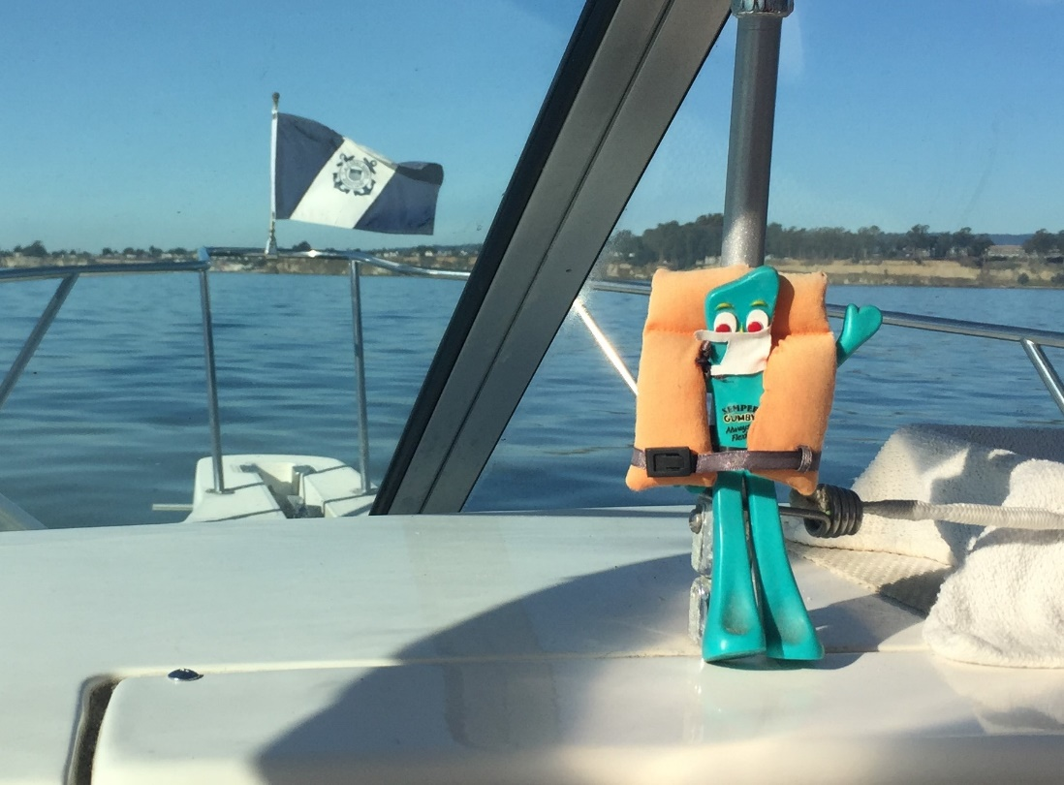
Current State of Affairs
When will these “COVID-19” procedures end?
Your guess is as good as mine!!!!!!!

Slide 21
And now … on to …..
Briefing – Pre-Underway &
De-Brief
Sign-offs
Q & A

Slide 22
Pre-Underway
Conduct a full / complete briefing!
Critically important!

Slide 23
Pre-Underway
Develop and use a Pre-underway Check List designed for your facility!

Slide 24
Pre-Underway
Personalize it!
Examples

Slide 25
Risk Management (GAR 2.0)
Every mission involves some level of risk
Remember lessons learned in the TCT Refresher course
Evaluate mission for “Risk” and “Gain”

Slide 26
Risk Management (GAR 2.0)
Use the PEAACE Model to assess overall “Risk”
Risk should be “Low”

Slide 27
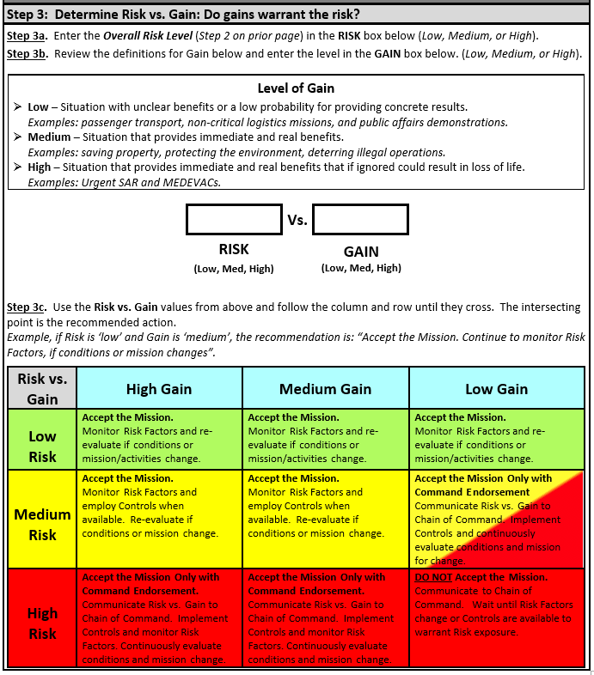
Risk Management (GAR 2.0)
Training
Low
Medium
Notes:
Go to your break out groups and complete the GAR 2.0 form for this incident.

Slide 28
Pre-Underway
Following the Briefing and risk assessment, ask if there are any questions!

Slide 29
Ensure all crew members are capable of performing the mission
Ensure crew follows fatigue standards in Aux Ops Policy Manual
Ensure all crew are equipped with required PPE and are proficient in its use
Ensure PPE maintained in accordance with Maintenance Procedure Cards

Slide 30
Underway
While underway ….

Slide 31
Quote from Ops Policy Manual …
Each Auxiliarist is charged with an ongoing responsibility to use good judgment and common sense when evaluating their continuing ability to carry out their assignments. Each individual’s responsibility to exercise sound judgment requires each operator or crewmember, prior to departing on an ordered mission, to evaluate their own physical status and decline orders when unable to perform the required duties … It is incumbent upon the member to self-enforce; however, this does not always occur. It is critically important that the coxswain evaluate each crew member’s physical abilities prior to getting underway and this too does not always occur.
Notes:
It’s important to note that in the operations policy manual we already have statements saying it is
EVERY crew person’s responsibility to evaluate their own physical condition. Additionally the Coxswain is responsibility evaluate the condition of the crew before (and During) the start of the mission.

Slide 32
Quote from Ops Policy Manual …
It is the responsibility of each crew member to evaluate other crew members with regards to physical abilities to perform the tasks.
The Operations Policy Manual contains the following:
In the event a crew member becomes aware of a physical or mental condition in one of the other crew members or in himself/herself, which may jeopardize the safety of the mission, said person has a responsibility for immediately bringing the condition to the attention of the coxswain, FC, and Director via the chain of leadership and the OIA.
Notes:
It goes on to state EVERY crew member should be aware of the condition of fellow crew members
In reality isn’t this a tenet of our TCT program
We need to do everything we can ensure this happens

Slide 33
Coxswain & Crew Responsibilities
Per the Ops Policy Manual, maintain awareness of physical limitations, i.e. vision & hearing acuity, in yourself and in others
First line of awareness – Coxswain during pre-underway briefing
Second line of awareness – Crew continually observing each other during mission for physical limitations
Third line of awareness – QE check rides but that only happens once every three years
Notes:
Capable of performing the mission includes physical capabilities including vision and hearing acuity. Make the point that we are all to watch out for one another! The key is he crew, not the mission.

Slide 34
De-Briefing
Very Important!
Starting with least experienced, ask each:
What was done well?
What could be improved?
Was there any time that you were unclear of your duties?
Any questions or comments?

Slide 35
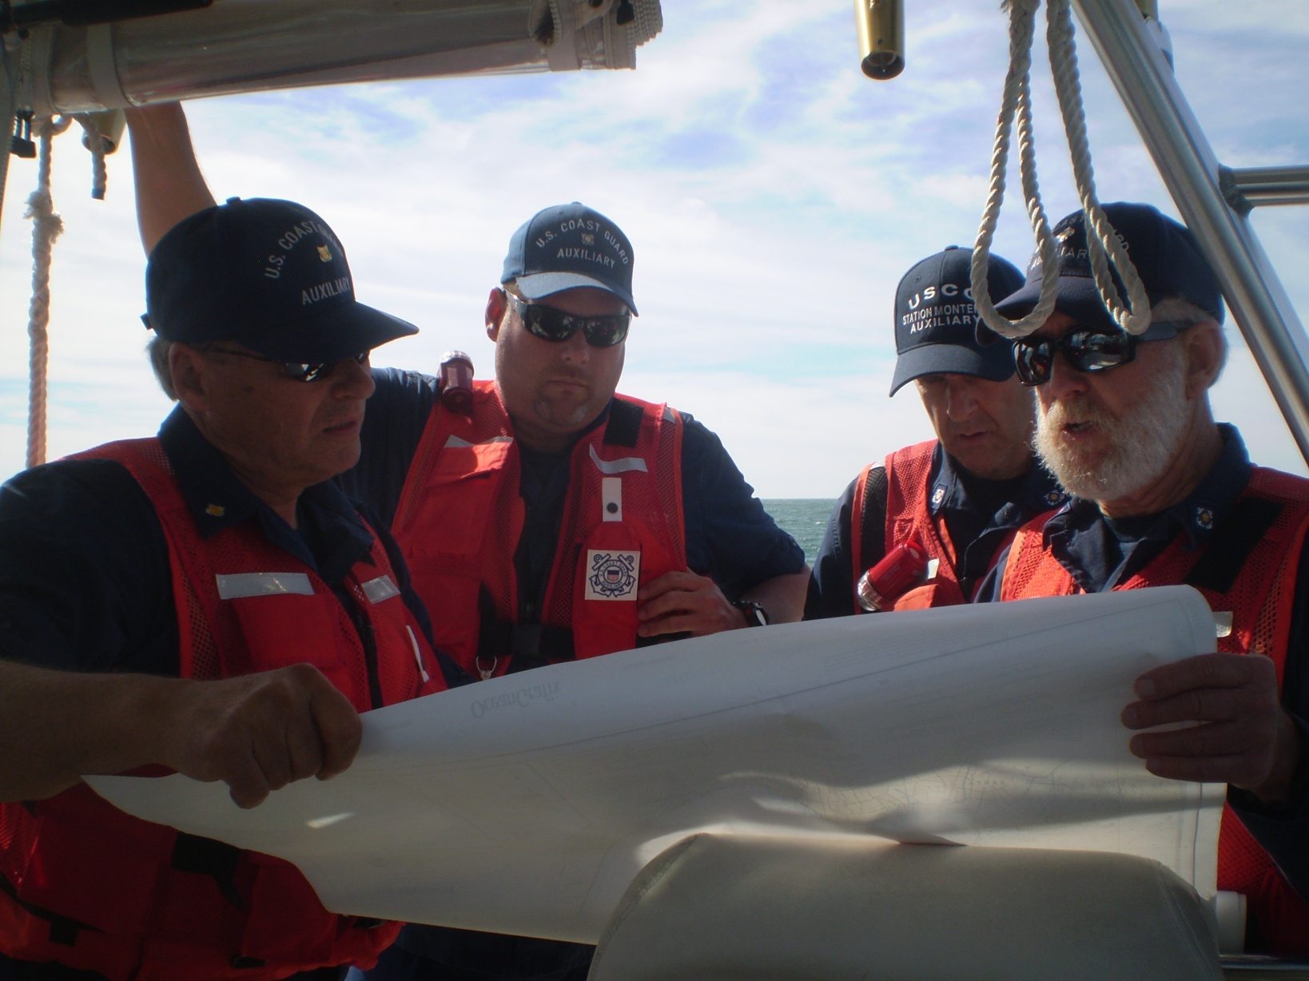
Certifications

Slide 36
SIGN-OFFs
As a coxswain or crew, you will likely mentor trainees in all phases of Boat Crew qualifications.
Signing off tasks is a process!

Slide 37
The Sign-Off Process
1. Develop a plan with the trainee
How many tasks will be signed off?
Individually or in groups?
Schedule on-the-water sessions
2. Trainee studies reference materials and prepares to demonstrate tasks.

Slide 38
The Sign-Off Process
3. Mentor demonstrates tasks
4. Mentor walks trainees through a task until trainee learns the task

Slide 39
The Sign-Off Process
5. The trainee practices the task until the mentor is confident that the trainee is able to consistently meet the task standards on his/her own.

Slide 40
The Sign-Off Process
6. When satisfied that the trainee meets the standard,
the mentor verifies completion by signing off the task at the bottom of the task page.

Slide 41
The Sign-Off Process
Should a QE find a weakness in a candidate,
The QE may review the Qualification Guide for that task to learn who the Mentor was.

Slide 42
Crew Responsibilities Review
Safety is paramount!
If you see something, say something
If you see something and ignore it …
You condone it!
Notes:
ORM is all about a continuous review of changing conditions that may influence the “Risk” of a mission.

Slide 43
Priorities
Me
Mine
You
Yours

Slide 44
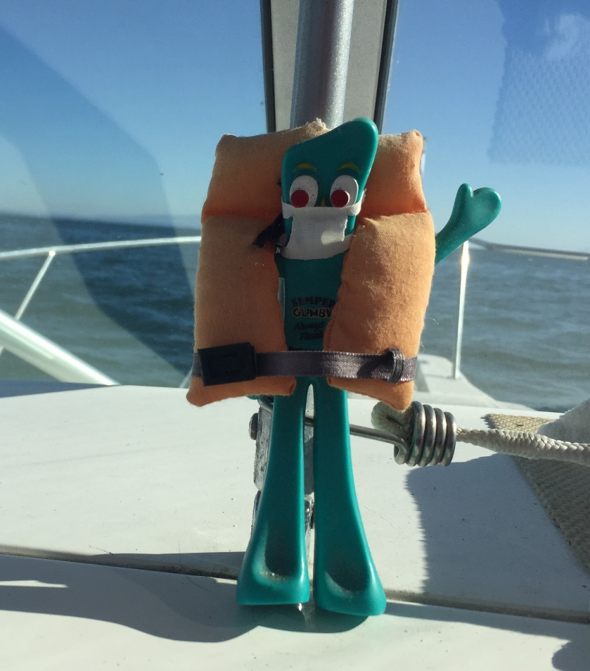
OPERATIONS CERTIFICATIONS & REYR
Prepared by:
COMO Wally Smith
District Staff Officer - Operations
Auxiliary D11N
END OF SEGMENT

