Slide 1
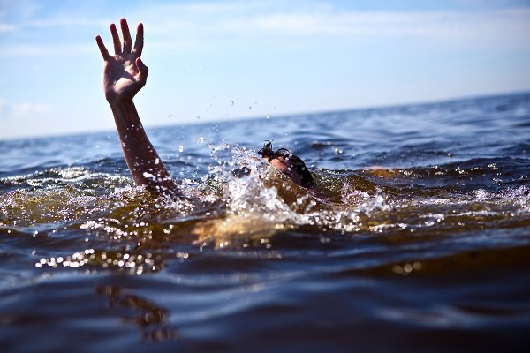
EYES ON
DROWNING
101
USCG Aux
August 1, 2023
By Maggie Grymes

Slide 2
The Importance of Water Safety Education
In the United States, drowning ranks second (behind motor vehicle crashes) as a cause of death from unintentional injury in children ages 1 through 14
On average there are 10 fatal drowning accidents per day in the US
The best thing you can do to enjoy water activities is to participate in swimming and water safety training as you are today, such as swim lessons and water safety courses that help prepare you to handle an aquatic emergency.
Approximately 54% of Americans don’t know how to swim
More than 50% of fatal and nonfatal drownings among people 15 years and older occur in natural waters such as lakes, rivers and oceans
It is the third-leading cause of unintentional injury and death worldwide

Slide 3
What is drowning
What does it look like
What to do when someone is drowning
How to prevent Drowning

Slide 4
What is Drowning
Drowning is the process of experiencing respiratory impairment from submersion/immersion in liquid
Respiratory impairment occurs as airway goes below the surface (submersion) or water splashes over the face (immersion)

Slide 5
Secondary drowning happens if water gets into the lungs. Because it can irritate the lungs, fluid builds up and pulmonary edema occurs. Difficulty breathing occurs almost at once and worsens over time
Nonfatal Drowning: rescue at any time/when the process of drowning is interrupted
Fatal Drowning: death as a result of drowning
Water Rescue: any submersion or immersion incident w/o evidence of respiratory impairment

Slide 6
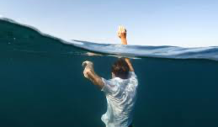
Drowning doesn’t look like drowning. Drowning is…
Silent
Fast
Preventable
Remember, nobody is “drown proof” not even Michael Phelps!
Now to the 5 Stages →

Slide 7
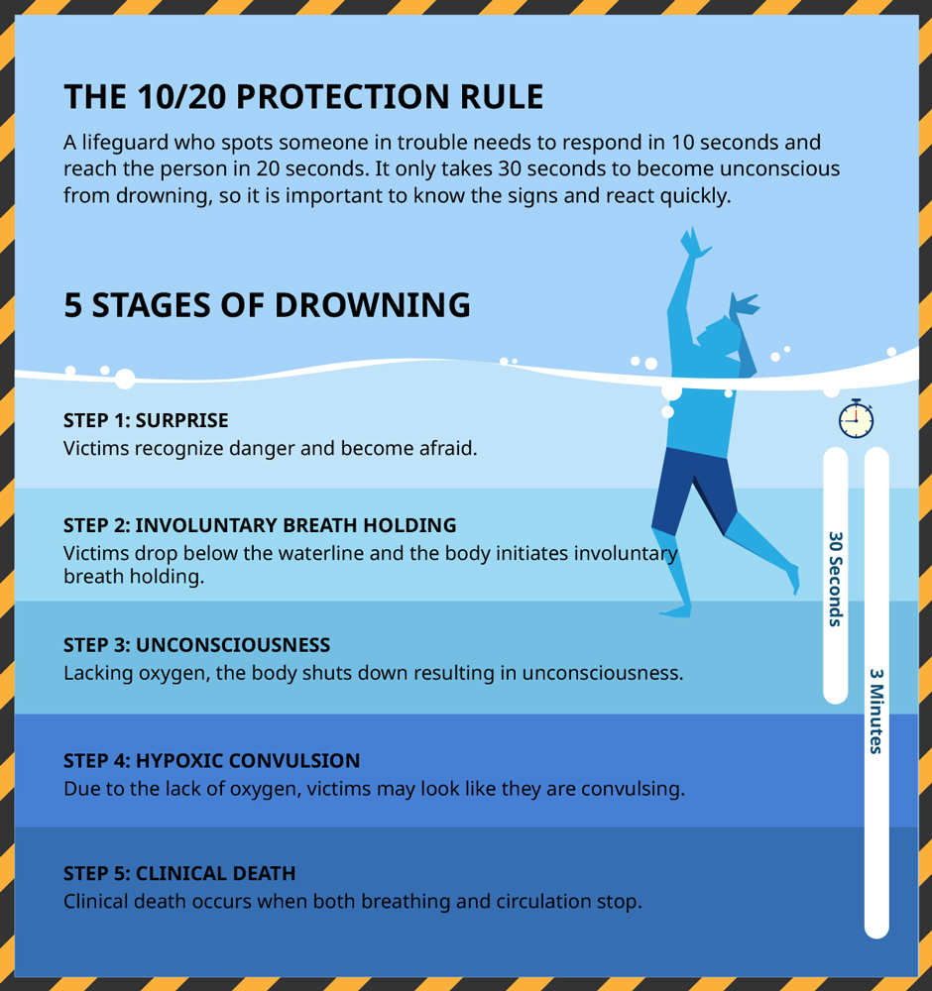

Slide 8
Head tilted back with mouth open;
Head low in the water, with mouth at water level;
Eyes glassy and empty, unable to focus;
Eyes closed;
Hair over forehead or eyes;
Not using legs;
Hyperventilating or gasping;
Trying to swim in a particular direction but not making headway;
Trying to roll over onto the back;
Appears to be climbing an invisible ladder.
Stages 1 through 3 you will see these visual cues:

Slide 9
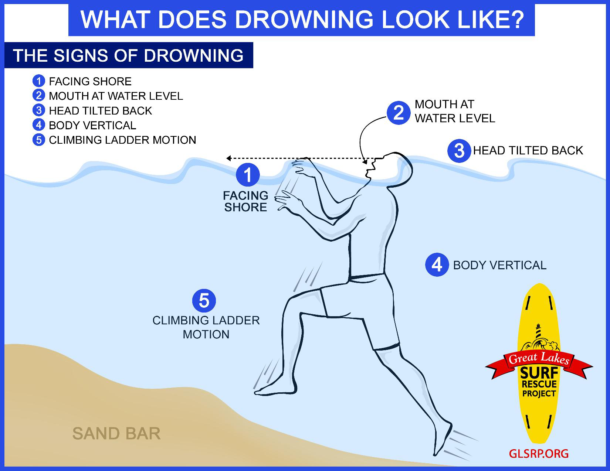

Slide 11
What to do when someone is drowning a twofer:
The Chain of Drowning Survival
Rescuing a drowning victim by boat

Slide 12
The Chain of Drowning Survival

Slide 13
1. Eyes on
When someone falls in the water, the first person on your boat who sees the victim needs to keep his eyes on the man overboard and point at him
That way, someone always has a view of the victim’s location if he is drifting in a current or struggling in rough seas

Slide 14
2. Alert the authorities over VHF radio
You may not be able to rescue the person on your own and even if you do, he or she may need immediate medical attention that you cannot provide

Slide 15
3. Circle the boat
Do not point the boat straight at the victim because your momentum might carry you over them even after you cut the throttles
Circle around to the person, positioning the boat on the downwind side so that the wind does not push the boat over the victim

Slide 16
4. Reach or throw, don’t go
If the person in the water is conscious, try to reach him with your ­throwable PFD (a Coast Guard ­requirement to have on board)Be sure to cleat off the tag end of the line attached to it so you can haul in the victim after he grabs it
Also, consider having a weighted ball or monkey’s fist on board. Both are easier to throw longer distances and less susceptible to wind.
Use a boat hook, gaff, anything the victim can grab. Keep throwing items that float to help create visuals as well

Slide 17
5. Harness a swimmer aboard **
**IF the drowning victim is unable to grab the throwable PFD or is struggling to stay afloat, you may have no choice but to send a crew member in with them
The swimmer should be tethered to the boat, if possible, and be wearing a life jacket before going overboard
Otherwise, you may wind up dealing with two people struggling in the water. Again, assess the risk using GAR 2.0
Never accept HIGH risk for LOW gains!!

Slide 18
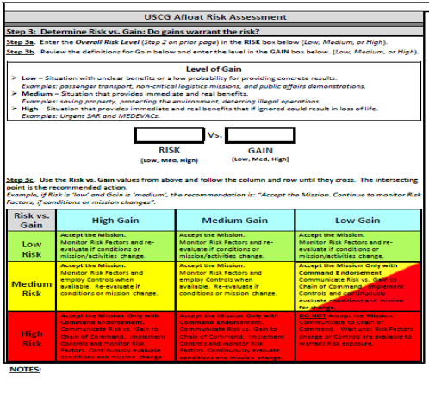
Never accept HIGH risk for LOW gains!!

Slide 19
6. Attack from the back
It’s always best to approach a drowning victim from behind, if possible
If they see you and are panicking, they may try to grab your head or arms and push you underwater in the process
Grabbing from behind allows you to control the situation and keeps them from wrapping their arms around you

Slide 20
7. It’s Not Over
Even if you are able to pull a drowning victim back on board the boat and everything seems OK, you should still get the person medical ­attention as fast as possible. The reason? Secondary drowning.
“People who experience a drowning incident can still have water in their lungs for hours afterward and need to be watched closely.”
Be alert for breathing issues and seek help from a medical professional

Slide 21
How to Prevent Drowning:
Circle of Drowning Prevention
Water Competency Skills
WHALE
Know Your Limits

Slide 22
Circle of Drowning Prevention Layers of protection are essential to drowning prevention

Slide 23
Watch out for the dangerous too’s:
Too tired
Too cold
Too far from safety
Too much sun
Too much strenuous activity

Slide 24
Water Competency Skills
1. Step or jump in the water over your head
2. Return to the surface and float or tread water for one minute
3. Turn around in a full circle and find an exit
4. Swim 25 yards to the exit without stopping
5. Exit from the water. If in a pool, be able to exit without using a ladder

Slide 25
Be a WHALE:
Water
Habits
Are
Learned
Early
Teach kids “Longfellow’s Whales Tales” a free online class provided by the American Red Cross

Slide 26
Know Your Limits
Set specific swimming rules for each individual in a group based on swimming ability (for example, inexperienced swimmers should stay in water less than chest deep). Young children should have an adult in the water with them within arm’s reach at all times.
The more informed people are, the more aware they will be of hazards as well as safe practices. Make sure swimmers know about the water environment and any potential hazards

