Slide 1

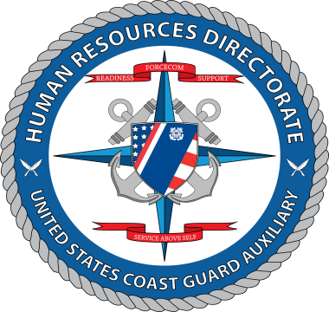
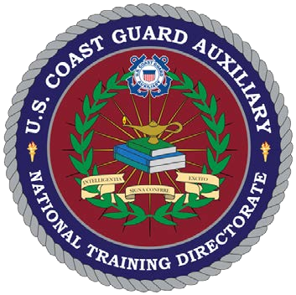
Coast Guard Auxiliary Uniforms
An overview – April 2015
Reviewed, DIR-T and ANACO-FC USCGAUX 04APR15

Slide 2
Topics
Uniform standards
Uniform Board 46 changes
Types of uniforms
Uniform descriptions
Proper placement of ribbons, name tags & devices
Grooming standards
Where to procure your uniforms
2

Slide 3
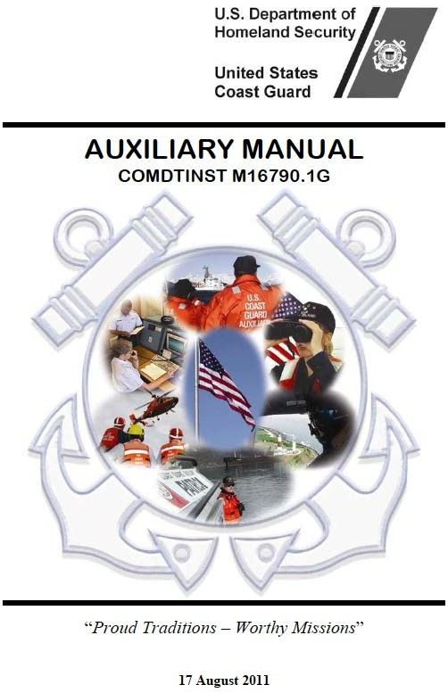
Uniform Standards
The word uniform implies consistency and conformance to certain standards.
Auxiliary Manual COMDTINST M16790.1G
Chapter 10 – Section C.3
“Uniformity in Grooming and Appearance”
2

Slide 4
Uniform Standards
Wear the uniform with Pride!
YOU are a representative of the U.S. Coast Guard and the U.S. Coast Guard Auxiliary
Elected and Appointed officers are expected to set the example
Human Resources staff (FSO/SO/DSO-HR) can assist with your Uniform questions
Uniform Standards are established by:
  USCG Uniform Regulations Manual – COMDINST M1020.6 (series)
  USCG Auxiliary Manual – COMDINST M16790.1 (series)
  Uniform Board announcements & ALCOAST/ALAUX messages
2

Slide 5

Uniform Board 46 Changes
December 2014
Foul Weather Parka Wear Changes Garrison Cap Wear Changes
2

Slide 6
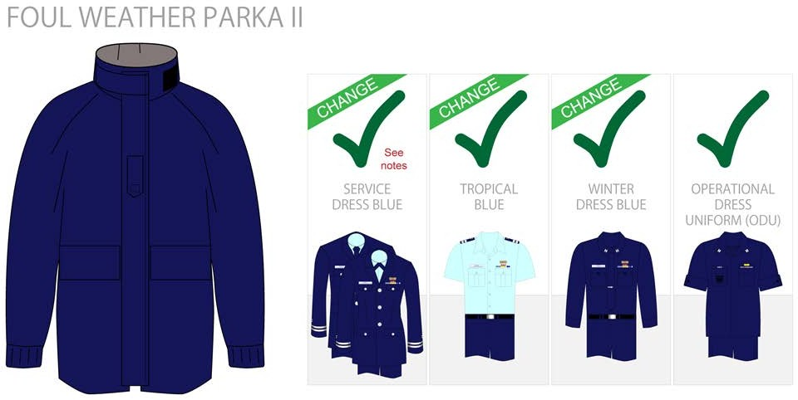
Foul Weather Parka Wear Changes
The Foul Weather Parka II (worn with or without the liner) is authorized for wear with the Operational Dress Uniform (ODU), Tropical Blue, Winter Dress Blue, and Service Dress Blue.
The Parka Liner/ODU Utility Jacket can only be worn as stand alone outerwear with the Operational Dress Uniform (ODU).
Approval DIR-H <ADD approval Date>
6

Slide 7
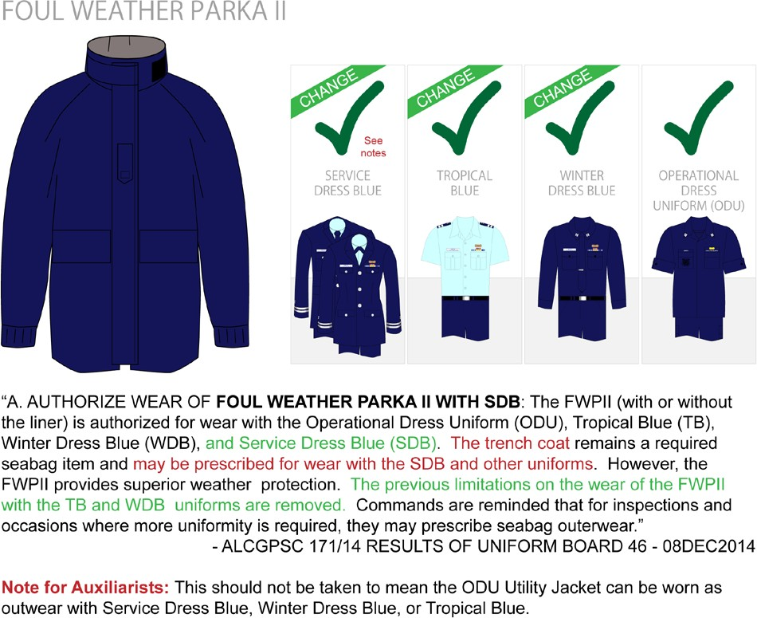
Detailed Changes to Foul Weather Parka Wear

Slide 8
Garrison Cap Wear Changes
The Garrison Cap may be worn optionally with the Service Dress Blue (SDB) uniform unless the Combination Cap is otherwise prescribed
The Combination Cap remains the preferred cover for wear with the SDB, especially for outdoor or formal ceremonies where the cover is integral to the uniform
Commands may prescribe when the Combination Cap is required
The wear of the Garrison Cap allows for greater flexibility during travel and transiting between indoor and outdoor spaces

Slide 9
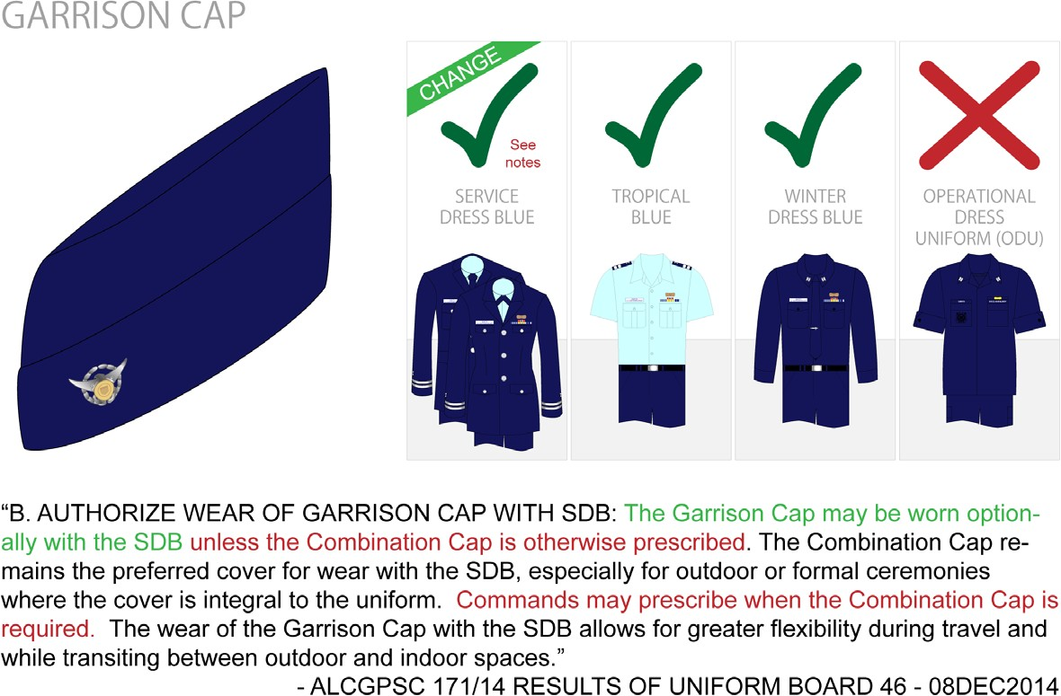
Detailed Changes to Garrison Cap wear

Slide 10
Common Uniforms

Slide 11
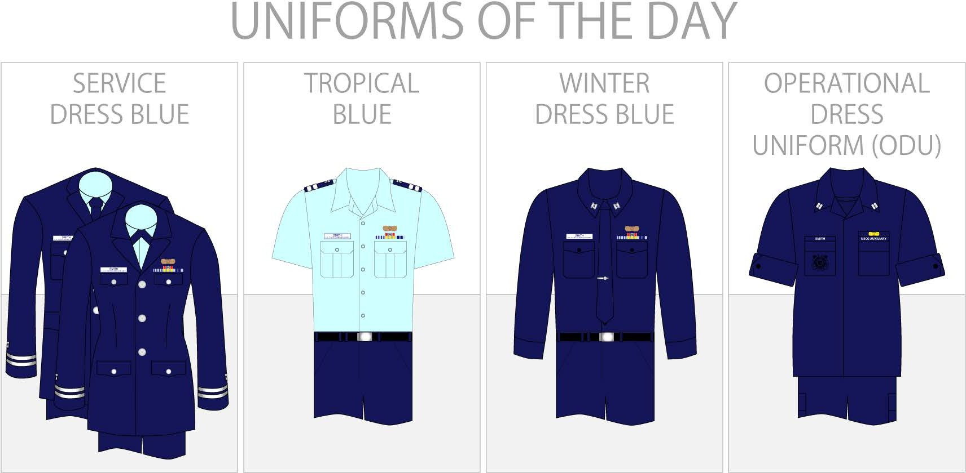
Reviewed, DIR-T USCGAUX

Slide 12
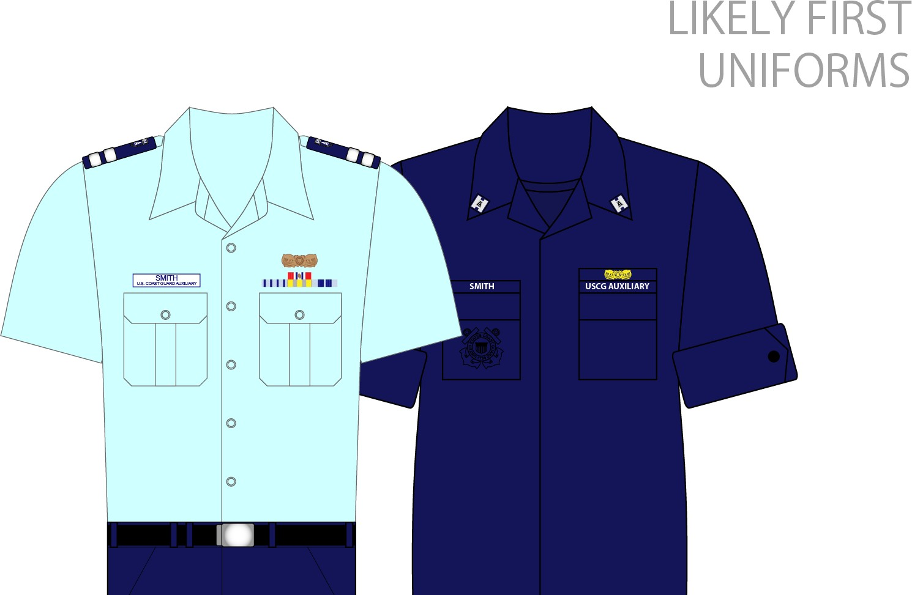
Reviewed, DIR-T USCGAUX

Slide 13
How to wear the U.S. Coast Guard Auxiliary uniform
General Information
Hats should be worn squarely on the head
Shirts will be buttoned.
Sleeves should not be rolled up, except when authorized
Bottom of pants should touch shoe tops
Women’s skirt hemline will be:
  no higher than the crease in the back of the knee
  no lower than 2 inches below the crease in the back of the knee
Bracelets, necklaces, wristwatches, ID bracelets and rings must be conservative, noncontroversial, and in good taste
  No more than 2 rings on each hand
Reviewed, DIR-T USCGAUX
13

Slide 14
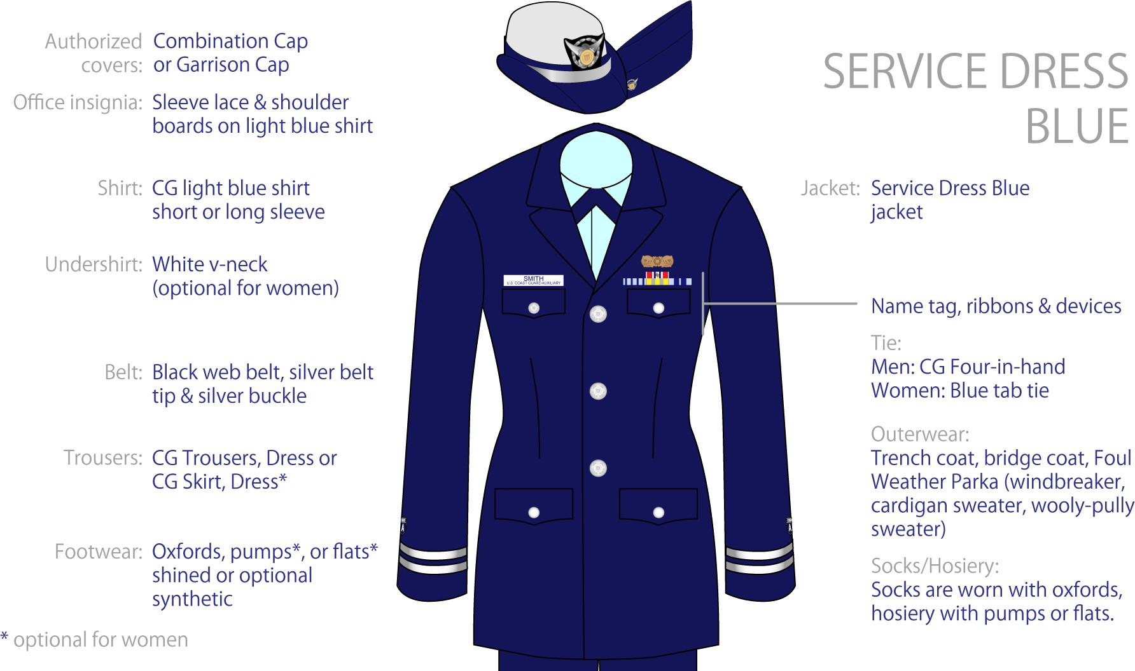
Reviewed, DIR-T USCGAUX

Slide 15
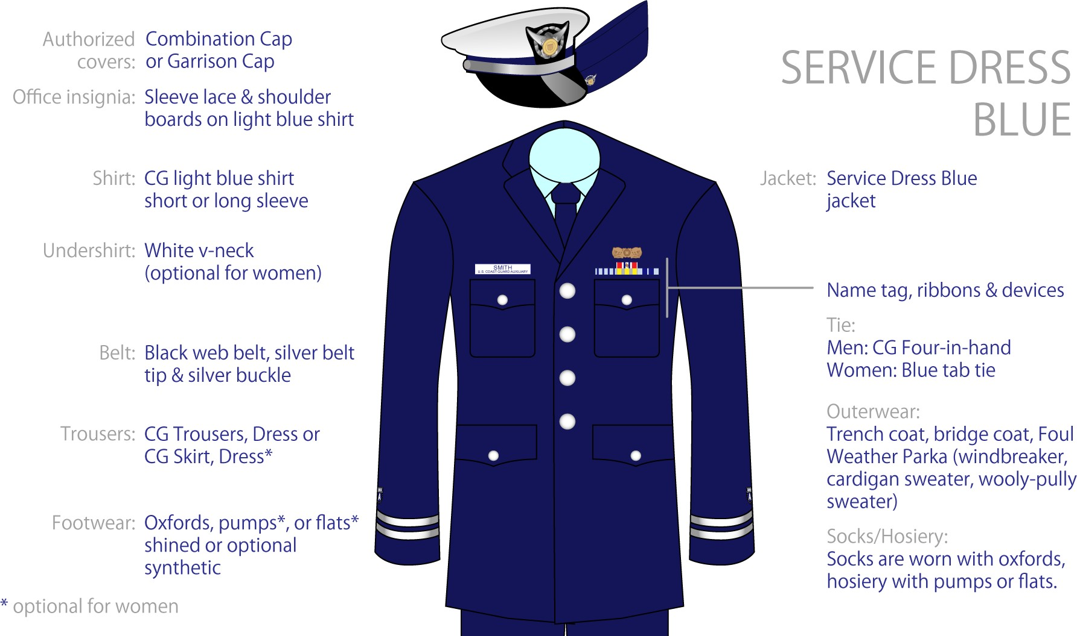
Reviewed, DIR-T USCGAUX

Slide 16
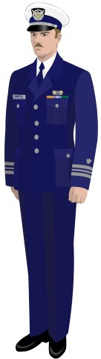
Service Dress Blue (SDB) - Men
Dress Blue coat with silver buttons, dress blue pants
Light blue CG uniform shirt, long or short sleeve
Black socks and shoes
Sleeve lace with sleeve shield
Worn with ribbons, breast insignia, qualification devices and name tag
Combination Cap and Garrison Cap are authorized for wear
Appropriate for classrooms, meetings and similar functions
Outerwear:
  Trench Coat, Bridge Coat, Foul Weather Parka
  Windbreaker, Cardigan Sweater, or Wooly-Pully sweater may be worn in lieu of SDB jacket, when appropriate

Slide 17
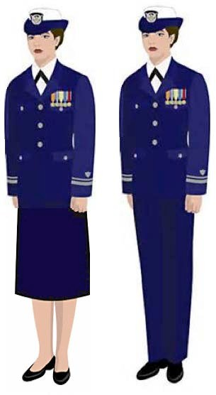
Service Dress Blue (SDB) - Women
Same as men’s SDB except:
  Blue skirt or pants
  Coast Guard Blue Tab Tie
  Stockings (plain) with the skirt
  Black pumps with low heels

Slide 18
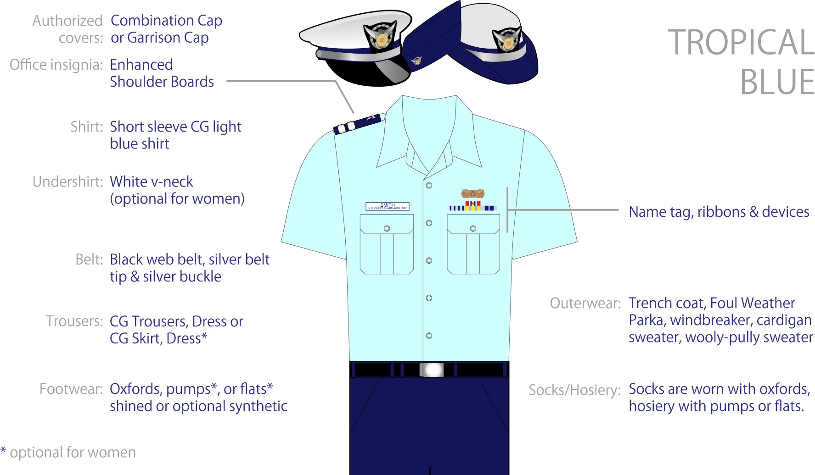

Reviewed, DIR-T USCGAUX 18

Slide 19
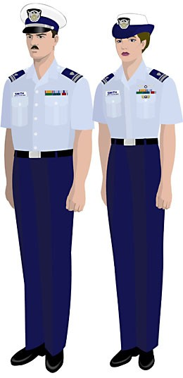
Tropical Blue
May be worn when Service Dress Blue is not required
Light blue CG uniform shirt, long or short sleeve.
  Tunic overblouse, untucked, may be worn by women
Black socks and shoes
Shoulder boards, name tags, ribbons, qualification devices
V-neck T-shirt (No crew neck T-shirt)
Garrison cap or Combination cap (No ball caps)
Reviewed, DIR-T USCGAUX
19

Slide 20
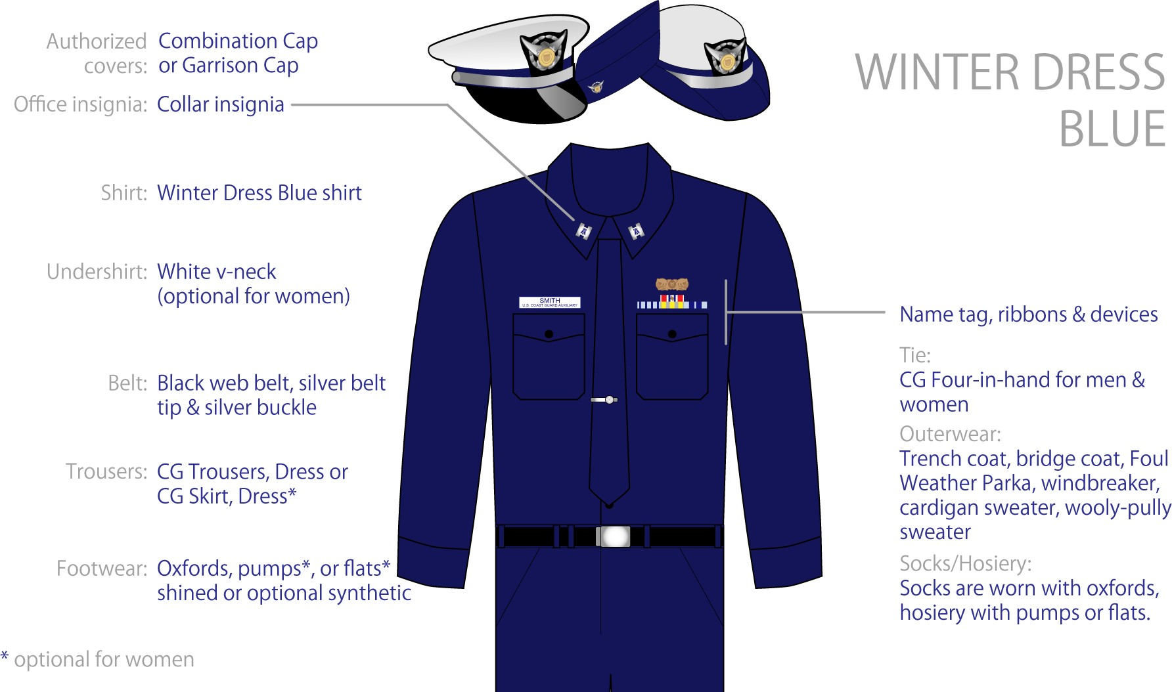
Reviewed, DIR-T USCGAUX
20

Slide 21
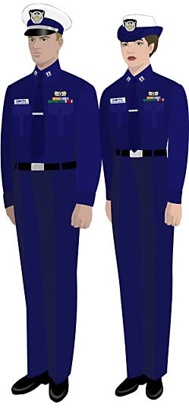
Winter Dress Blue
Available for wear between November 1 to March 31
May be worn unless Service Dress Blue is more appropriate
Coast Guard blue winter shirt (long sleeve) and blue pants
Coast Guard blue tie
Black shoe and socks
Metal collar devices, name tag, ribbons, qualification devices
Garrison or Combination cap
Approved outerwear:
  Windbreaker, Bridge Coat, Trench Coat, Foul Weather Parka, Cardigan Sweater or Wooly-Pully sweater
Reviewed, DIR-T USCGAUX
21

Slide 22
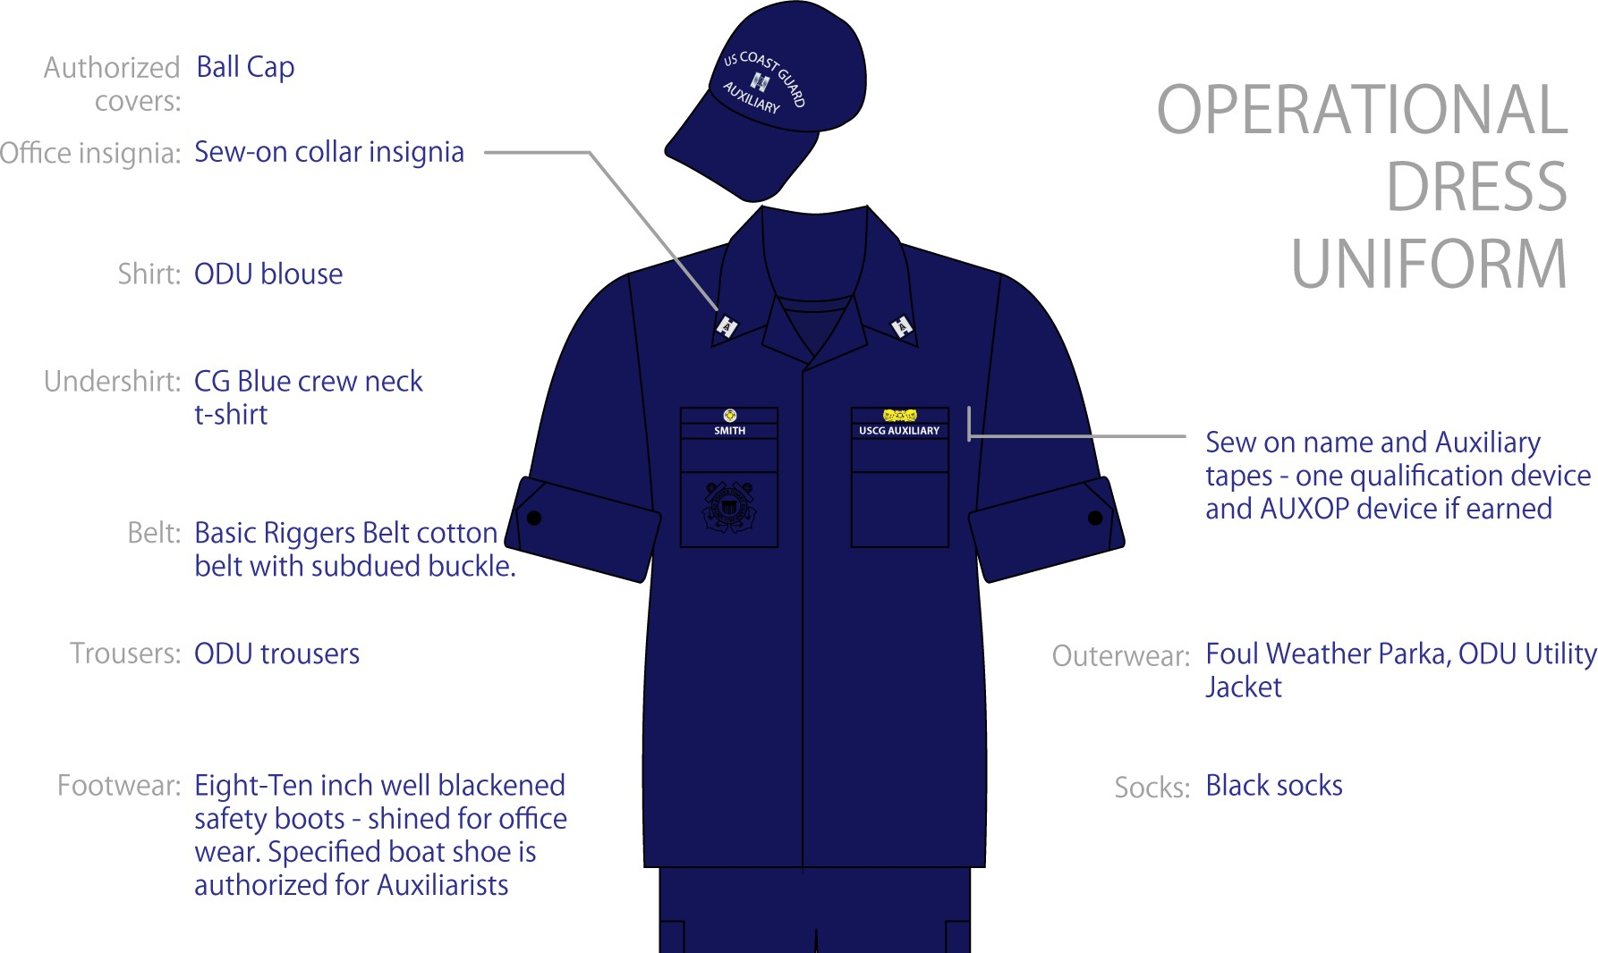
Reviewed, DIR-T USCGAUX
22

Slide 23
Operational Dress Uniform (ODU)
Worn where any form of Dress Uniform is not required (or more appropriate) and while commuting
Auxiliarists working directly with USCG units must wear the untucked version of the ODU, unless otherwise directed
Sleeves shall not be rolled up except as authorized for the ODU
Rolled up sleeves must be worn in prescribed accordion style with only the cuff showing

Slide 24
Operational Dress Uniform (ODU)
Boots, high top, lace up are worn for most occasions, but the boat shoe is an authorized option for Auxiliarists, regardless of the type of ODU that is being worn (regular or hot weather)
ODU trousers are worn bloused with boots. They are worn un- bloused with boat shoes, only when conducting vessel safety checks, underway on an Auxiliary operational facility, commuting to or from a point of Auxiliary patrol or safety check activity, or specifically authorized by a Coast Guard order issuing authority.

Slide 25
Operational Dress Uniform (ODU)
Sew-on cloth nametapes, USCG AUXILIARY, and devices must be the full width of the pocket
Sew-on or Velcro cloth member and officer collar devices are worn with black “A” for officer devices
Embroidery, plastic name tags, and metal devices are prohibited

Slide 26
Operational Dress Uniform (ODU)
The dark blue crew neck tee-shirt with USCG AUXILIARY embroidered or screen printed on the front left chest is worn
Belt is black web belt with subdued open-faced buckle or basic riggers belt
USCG Auxiliary ball cap, or Tilley hat obtained from an appropriate source may be worn with the ODU
Tucked version of the ODU is authorized for Auxiliary wear until no longer serviceable

Slide 27
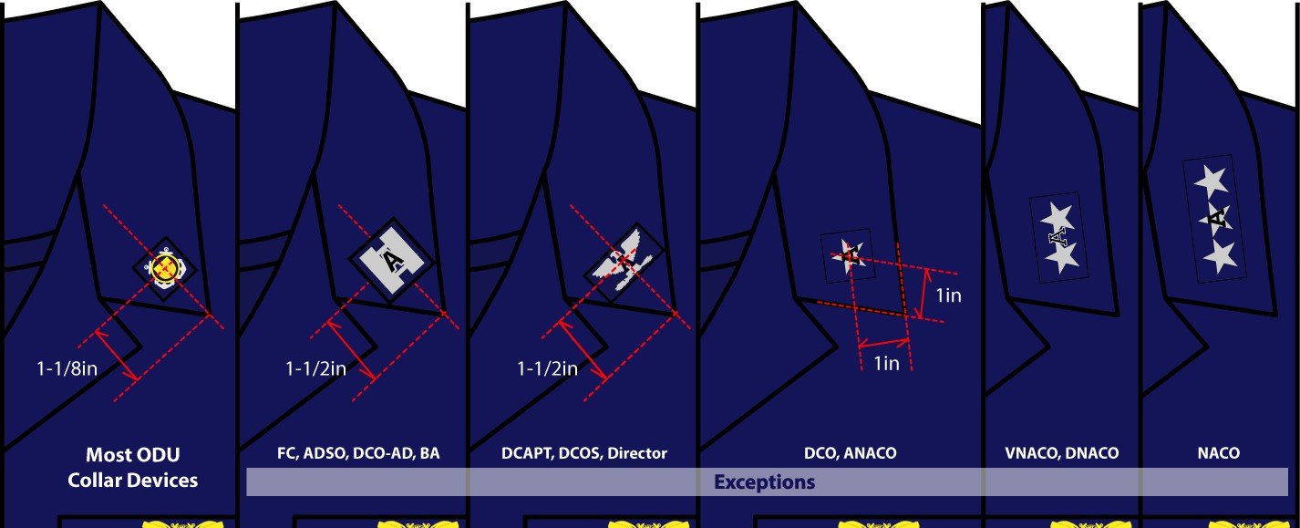
ODU Member and Office Devices

Slide 28
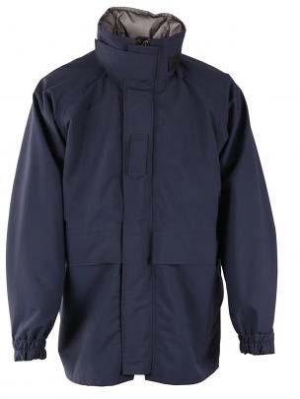
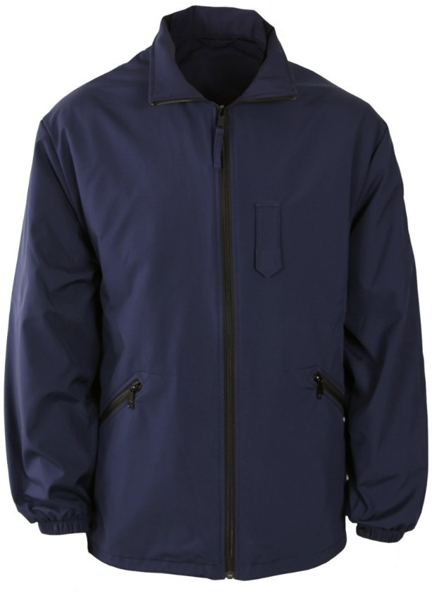
ODU Outerwear
Foul Weather Parka II (FWP)
(note: the fleece FWP liner is no longer authorized as stand alone outerwear)
ODU Utility Jacket
(enhanced Foul Weather liner)

Slide 29
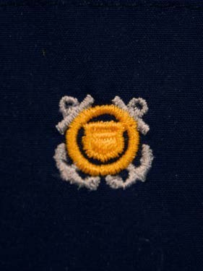
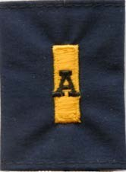
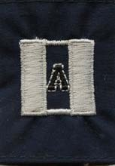
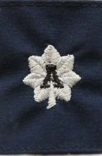
Foul Weather Parka Devices
The Foul Weather Parka (FWPII) fabric office device is a mandatory uniform item for the parka shell.
The device is required on the Parka Liner/ODU Utility Jacket when worn as a stand alone, exterior garment.
Wear of metal office insignia is not authorized

Slide 30
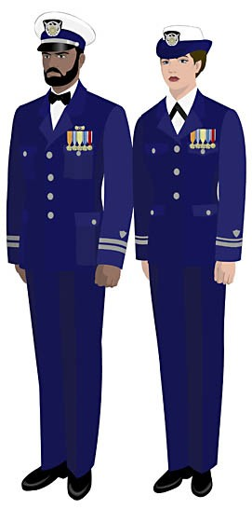
Dinner Dress Blue Uniform

Slide 31
Dinner Dress Blue Uniform
The Dinner Dress Blue uniform may be prescribed and worn for formal evening occasions
Uniform components are the same as Service Dress Blue, but with white shirt and plain black bow tie (not to exceed 2¼ inches in vertical width
Miniature medals and devices are worn
Name tag is not worn
The Combination cap is worn

Slide 32
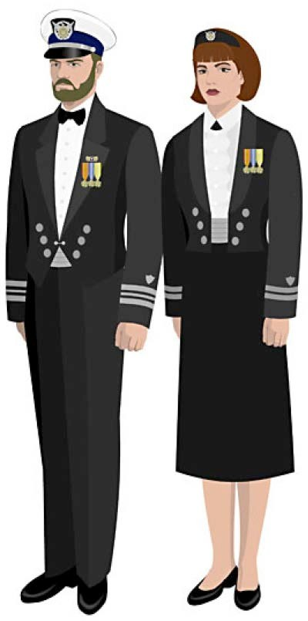
Dinner Dress Blue Jacket Uniform

Slide 33
Dinner Dress Blue Jacket Uniform
The Dinner Dress Blue Jacket uniform may be prescribed and worn for formal evening occasions
The jacket is the standard Coast Guard (Navy) Blue Mess jacket
Sleeve lacing with sleeve shield is worn
The three gold buttons down each forepart are replaced with three large silver Coast Guard Auxiliary buttons
A silver chain with medium size Auxiliary buttons on each end close the jacket at the button holes
The Combination cap is worn

Slide 34
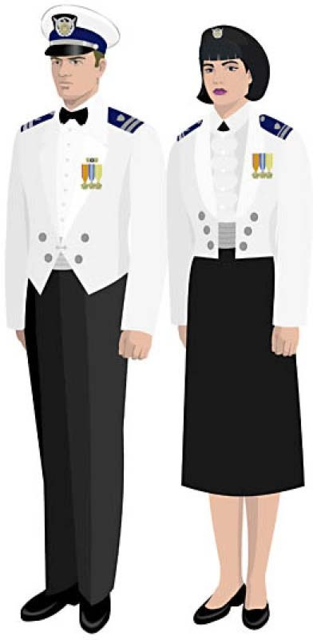
Dinner Dress White Jacket Uniform

Slide 35
Dinner Dress White Jacket Uniform
The Dinner Dress White Jacket uniform may be prescribed and worn for formal evening occasions
The jacket is the standard Coast Guard (Navy) White Mess jacket
Hard shoulder boards are worn on the jacket
The two gold buttons down each forepart are replaced with two large silver Coast Guard Auxiliary buttons
A silver chain with medium size Auxiliary buttons on each end close the jacket at the button holes
The Combination cap is worn

Slide 36
Ribbons, Name Tags, Devices, & Insignia
Auxiliary Devices & Badges on wearer’s right
Insignias & Ribbons on wearer’s left

Slide 37
Left Side of Uniform
Ribbons & Qualification Insignias
  Lowest row of ribbons is ¼” above top of the left pocket
  1st breast insignia is ¼” above ribbons
  2nd breast insignia is ¼” below top of left pocket
You may elect to wear all earned ribbons, highest 3 ribbons, or any 9 ribbons of your choice.

Slide 38
Right Side of Uniform
Devices & Badges
  Name tag ¼” above top of right pocket
  Devices may include AUXOP & Past Officer and Command insignias
  Badges may include Recruiting & Staff badges
Name tag on Women’s uniform shirt with no pockets: bottom edge aligned with top of the third button from the top of the shirt front.

Slide 39
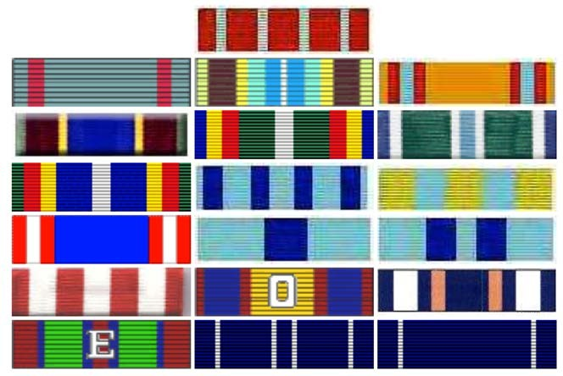
Ribbons Have an Order
http://www.uscg.mil/uniform/Ribbons.asp

Slide 40
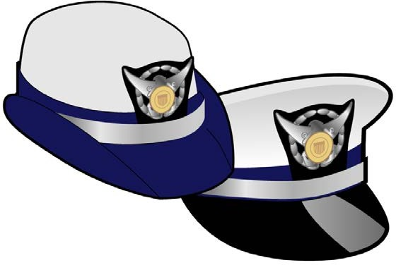
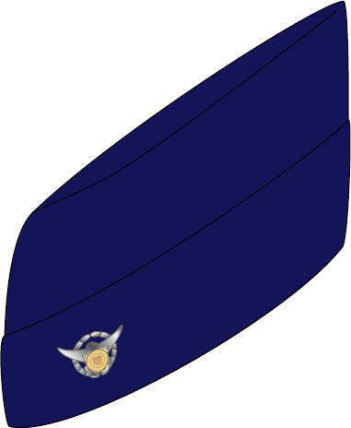
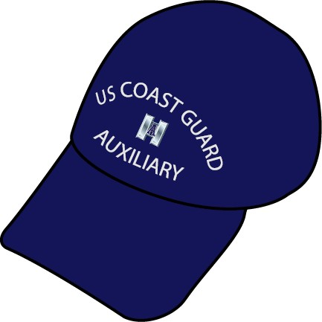
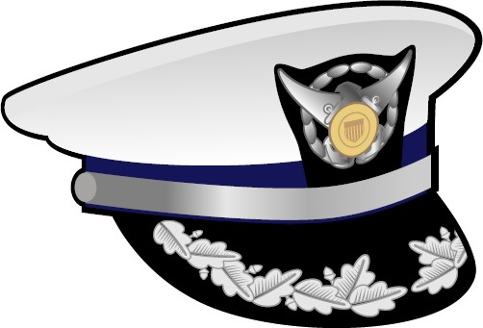
Coast Guard Auxiliary Covers

Slide 41
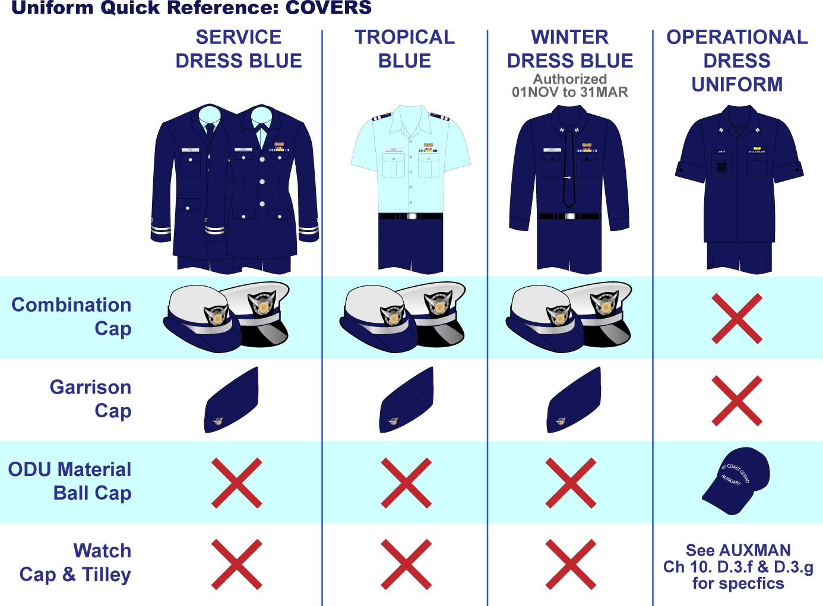
Which Cover to Wear

Slide 42
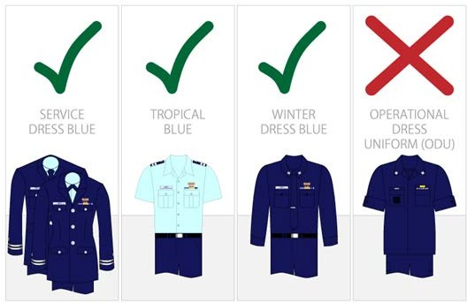
Combination Cap
Can be worn with most uniforms
Men’s and Women’s styles
The combination caps for Auxiliarists holding DCDR or above (and commensurate) office positions are adorned with one or two rows of silver oak leaves and acorns.

Slide 43
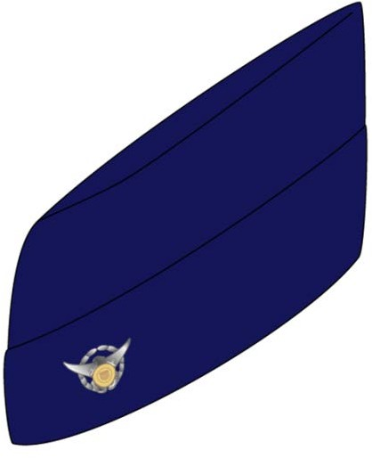
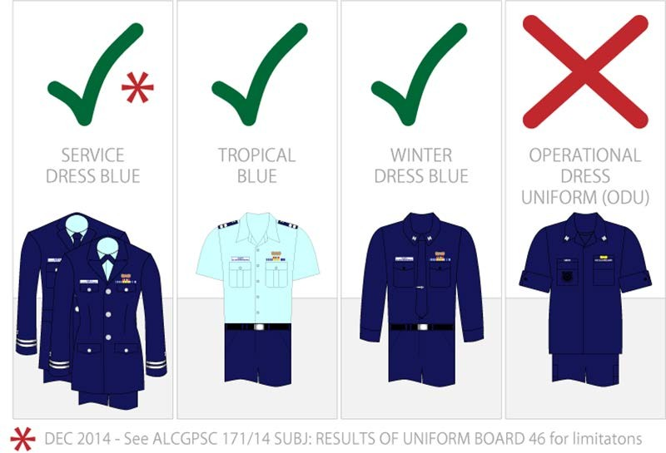
Garrison Cap
Can be worn with Tropical Blue, Winter Dress Blue, and Flight Suit
May be authorized for wear with Service Dress Blue

Slide 44
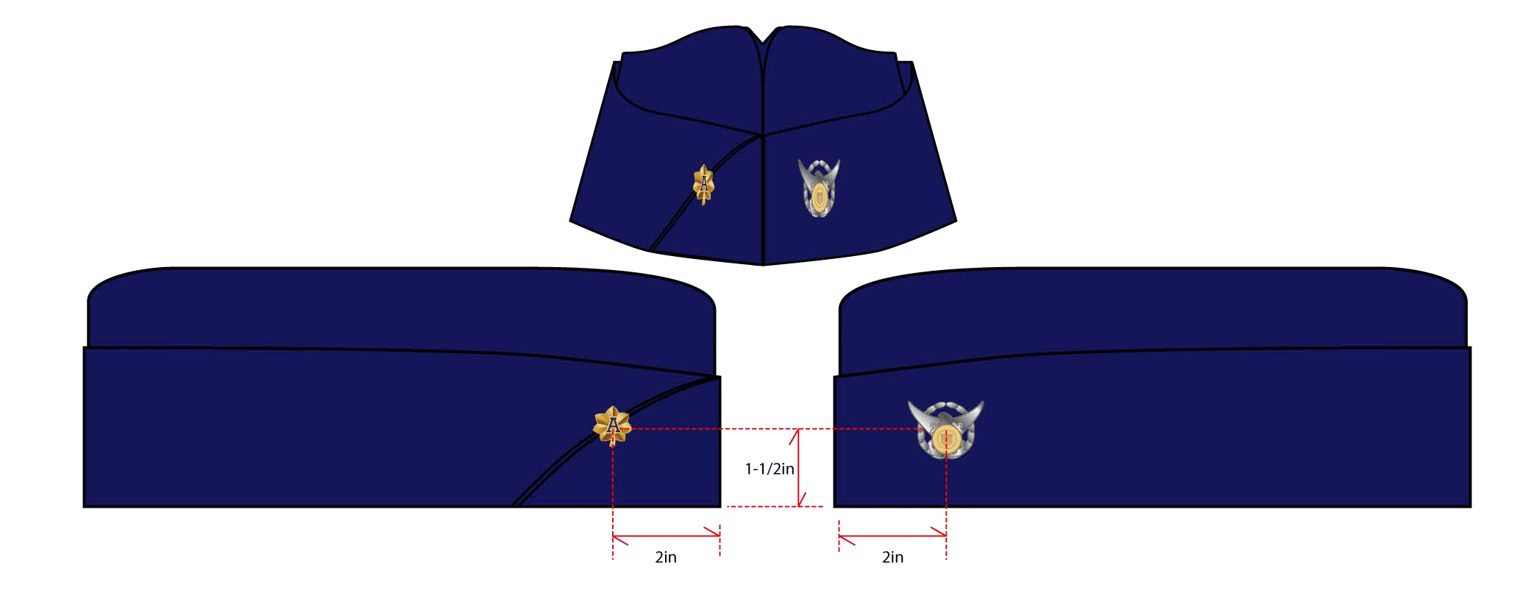
Garrison Cap
Worn with small cap device (wearer’s left) and small metal office insignia (wearer’s right)

Slide 45
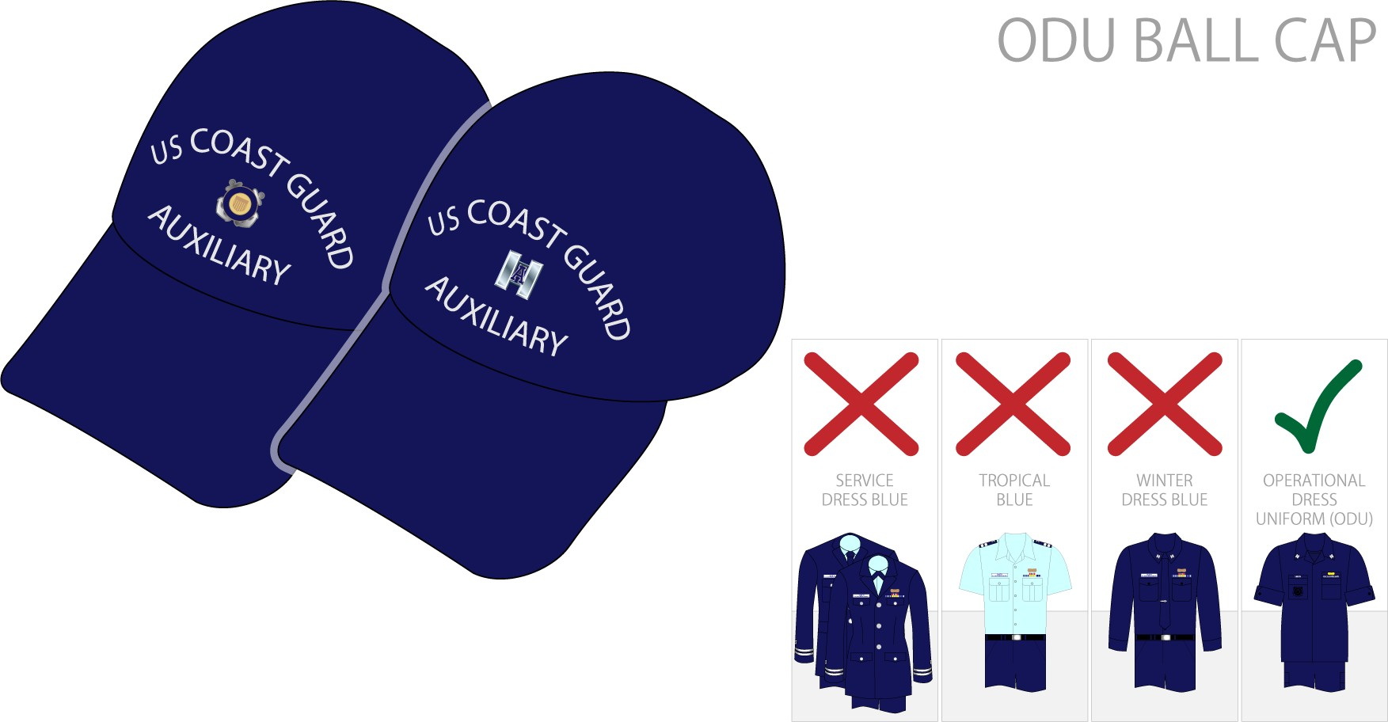
Reviewed, DIR-T USCGAUX
45

Slide 46
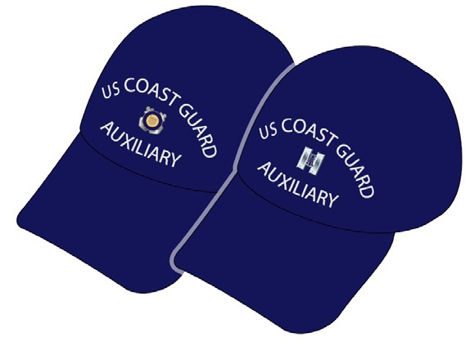
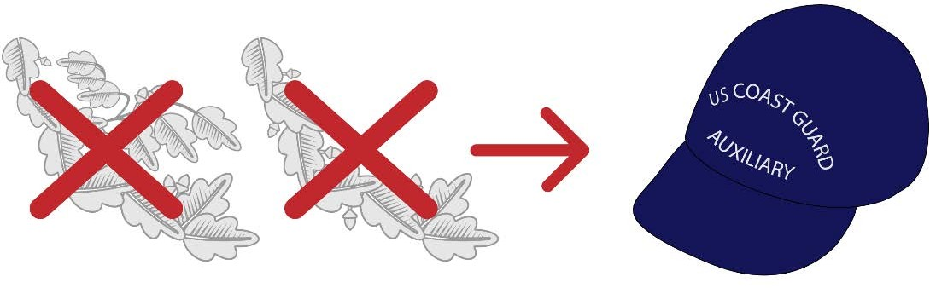
ODU Ball Cap
Note: Auxiliary ball caps must be obtained from:
  USCG Exchange (CGEX)
  AUXCEN
  UDC
Only ball caps made of ODU material ball cap are authorized for use
Embroidered cap ornamentation (acorns and leaves) are no longer authorized

Slide 47
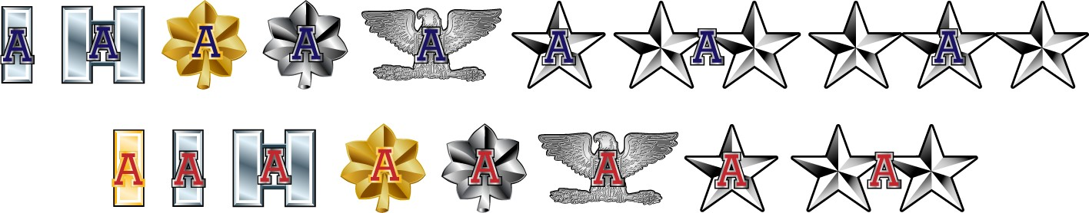
Cap devices
Metal device on your ball cap must match ODU collar devices
Metal device on your garrison cap must match your shoulder boards or collar devices
Small metal devices are worn on caps for men’s and women’s uniforms
Large metal devices are reserved for outerwear only

Slide 48
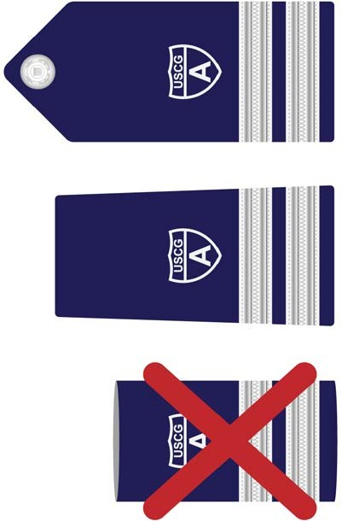
Shoulder Boards
Hard shoulder boards are worn with Dinner Dress White Jacket or Service Dress White uniforms
Enhanced shoulder boards are worn on Tropical Blue uniform, cardigan sweater, and the wooly-pully sweater
Soft shoulder boards (“Loops”) are no longer authorized for wear with any uniform

Slide 49
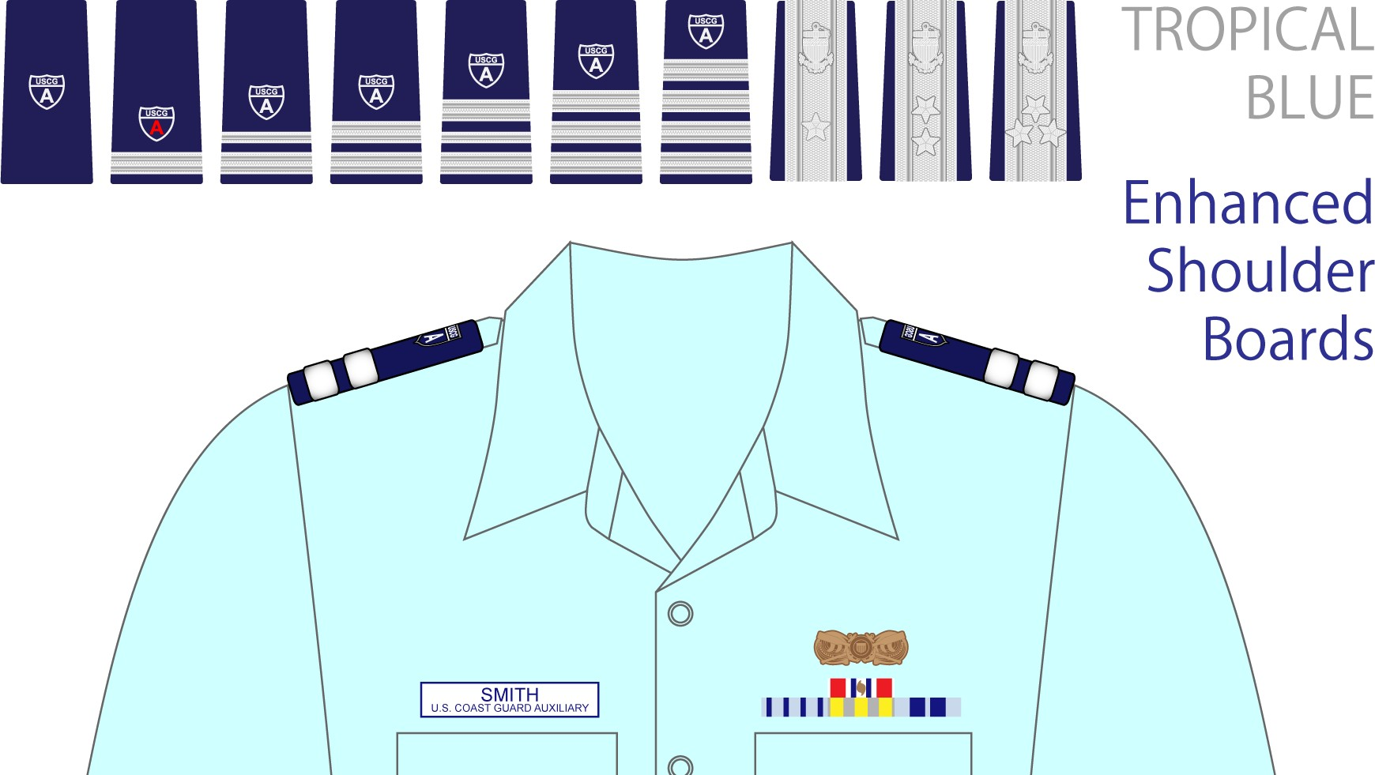
Reviewed, DIR-T USCGAUX

Slide 50
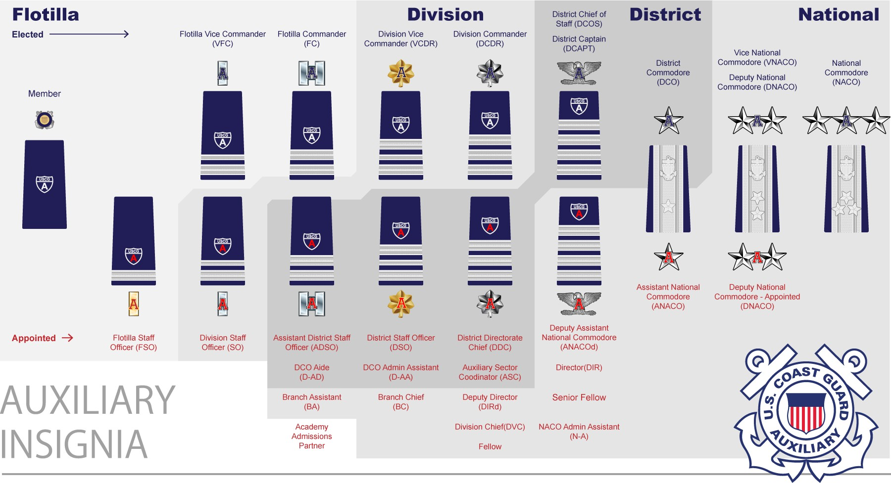
Reviewed, DIR-T USCGAUX

Slide 51
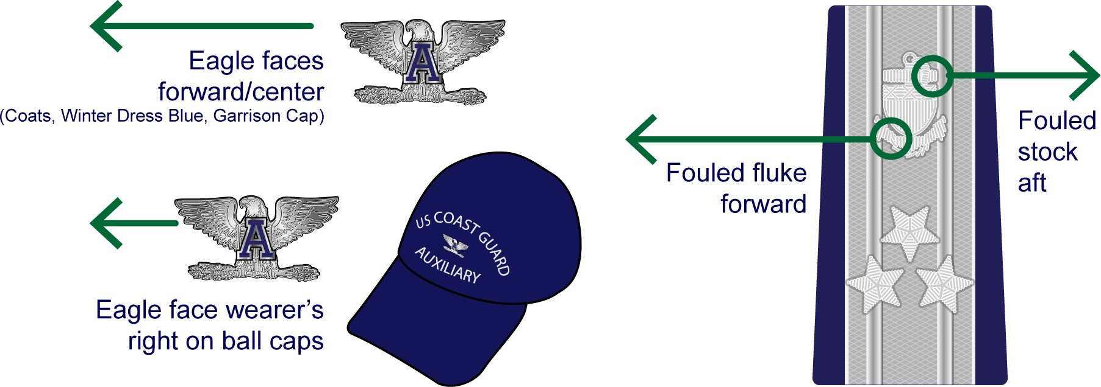
A few items have left and right elements

Slide 52
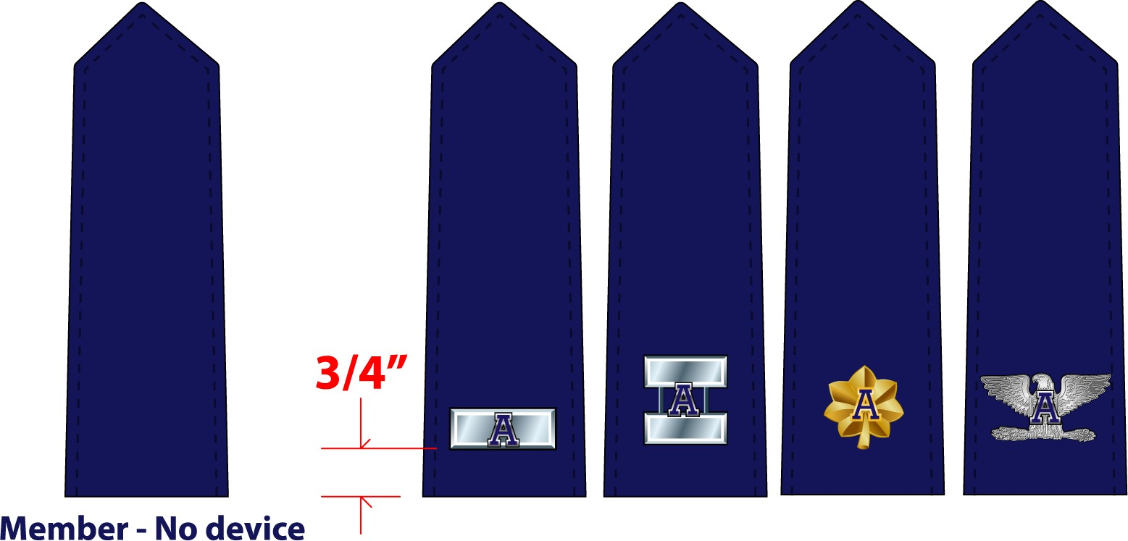
Outerwear Devices
Windbreaker, Trench Coat, Reefer Coat, and Bridge Coat use large devices

Slide 53
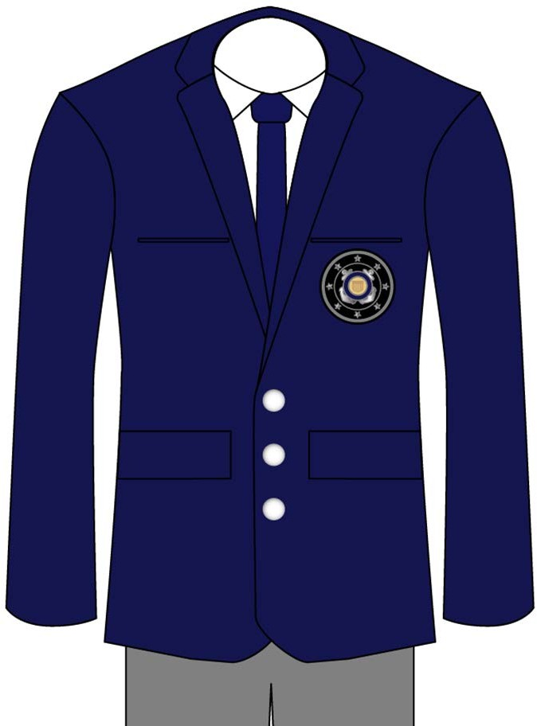
Blue Blazer Uniform
The Auxiliary blue blazer may be substituted for all uniforms except the operational dress uniform (ODU)
The blue blazer is worn with white or gray pants (or skirt), white shirt, and black shoes
A dark blue or black tie is worn by men, and a blue or black tab is worn by women depending upon the occasion

Slide 54
Blue Blazer Uniform
The official Auxiliary blazer patch is available through AUXCEN
It is recommended for wear when the UDC does not stock or offer properly fitting uniform sizes
The Auxiliary Blue Blazer outfit may be authorized by unit Commanding Officers for wear in office spaces while on duty at Coast Guard units.

Slide 55
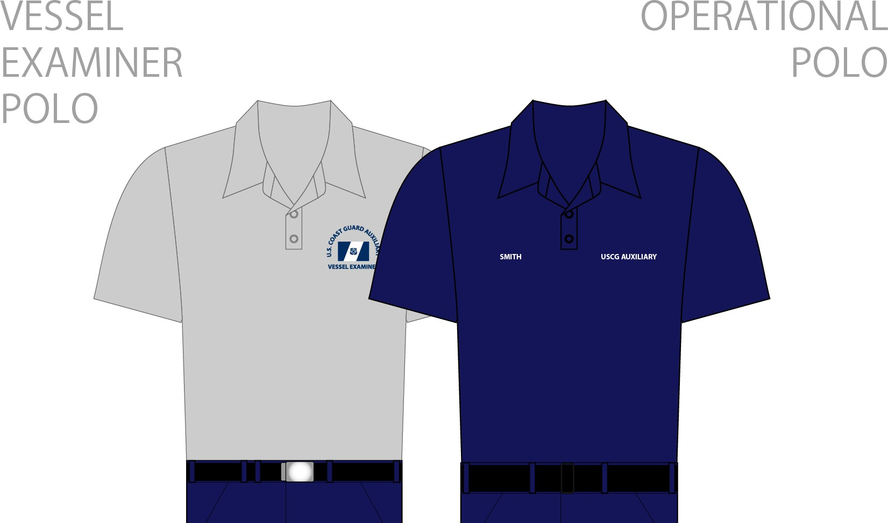
Reviewed, DIR-T USCGAUX
55

Slide 56
Vessel Examiner (VE) Polo Shirt
The VE Polo shirt is authorized for wear as an optional uniform shirt worn as part of the ODU, and Hot Weather uniform.
The shirt is not authorized for wear on patrol and no insignia, name tags or breast devices shall be worn with the shirt.
Headgear (when wearing the Polo shirt) shall not display office insignia. Only the member device shall be displayed on the hat.
The AUXCEN carries the only authorized shirt.

Slide 57
Auxiliary Operations Polo Shirt
The Auxiliary Operations Polo Shirt may be worn as an alternative to the Operational Dress Uniform (ODU) top, and the Hot Weather Uniform shirt for patrol activities.
No logos, patches, insignia, name tapes, nor name tags of any type may be worn on this shirt.
The Auxiliary Operations Polo shirt will be dark blue in color, and have two or three buttons with no pockets. It may be 100 percent cotton or be made of a cotton-polyester blend to facilitate moisture wicking.
Lettering will be embroidered with USCG AUXILIARY on the left front side, and the LAST NAME of the Auxiliarist on the right front side.
The AUXCEN carries the only authorized shirt.

Slide 58
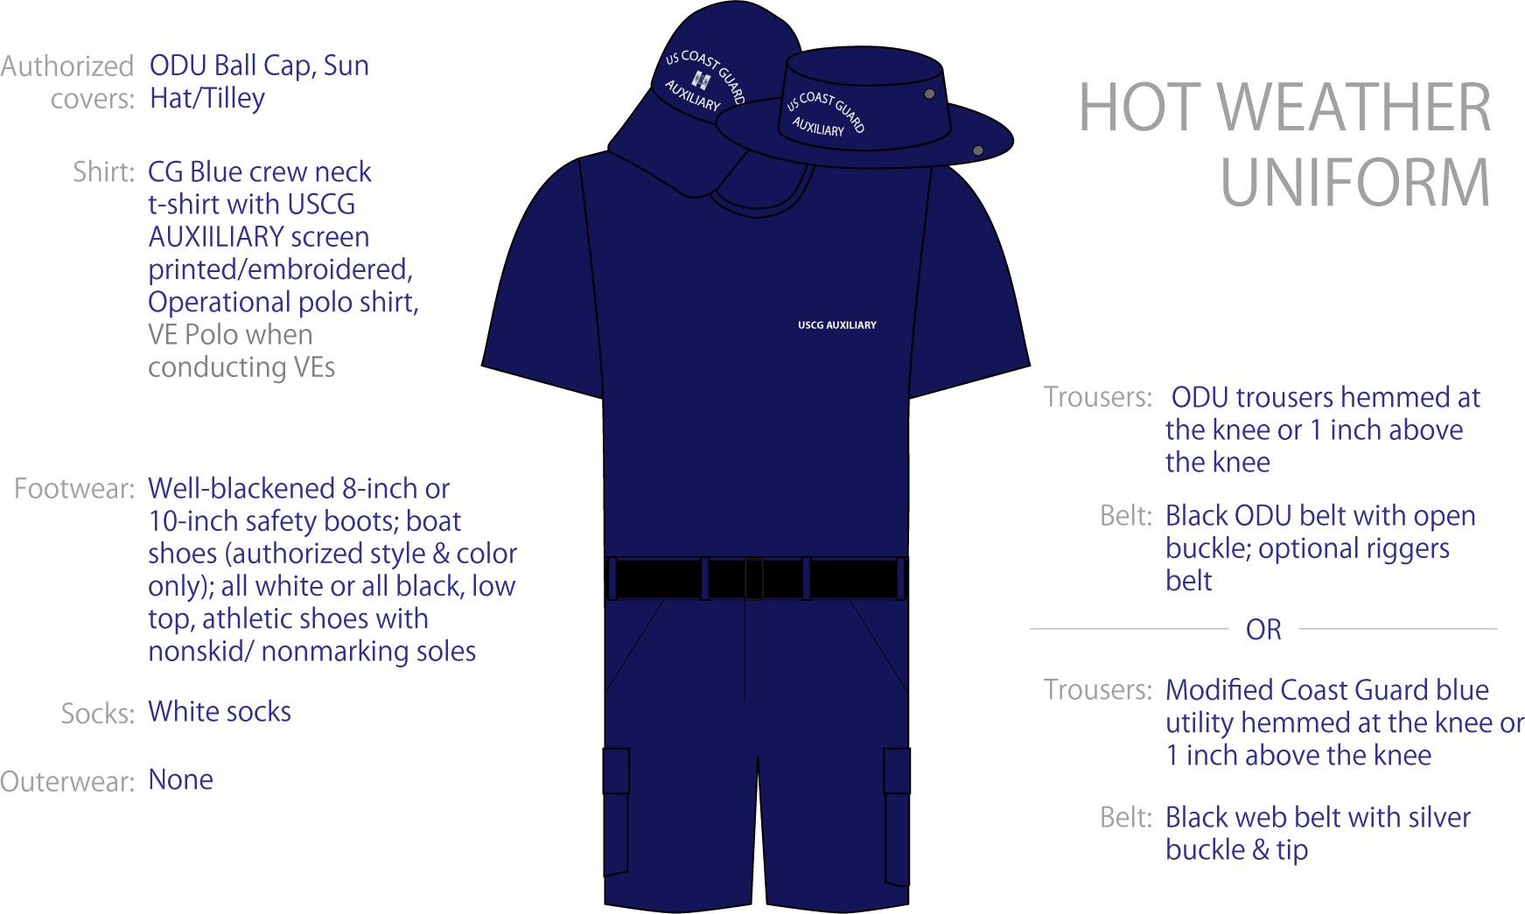
Reviewed, DIR-T USCGAUX
58

Slide 59
Hot Weather Uniform
This uniform is authorized as an optional uniform for Auxiliarists only (no USCG equivalent).
The Director (DIRAUX) shall prescribe the proper season for its wear.
It is not appropriate for routine office wear.
Shorts are modified Coast Guard modified blue utility or ODU trousers, cut and hemmed at knee or 1 inch above knee.
Any shirt worn, must be tucked into the shorts with this uniform.

Slide 60
Hot Weather Uniform
The Coast Guard dark blue crew neck T-shirt (stenciled or embroidered with the words “USCG AUXILIARY” across the front left chest in white ¾-inch tall block-style letters) is the prescribed shirt with this uniform.
The Auxiliary Operations Polo Shirt may be worn with this uniform as an alternative for patrol activities.
The optional VE shirt may be worn when conducting vessel safety checks (VSCs).

Slide 61
Hot Weather Uniform
Well-blackened 8-inch or 10-inch safety boots, boat shoes (dark blue or brown leather) or all white or all black, low top, athletic shoes with nonskid/non-marking soles are authorized for Auxiliarists wearing the hot weather uniform.
Socks shall be all white, athletic type, crew length.
Belt is black web belt with silver buckle and tip or the optional basic riggers belt.

Slide 62
Hot Weather Uniform
The Auxiliary ball cap, or the Tilley hat, are the prescribed hats to be worn with this uniform.
No insignias are worn on the ODU T-shirt, the Operations Polo Shirt, or the VE polo shirt.

Slide 63
Flight Suits
Authorized for wear only during flight or any aviation mission performed under orders.
Shall be similar in pattern, color, and design to those worn by active duty Coast Guard aviators.
Zipped to within 3 inches of top at all times.
Head gear either garrison cap, baseball cap, or protective gear as required.
Confirm local standards through your DSO-AV.

Slide 64
Footwear
Dress shoes = Service Dress Uniforms (heels no higher than 1”)
Boat Shoes = ODU, Hot Weather Uniform
  Dark Blue or brown leather, low cut moccasin type
ODU Boots = ODU & Hot Weather Uniform
  Shall be shined when in a classroom or office
Tennis Shoes = Hot Weather Uniform
  All white or all black
Black socks made of knitted or ribbed on decorated material
  Not grey, dark blue, etc.
  No stitching or seam across the toe
White socks shall be all white, athletic type, crew length

Slide 65
Grooming Standards while in Uniform
Earrings
  Men cannot wear earrings
  Women can wear one pair of small gold, silver or pearl earrings of the ball style (no larger than ¼ inch)
Diamond studs can be worn with the Dinner dress uniforms
Necklaces, chains, suspenders, pens, handkerchiefs, etc…should not be visible

Slide 66
Grooming Standards while in Uniform
Hair should be neat and clean and above the collar (for men) or at the collar (for women)
Mustaches must be no lower than the lower lip line of upper lip
Fingernails: Men and women shall keep their nails clean. Women may wear nail polish, but the color shall be conservative and neutral in color. Decorative nail art is not authorized while in uniform

Slide 67
Grooming Standards while in Uniform
Full and partial beards, van dykes, and goatees are authorized
In uniform, patches and spotty clumps of facial hair are not considered beards and are not authorized
The bulk of the beard (distance that the mass of facial hair protrudes from the skin on the face) shall not exceed 1 inch
Beards, sideburns, or mustaches if worn, shall be well groomed and neatly trimmed at all times in order not to present a ragged appearance

Slide 68
Prohibited Wear of Auxiliary Uniform
In public places of dubious reputation
When engaged in political activities
When in a foreign country unless specifically authorized
Don’t wear distinctive parts of the uniform or insignia with civilian clothes when not on duty
Auxiliarists must adhere to uniform policies when engaged in U.S. Coast Guard or Coast Guard Auxiliary programs and activities

Slide 69
Where to buy uniform and uniform items
 | How: http://www.uscg.mil/UNIFORMS/ 1-609-861-1221 1-800-874-6841 Items available: Tropical Blue, Service Dress Blue & ODU uniforms Coats, Foul Weather Parkas, Windbreakers, and Sweaters USCG AUXILIARY and nametapes Garrison and Combination caps Shoes & boots
Uniform Distribution Center (UDC)
Your local Coast Guard Exchange (CGEX)
USCG Auxiliary Center (AUXCEN/Shop Auxiliary)
USCG Installation Lucky Bags
USCGA Used Uniform Exchange

Slide 70
Where to buy uniform and uniform items
 | How: Once you have an ID card you can gain access to the CGEX Access for newer members in AP status can be obtained when accompanied by another member Items available: Tropical Blue, Service Dress Blue & ODU uniforms Combination, Garrison, and ball caps Shoes and boots
Uniform Distribution Center (UDC)
Your local Coast Guard Exchange (CGEX)
USCG Auxiliary Center (AUXCEN/Shop Auxiliary)
USCG Installation Lucky Bags
USCGA Used Uniform Exchange

Slide 71
Where to buy uniform and uniform items
 | How: http://www.shopauxiliary.com Click on “District Online Members Store” Items available: Shoulder boards Name tags Officer devices Qualification insignia Sleeve lacing And much more
Uniform Distribution Center (UDC)
Your local Coast Guard Exchange (CGEX)
USCG Auxiliary Center (AUXCEN/Shop Auxiliary)
USCG Installation Lucky Bags
USCGA Used Uniform Exchange

Slide 72
Where to buy uniform and uniform items
 | How: Talk to your FSO-HR Items available: Depends upon the local stock Member service: If your local area or USCG installation does not operate or maintain a lucky bag, consider the possibility of starting one
Uniform Distribution Center (UDC)
Your local Coast Guard Exchange (CGEX)
USCG Auxiliary Center (AUXCEN/Shop Auxiliary)
USCG Installation Lucky Bags
USCGA Used Uniform Exchange

Slide 73
Where to buy uniform and uniform items
 | How: http://www.trlmo.com/cgaux8wr/pws/uue.htm Items Available: Dependent upon changing availability
Uniform Distribution Center (UDC)
Your local Coast Guard Exchange (CGEX)
USCG Auxiliary Center (AUXCEN/Shop Auxiliary)
USCG Installation Lucky Bags
USCGA Used Uniform Exchange

Slide 74
Ask Your Flotilla Commander
It is highly recommended that New Members of the Coast Guard Auxiliary speak with their Flotilla Commander first about procuring either the Tropical Blue and/or Operational Dress Uniform, as these will be appropriate for a majority of USCGAUX activities.

Slide 75
Presentation Contributors
Todd Monis, Division Chief - Uniforms
COMO E. Lee Ward, Branch Chief - Uniform Division (Atlantic East)
William D. Strawn, Branch Chief - Uniform Division (Atlantic West)
Brett C. Bigelow, Branch Chief - Uniform Division (Pacific)
Clinton J. Wells, Division Chief - Support Services
Phillip B. Horlings, Branch Chief - Media
Andrew Hahn Winz, Branch Chief - Web
Pat Hickey, Deputy Director, Human Resources Directorate
Robert Holm, Deputy Director, Training Directorate
Ralph Tomlinson, Director, Training Directorate
COMO Robert Smekta, Director, Human Resources Directorate
COMO Daren Lewis, Assistant National Commodore - IT
COMO Dale Fajardo, Assistant National Commodore - FORCECOM

